Slide 1
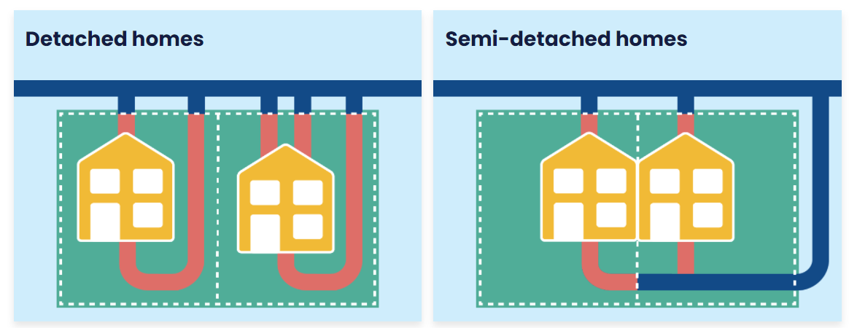
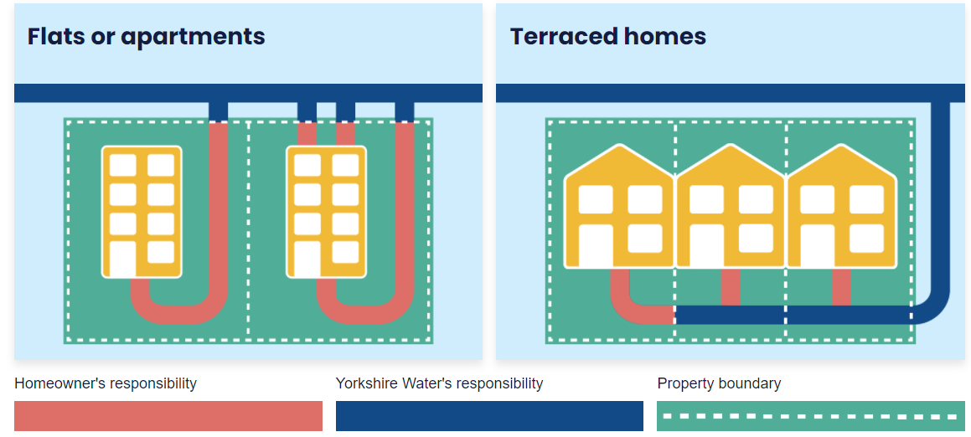
Pipe Responsibility
SHOWCARD 2

Slide 2
SHOWCARD 3

Slide 3
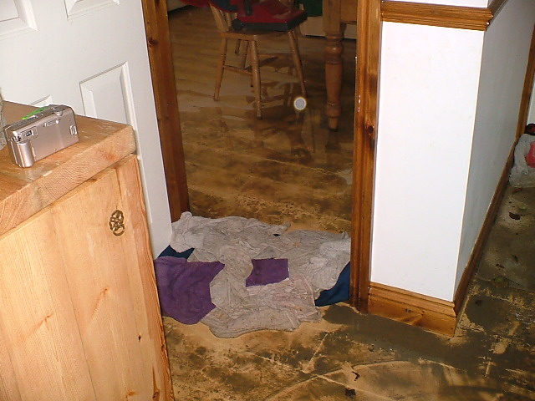
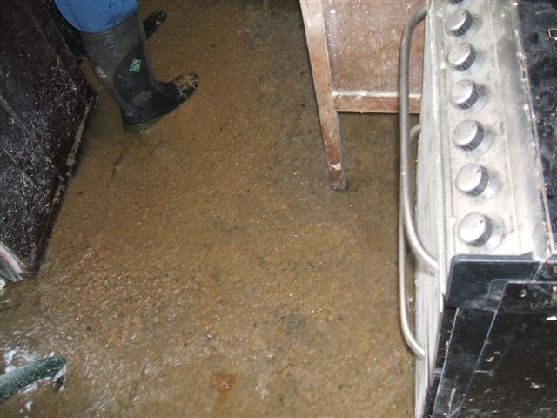
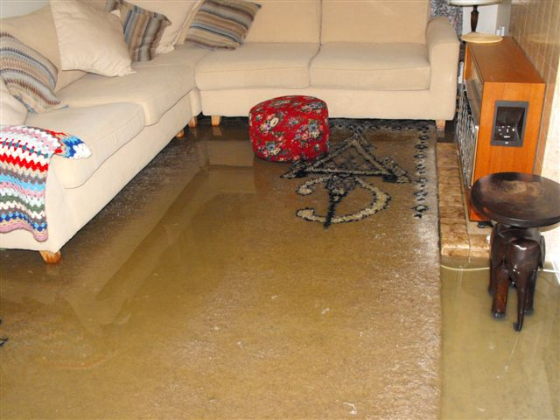
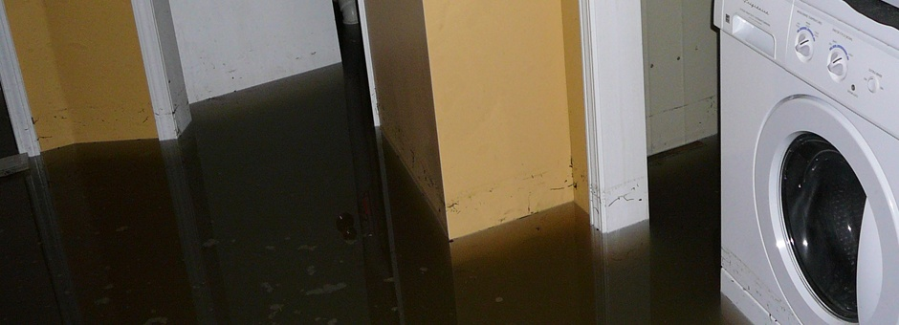
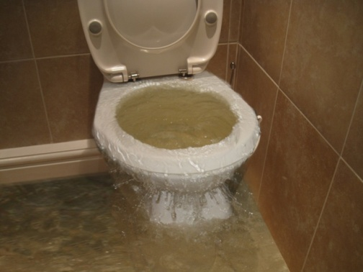
Flooding inside of properties (potentially outside as well)
SHOWCARD 4a

Slide 4
SHOWCARD 4b
Scenario 1
Household – family
Sewer flooding in the downstairs living areas
Occurred in winter following period of heavy rain
Flooding lasted for several hours before the levels reduced, leaving carpets and furniture damaged
House needed to be vacated for 2 months to be allowed to dry and be repaired
Has experienced this before – around 5 years ago
Scenario 4
Business - office
Sewer flooding in the office
Occurred in winter as a result of a sewer blockage
Flooding lasted for 1 day before the levels reduced
Business closed for 3 months whilst office is allowed to dry and be repaired; some staff do not work or get paid during this period.
Experienced this before – around 10 years ago
Scenario 2
Care home
Sewer flooding in the downstairs living areas
Occurred in summer as a result of a sewer blockage
Flooding lasted for 1 day before the levels reduced, leaving carpets and furniture damaged
Home needed to be vacated for 3 months to be allowed to dry and be repaired
Not experienced this before
Scenario 5
Household – one person has a disability
Sewer flooding in the garage and basement
Occurred in winter following period of heavy rain
Flooding lasted for 1-2 days before the levels reduced, leaving carpets and furniture damaged
House does not need to be vacated whilst building is left to dry and damage repaired
Occurs regularly – at least once a year
Scenario 3
Household – family
Restricted wastewater services – water cannot go down the drains (cannot flush toilet, or let water down sinks, or use shower/bath/washing machine)
Portable toilet provided in the garden
Lasted for 1 week – no damage to carpets or furniture
Not experienced this before
Scenario 6
School
Sewer flooding in the classroom
Occurred in summer as a result of a sewer blockage
Flooding lasted for 1-2 days
School closed whilst classrooms are allowed to dry and be repaired; children need to go to alternative schools for 2 months
Not experienced this before

Slide 5
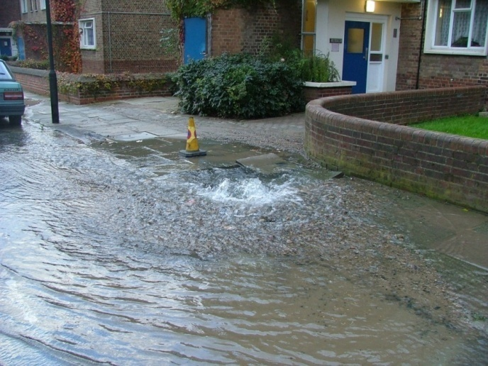
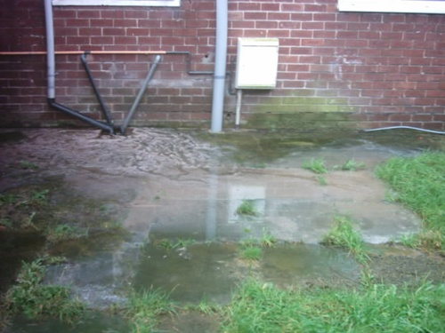
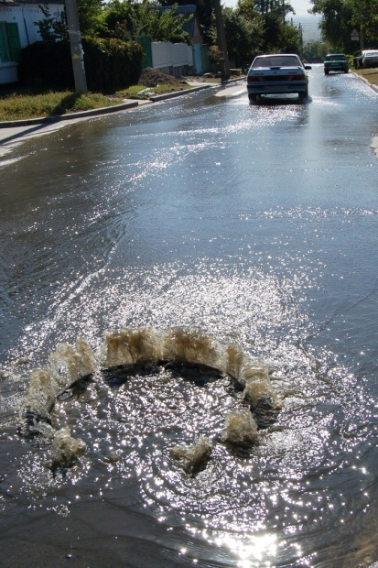
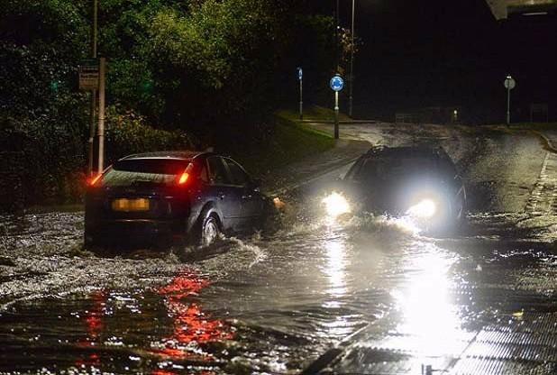
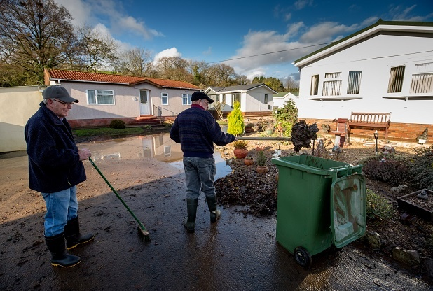
Flooding of outside / external areas
SHOWCARD 5a

Slide 6
SHOWCARD 5b
Scenario 1
Household – family
Sewer flooding in the garden
Prevented access to parts of the garden, but could still enter the house
Occurred in winter following period of heavy rain
Flooding lasted several hours before levels reduced, leaving plants and garden with minor damage
Has experienced this before – around 5 years ago
Scenario 4
Retail shop
Sewer flooding outside the shop, preventing access
Occurred in winter as a result of a sewer blockage
Experienced this before – around 10 years ago
Flooding lasted for 1 day before the levels reduced
Retail shop closed for 2 days until flood recedes and grounds cleaned up; some staff do not work or get paid during this period.
Scenario 2
Park
Sewer flooding in a public park
Prevents access to the park, including children play areas
Occurred in summer following period of heavy rain
Flooding lasted 1 week, leaving the park damaged and needing clean up
Has experienced this before – around 2 years ago
Scenario 5
Household – one person has a disability
Sewer flooding across the whole garden, prevents access to the house
Occurred in winter following period of heavy rain
Occurs regularly – at least once a year
Flooding lasted 3 days before levels reduced, leaving damaged plants and garden
Scenario 3
Household – family
Sewer flooding in the street and pavement outside the house
Still had full access to the house
Occurred in winter as a result of a sewer blockage
Flooding lasted for 1 day before the levels reduced
Has experienced this before – around 5 years ago
Scenario 6
Farm
Sewer flooding in the fields
Occurred in summer as a result of a sewer blockage
Not experienced this before
Flooding lasted for 1-2 days
Farm crops are destroyed as not safe for human consumption.

Slide 7
YW’s planning objectives are as follows
Showcard 6
To take care of customers waste water and protect customers and the environment from sewer flooding.
To protect and improve the water environment

Slide 8
DWMP Measures
Showcard 7
 | DWMP Measures
A | Minimising risk of internal flooding of properties due to incapacity of sewers.
B | Minimising risk of external flooding of areas of land due to incapacity of sewers.
C | Improving resilience of the waste water and drainage system to extreme events
D | Improving the condition of the sewers e.g. by predicting blockages and / or collapses along the network.
E | Monitoring and improving wastewater flow & quality compliance to ensure discharges to river/sea meet allowed standards
F | Monitoring and improving Storm Overflows on how they are operating and the effect this may have on the river water/sea water they are entering.

