Slide 1
Pre-task pack:
Background to the water industry

Slide 2
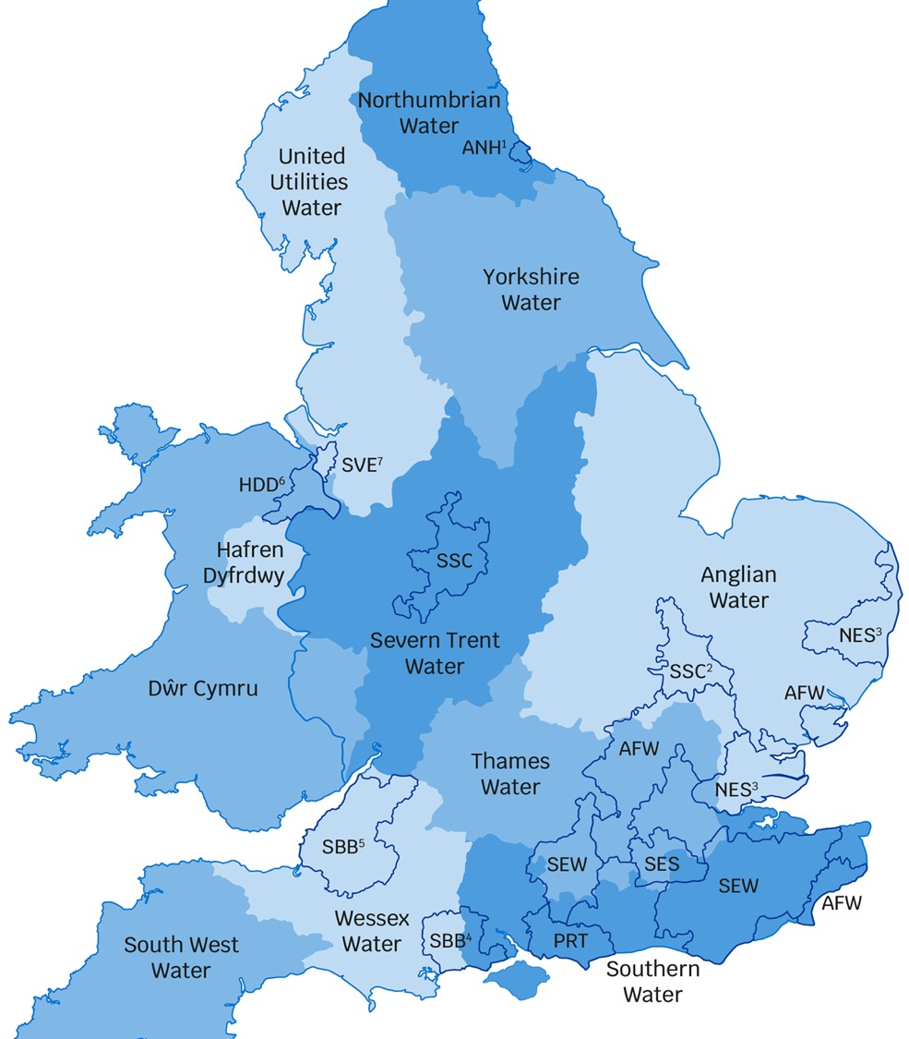
16
water companies in total
Water & wastewater companies
ANH: Anglian Water
WSH: Dwr Cymru
HDD: Hafren Dyfrdwy
NES: Northumbrian Water
SVE: Severn Trent Water
SBB: South West Water
SRN: Southern Water
TMS: Thames Water
UUW: United Utilities Water
WSX: Wessex Water
YKY: Yorkshire Water
Water only companies
AFW: Affinity Water
PRT: Portsmouth Water
SEW: South East Water
SSC: South Staffs Water
SES: SES Water
Key
1. Water services provided under the Hartlepool Water name.
2. Water services provided under the Cambridge Water name.
3. Water services provided under the Essex & Suffolk Water name.
4. Water services provided under the Bournemouth Water name.
5. Water services provided under the Bristol Water name.
6. Hafren Dyfrdwy provides water services only in this area.
7. Severn Trent Water provides water services only in this area.
Source: www.ofwat.gov.uk/households/ your-water-company/contact-companies

Slide 3
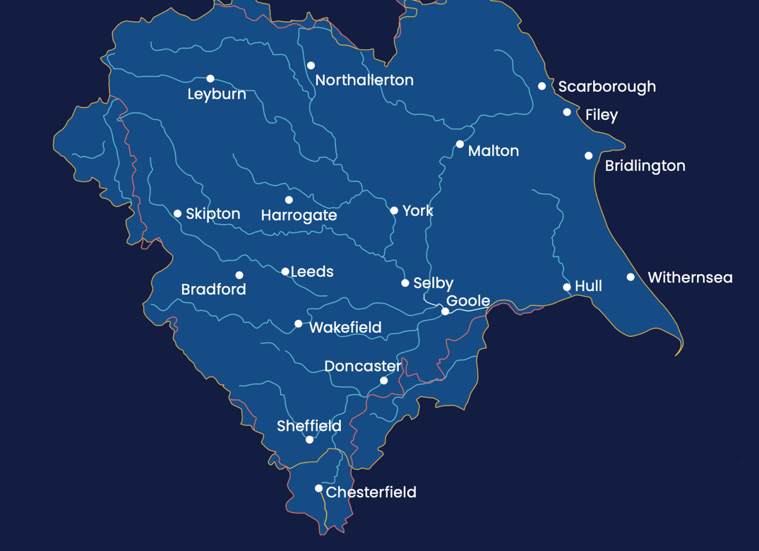
What Yorkshire Water do...
Provide water and waste water services to over 5 million people within 2.3 million homes
Sewerage collection & treatment: collection of wastewater from Yorkshire’s homes, liquid waste from industry, and rainwater that falls on roofs and roads. We treat wastewater and return it safely back to our rivers and coasts.
Investing over £1m every day to maintain and improve Yorkshire’s network of pipes, pumps and treatment works.
Drinking water: we provide 1.24 billion litres of drinking water every single day across Yorkshire.
Education & community: our colleagues volunteer in their local communities, they give talks and educate, they really make a difference locally. We also provide educational programmes for schools focusing on key issues facing the water industry such as water treatment, water conservation and pollution.
Taking care of the environment : As one of Yorkshires biggest landowners, keeping the land well looked after is one of our priorities - a thriving land environment ensures we can continue to provide clean and safe drinking water. We do this in many ways - we restore bogs and habitats, we ensure our operations are sustainable and where possible we generate energy from our processes. We aim to lessen the impact of water supply on climate change and innovate continuously to improve how we operate.

Slide 4
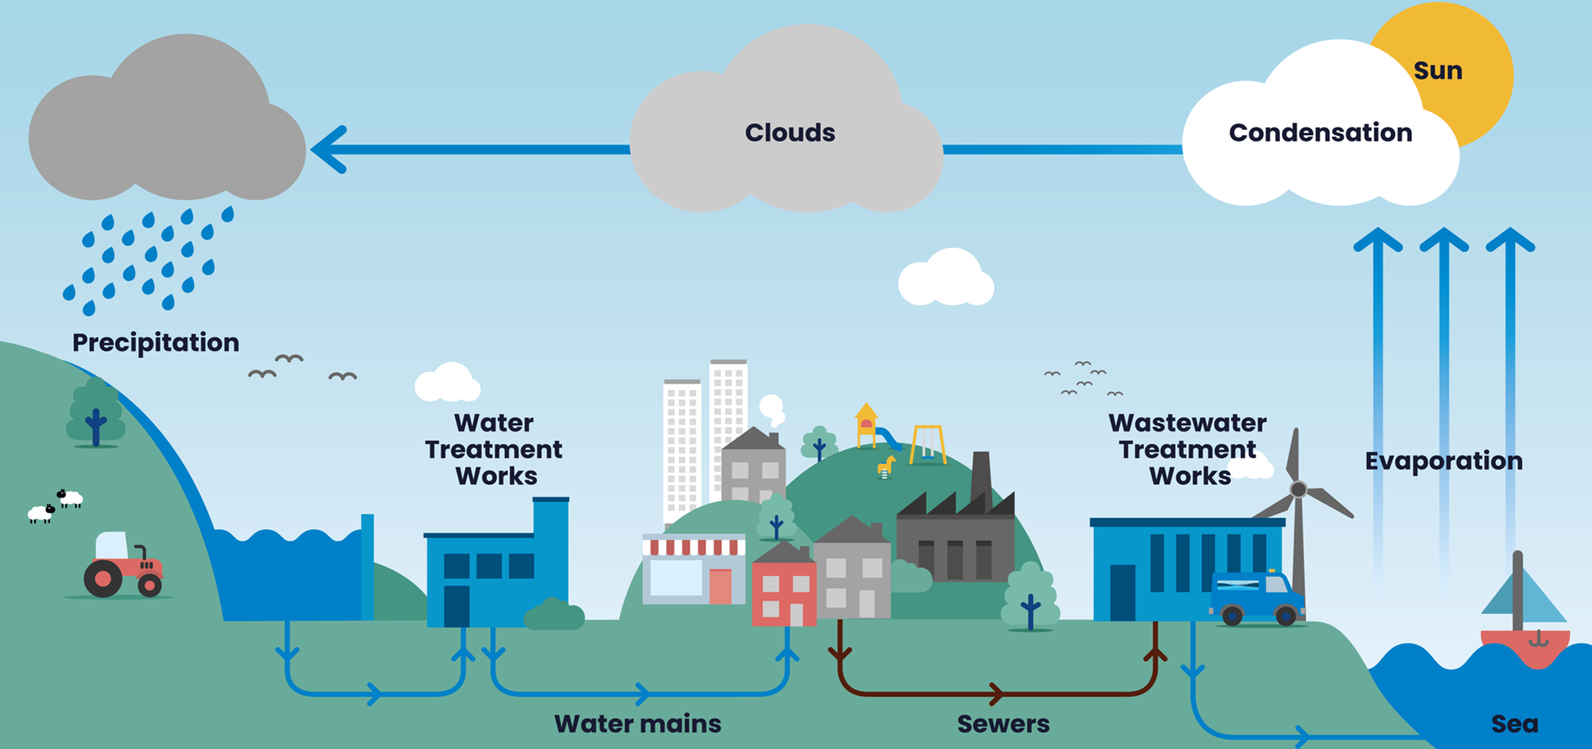
What we do: the water cycle & the role of Yorkshire Water

Slide 5
Pre-task pack:
Background to consultation

Slide 6
“
Every five years, water companies develop a ‘business plan’ that sets out how they want to develop their services, and the proposed cost to customers. As customers are not able to choose their water company, water companies must give them a say about what they want from their services and the price they pay. Talking to customers also helps water companies prioritise what to do first or what to do most of – because they are not able to fund everything they would like to do or do all of the things that customers might want them to do.
The business plan and prices are then finalised by Ofwat in a process known as the Price Review.
There is more information about this here: ‘All about the price review’.
Available at: www.youtube.com/ watch?v=OWmivC93AF8
One of the ways that people have their say is through this research, which will explain what the plans are for where you live, and ask what you think – whether the plans are ‘acceptable’ to you and whether you can afford the proposed bills from 2025–2030.
Companies also have to show to Ofwat that their plans reflect what their customers want – that means refining the plans based on what customers tell them.
“

Slide 7
Water companies are currently part way through their five-year business plan for 2020 to 2025. They have service level targets, called ‘performance commitments’, in every five year business plan. These targets are based on what customers have previously told companies they would like them to do, and on Ofwat’s assessment of what companies should deliver. These targets cover a wide range of the different services that water companies provide.
Ofwat monitors water company performance against each performance commitment every year to see if they have met the service level in their business plan. We are now going to show you how well your water and/or sewerage company is doing on some of their performance commitments, compared to other water companies in England & Wales.
These performance commitments are a snapshot out of the wide range of services companies provide. We are showing these examples as customers have told us they are particularly important to them.
Water companies have to provide reliable services, and plan for their services to be resilient to changing weather patterns and demand from consumers. Companies can miss or exceed performance commitment targets for a number of reasons. For example, leaks from pipes happen more often after very cold weather, which can contribute to a company not meeting the target, and flooding from sewers is less likely in dry weather, which can lead to better performance for sewer flooding service targets.

Slide 8
Pre-task pack:
Water company performance and comparison

Slide 9
Water company performance
As the regulator, Ofwat monitors the performance of water companies against their targets.
To encourage them to reach their targets, Ofwat have developed performance incentives.
These can be penalties or rewards:
Penalties:
Financial penalties for the water company, applied when the company fails to meet the target set, or if the company delivers much worse levels of service than promised.
Rewards:
Financial reward where the water company has over-delivered against a set target (delivering a significantly improved service) or reduced its costs through innovation for example (without impacting on service).
Consequences of poor performance:
If water companies are failing to deliver, they will need to address how they are putting things right through a clear improvement plan which Ofwat will monitor.

Slide 10
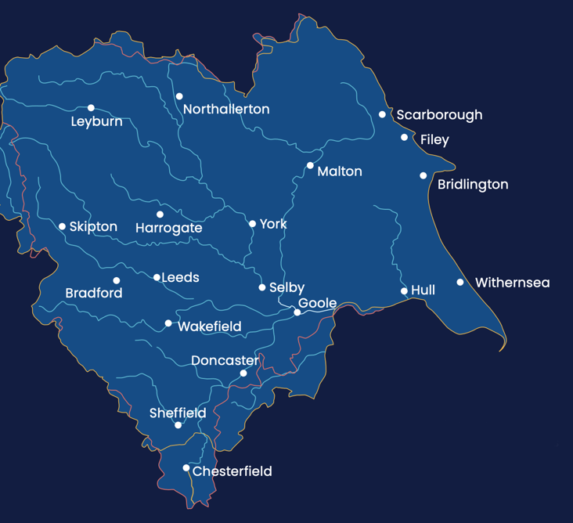
How did Yorkshire Water perform in most recent assessment?
Overall, Yorkshire Water’s performance in 2021/22 was scored as ‘Lagging behind’ for the sector by Ofwat.
Customer satisfaction
Priority services
Leakage
Per capita consumption
Supply interruption
Water quality
Mains repairs
Unplanned outage
Internal sewer flooding
Pollution incidents
Sewer collapses
Treatment works compliance
At or better than performance commitment
Lagging behind
Poorer than performance commitments

Slide 13
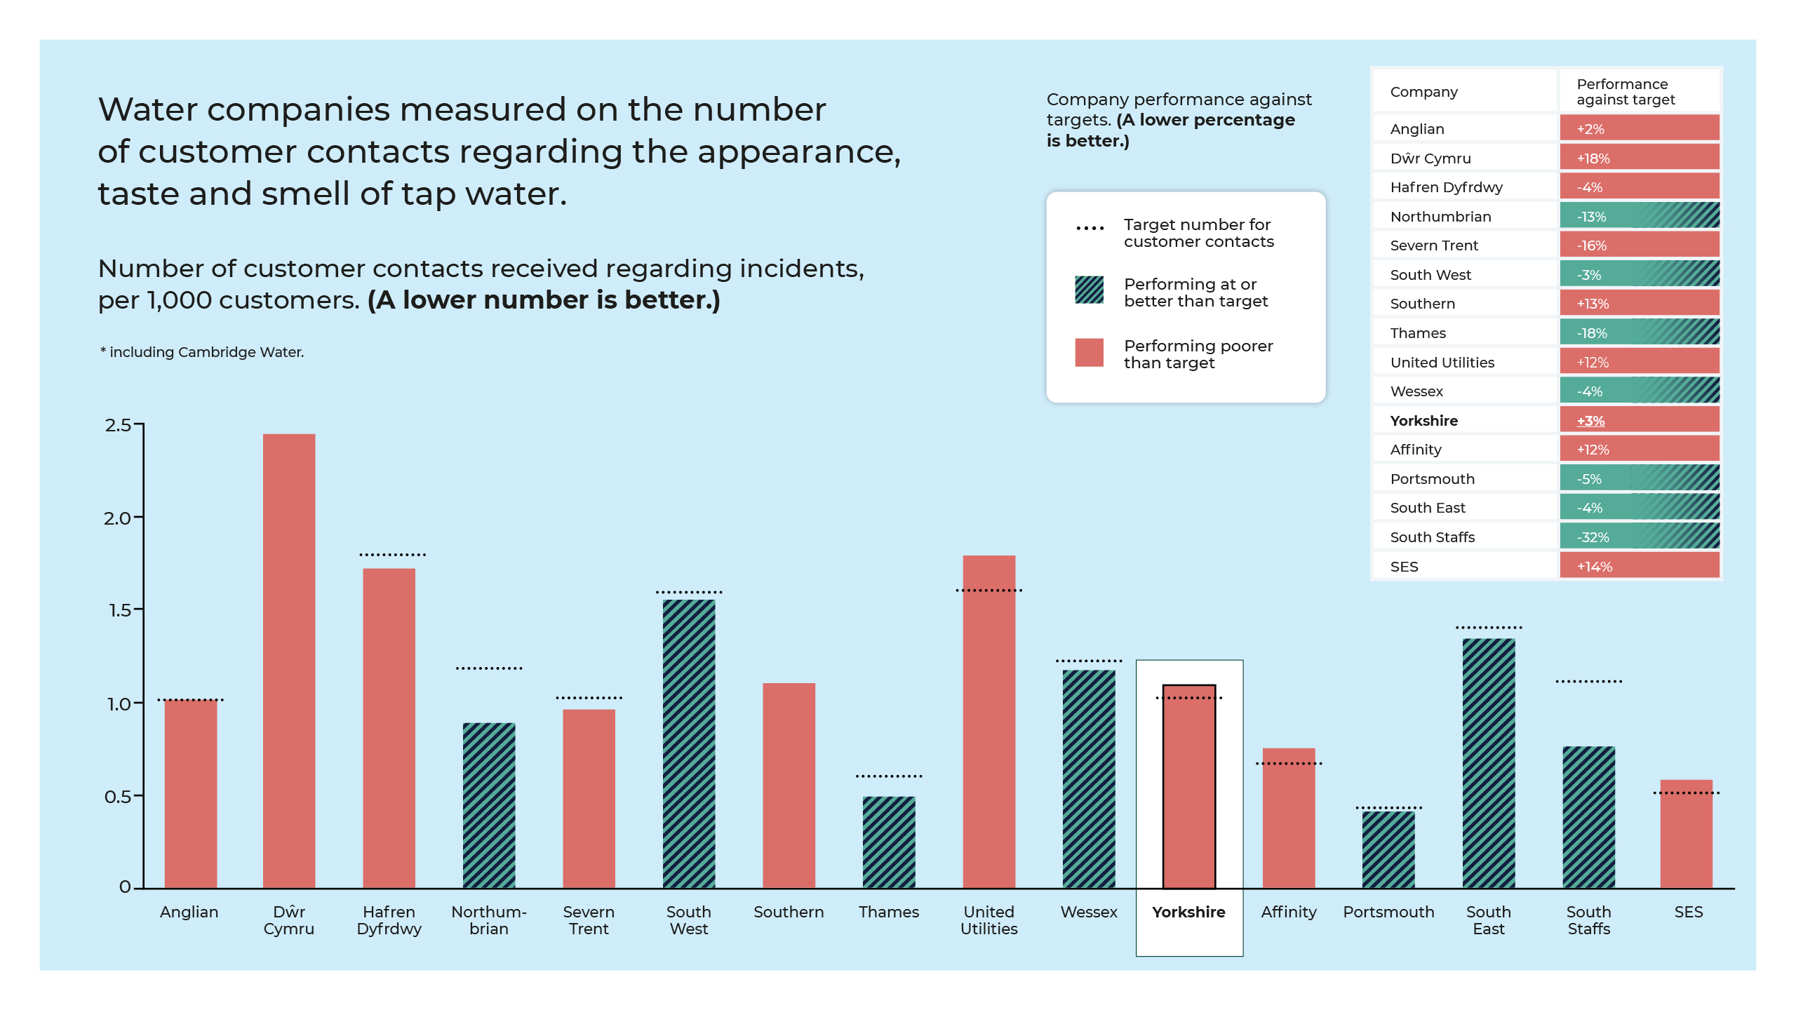
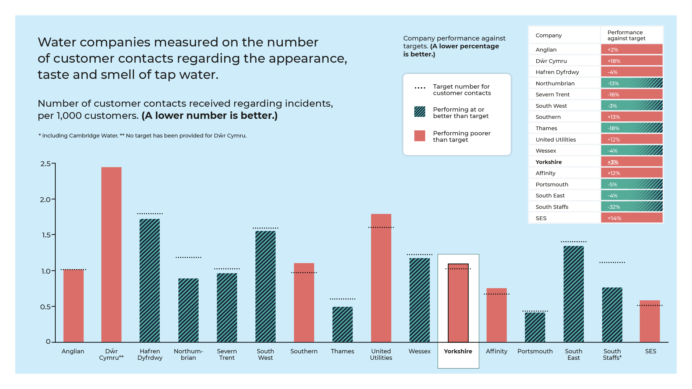

Slide 14
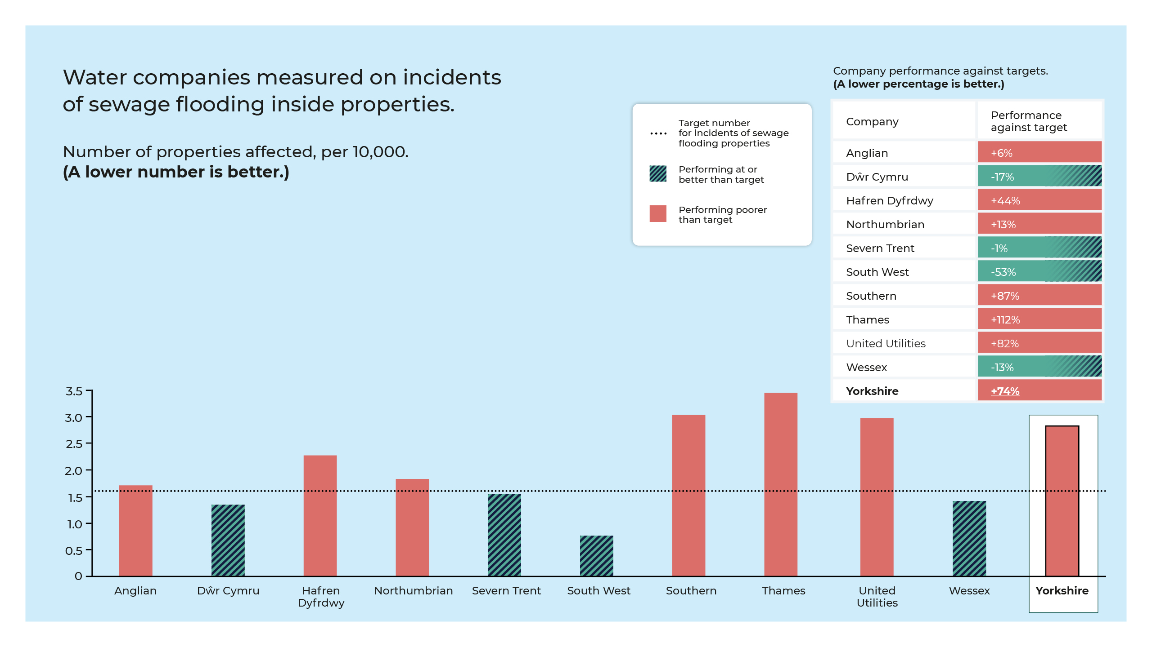

Slide 17
Pre-task pack:
What customers’ bills pay for

Slide 18
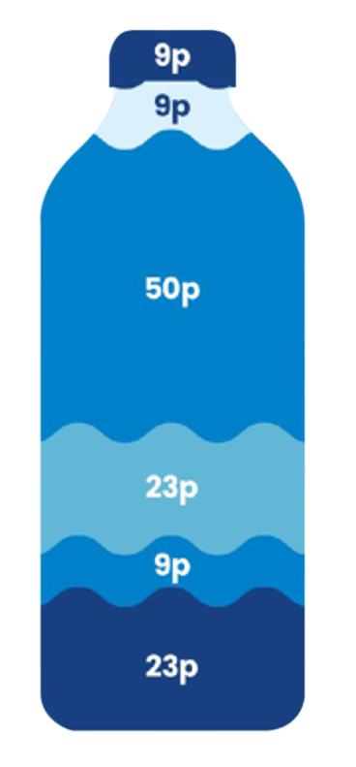
The average household spends £1.23 per day on water and wastewater services, this is how its broken down...
On energy
On taxes and licences
On running our business: people costs, material costs – the things we need to deliver services everyday.
On maintaining our equipment: looking after our pipes, pumping stations and reservoirs
On making improvements: investment in new projects and technology
On investing to improve our services: funding our borrowing debt that allows us money for investment

Slide 19
Glossary

Slide 20
Glossary of terms:
Per capita consumption: Lower per capita consumption (PCC) means less water is taken from the environment and fewer resources are required to extract, treat and distribute it.
Priority services: A range of services and accessibility option offered to customers who may need extra support, perhaps because of circumstances that might make them more vulnerable in a supply disruption incident or because of accessibility or communication needs.
Supply interruption: An incident when properties are without a continuous supply of water.
Unplanned outage: An incident where water to supply to properties is unexpectedly not available and where customers had not received prior notification.
Internal sewer flooding: Where a sewer becomes blocked and overflows contents from inside a property.
External sewer flooding: Where a sewer becomes blocked and overflows contents outside of properties.
Treatment works compliance: Whether a wastewater treatment works is complying with its requirements e.g. how much wastewater it must be able to treat at any one time etc.

