Slide 1
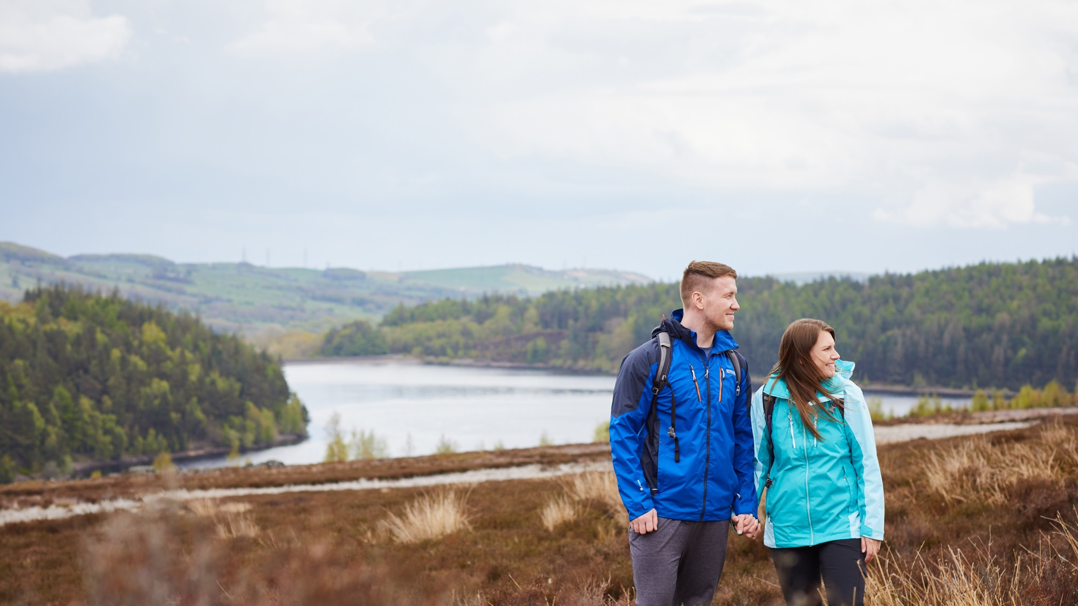

Welcome to the
‘Your Yorkshire Water, Your Say’ event
A thriving Yorkshire. Right for customers.
Right for the environment.

Slide 2




Housekeeping
The meeting is being recorded
for note-taking purposes, and the recording will be deleted once the written summary has been approved and published.
Auto captions
are available, just click the icon in the toolbar to activate them if yours aren’t working.
We encourage
you to keep your cameras on throughout the session, as it helps make the event more interactive and engaging.
Your microphones are muted by default, but if
you’d like to ask a question verbally, we’ll unmute you when it’s your turn.

Slide 3



Using Zoom
Some questions
submitted ahead
of the event will
be asked by the
host.
If you're asking
a question directly,
we’ll unmute your microphone and
the Chair will invite
you to speak.
Feel free to use the
chat function to
submit any additional questions during
the event—just click
the chat button in the toolbar.

Slide 4
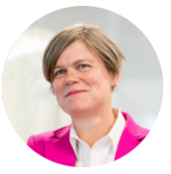



Welcome
what today’s session will cover...
6pm
Welcome &
introductions
to the Yorkshire
Water directors
6.10pm
A summary of
Yorkshire Water’s performance
& plans by
Nicola Shaw
6.30pm
Your opportunity
to ask questions!
7.25pm
Close &
next steps
*Please note timings are indicative and subject to change by Chair.

Slide 5
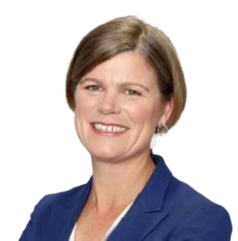
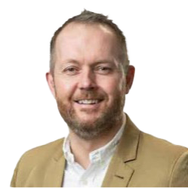
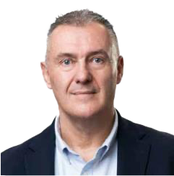
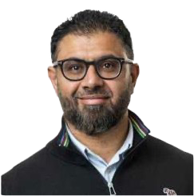
Our directors here today
Nicola Shaw CBE
Chief Executive Officer
Ben Roche
Director of
Wastewater
Dave Kaye
Director of
Clean Water
Imran Patel
Director of Customer Experience

Slide 6
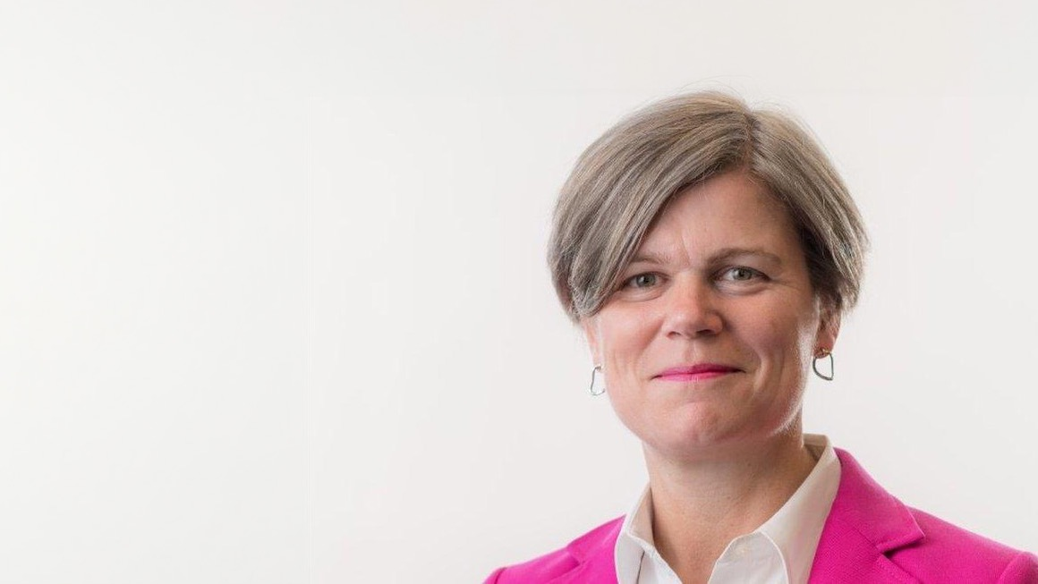
Introducing…
Nicola Shaw CBE
Chief Executive Officer of Yorkshire Water

Slide 7

A thriving Yorkshire. Right for customers.
Right for the
environment.

Slide 8

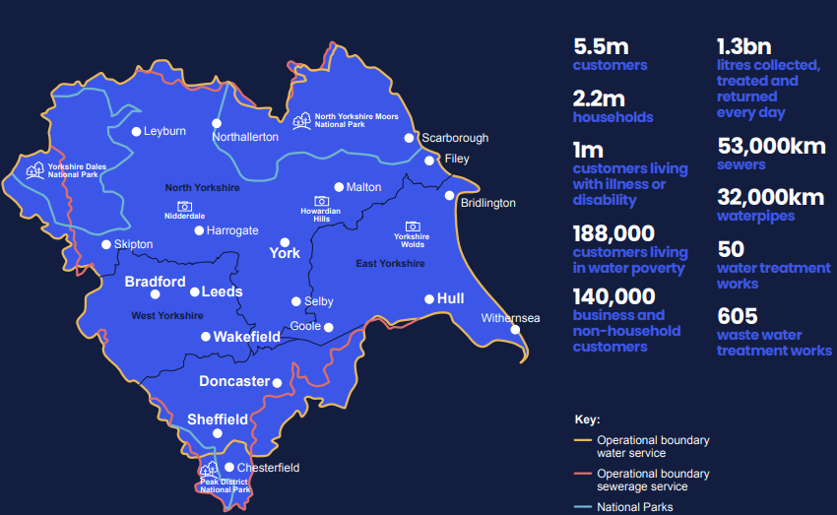
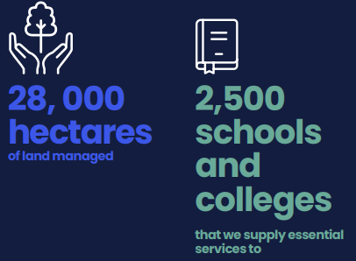

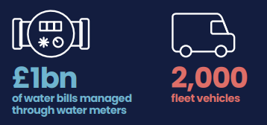
We have a big job to do…
The scale of what we take care of:

Slide 9



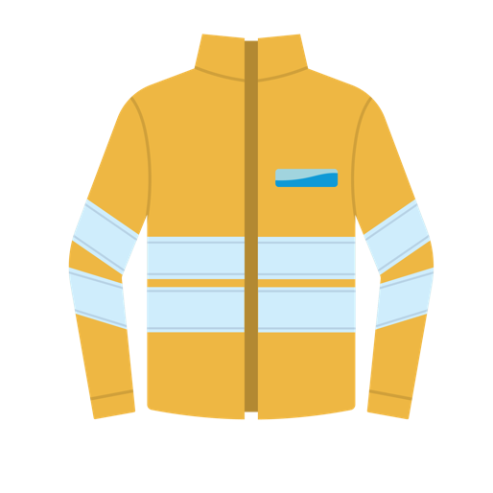

New sewage treatment
works for Scarborough
& Filey
Increased
phosphorus
removal
from treated
wastewater
Stormwater storage
Monitoring equipment
at 122 sites

Slide 10



How has Yorkshire Water performed?
We have 12 key performance commitments
Customer satisfaction
Priority services
Leakage
Per capita consumption
Supply interruption
Water
quality
Mains
repairs
Unplanned outage
Sewer collapses
Treatment works compliance
Internal sewer flooding
Pollution incidents
Achieved Regulatory Target
Failed Regulatory Target
Improvement
No movement
Our performance improved our rating from our regulator Ofwat to average.

Slide 11

Right for customers

Slide 12


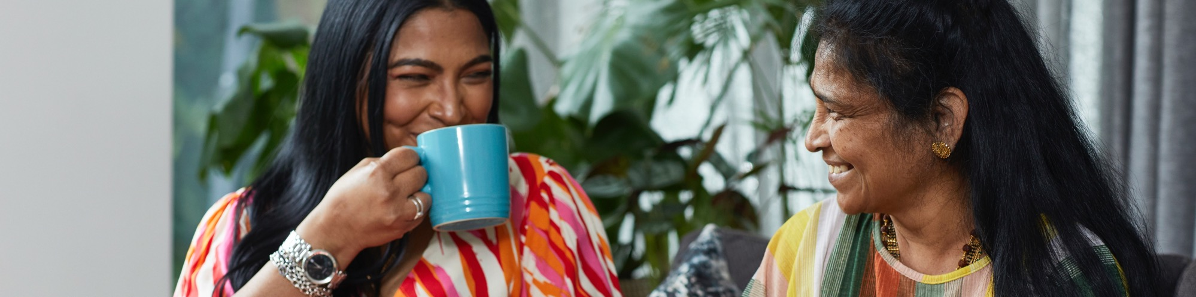
Right for customers means…
High-quality drinking
water
Bills
everyone
can afford
A tailored
& reliable service
An easy,
enjoyable experience
Support for those
who may be
more vulnerable

Slide 13

Right for customers
place in our customer experience (CMEX)
9th
Our position up from
11th place last year!

Slide 14

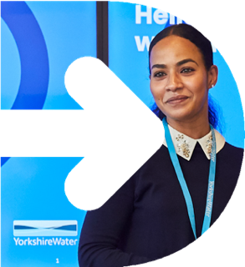
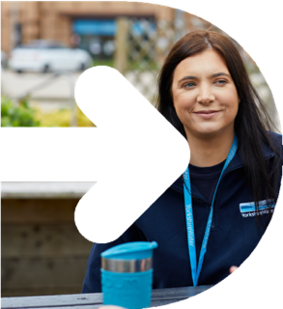


Right for customers
One team
Our modernisation plan provides
a new way of working that brings together the right people…
Contact
handlers
Customer Recovery
Planning & Scheduling
Field
Operations
Technical
triage

Slide 15


Our work continues…
‘Right for customers’
Perception
with customers is improving… Trust Pilot scores gone from…
1.6 to 4.6
We've reduced long standing complaints by…
40%

Slide 16




Over
We’ve supported over
210,000
125,000
customers to help to pay their bills
are on
our Priority Services Register
That’s a massive…
£35m
Double the amount from last year!
of bill support
in total

Slide 17

Right for the environment

Slide 18

Right for environment means…
Keeping wastewater in our pipes
Reducing
water use
& leaks
Achieving net zero

Slide 19

Storm overflows
£180millon investment programme
108 schemes
Across Yorkshire, from Ilkley
to York, to Doncaster
& Bradford
29
storm
overflows
are complete
61
in progress
18
due to
start soon

Slide 20
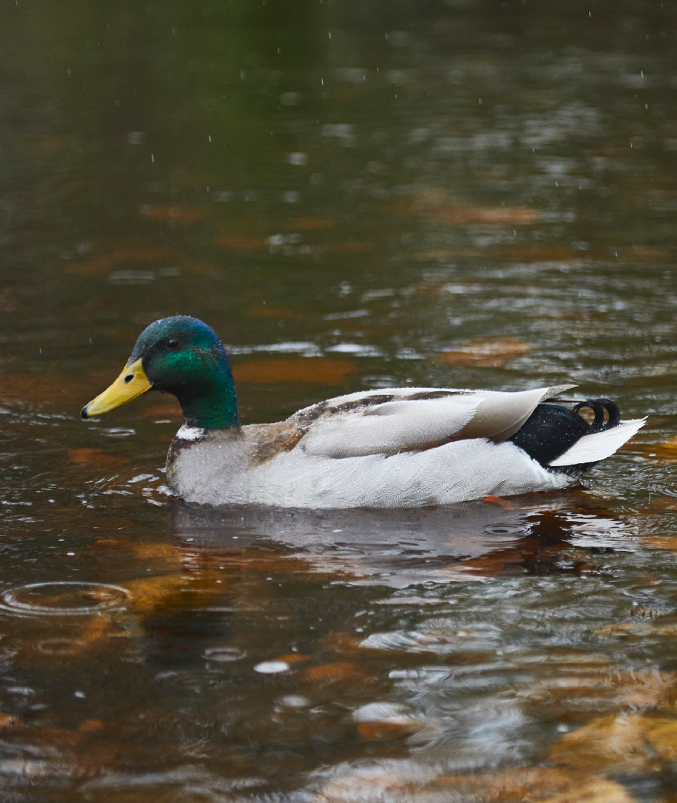

The first inland bathing water site in the UK
in Ilkley
We’ve invested in a new 835-metre £15m sewer.
This work was completed in early 2024 and is already reducing discharges over and above the bathing water standards.

Slide 21






Government announced
27 new inland bathing water designations
There is need to
work with all partner organisations on
improving bathing water quality
Including two in Yorkshire at Knaresborough and Wetherby.
This means the removal of pollution from...
Agriculture
Industry
Road
run-off
Other
sources
Our own impact

Slide 22
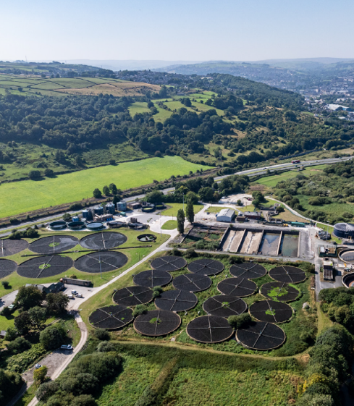
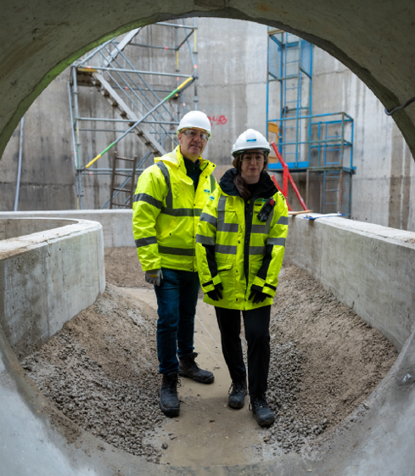
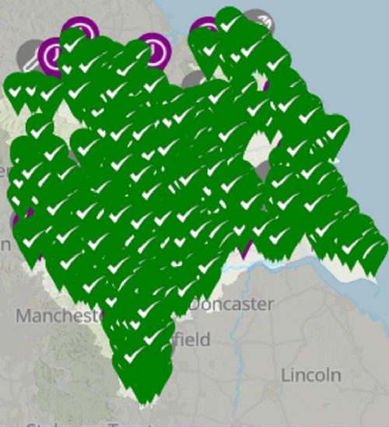
Launched our new Live Map
Our work continues…
‘Right for the environment’
Public now see storm overflow discharges live.
Tackling transparency challenges.
£770m
investment
to reduce
phosphorous in
Yorkshire’s rivers.
Maintained our excellent performance and are a leader
in the industry for wastewater treatment works compliance.

Slide 23


We are on track to achieve our 15% reduction in leakage
by 2025.
We have supported our customers to use less water.
Our customers use an average of 127 litres per day –that’s industry leading and
3.5% less than the previous three years.

Slide 24
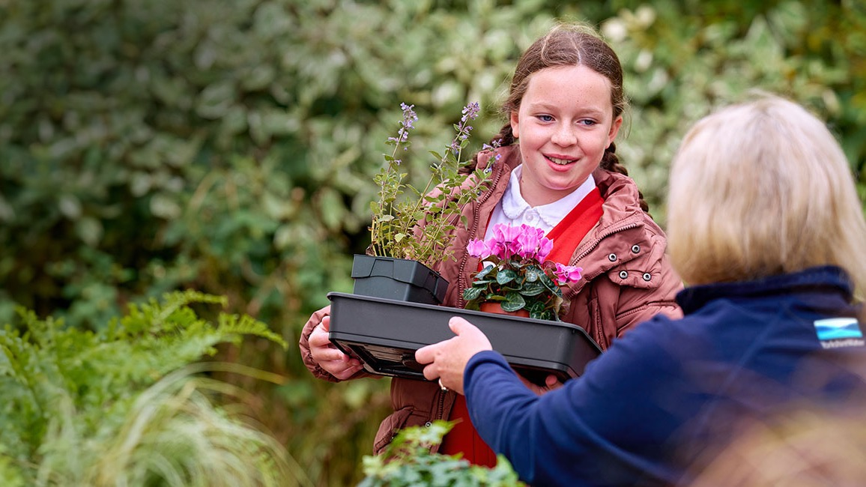
A Thriving Yorkshire …
We’ve
also been
busy working
within local
communities

Slide 25



Capital programme with over…
£800m
of investment
Watch the video of our current investment projects in-flight here:
YW Investor Update - YouTube

Slide 26
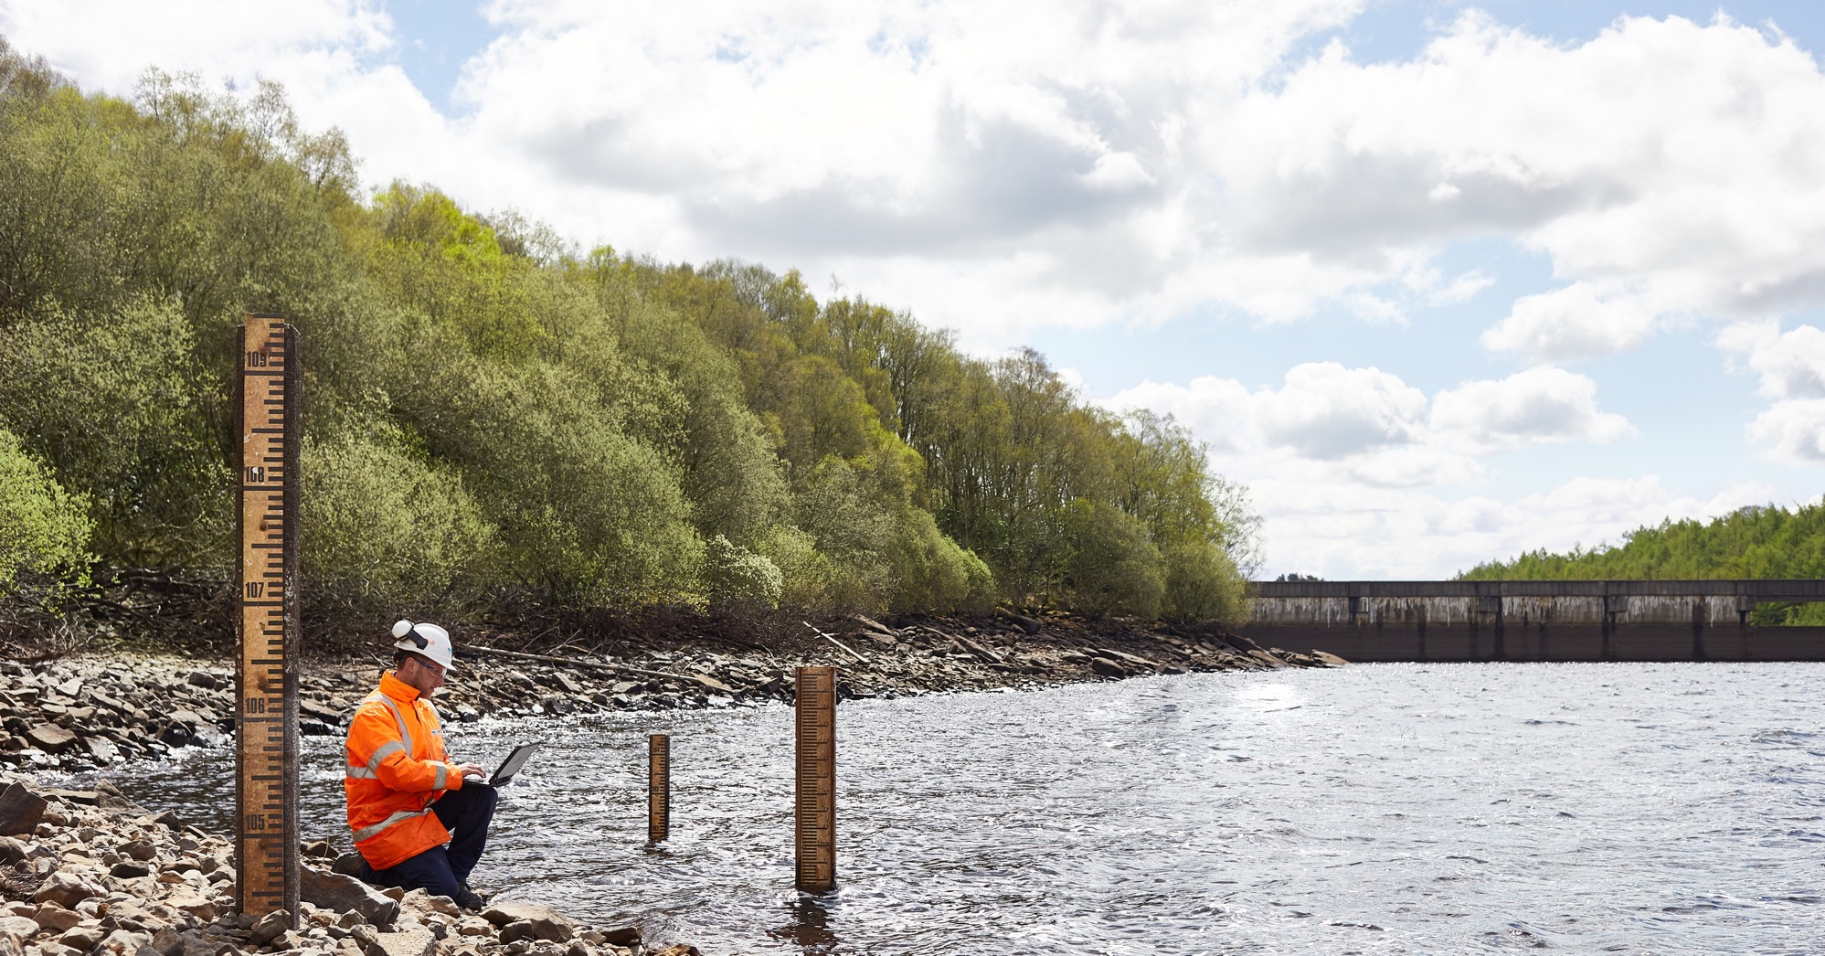
The largest environmental investment
since privatisation…
Looking forward…
the next 5 years
£8.36bn
programme

Slide 27






We want to make sure our plan delivers
on what’s important to customers…
Investment in
coastal bathing
waters
Continued support
flood mitigation
schemes in Hull
We tested this plan extensively with current
and future customers and it received strong levels of support (84%).
Increasing the
number of storm overflows improved
Increasing the resilience of our
water supply
Further reducing
our carbon
emissions
£55m extra to support customers struggling
to pay their bill

Slide 28


Get in touch
with us if you
are struggling
to pay your water bill
Impact on bills
If approved, our plans would see an average bill for the 2025-30 period of £553. That’s an extra £111 on average in 2025-30, compared to the average bill in 2020-2025.
Help to pay
Spending to support customers financially has gone up significantly enabling us to support 7% of our customers through our WaterSupport scheme.
This compares to 3% outlined in our October plan.
By 2030, we will provide
bill reductions to over 155,000 customers.

Slide 29
Your questions & answers
Nicola Shaw CBE
Chief Executive Officer
Ben Roche
Director of
Wastewater
Dave Kaye
Director of
Clean Water
Imran Patel
Director of Customer Experience

Slide 30
Close &
next steps…
Thank you for your time.
Email us: yourwateryoursay@yorkshirewater.co.uk

