Slide 1
Valuing Water Customer Priorities Research
Interim Qualitative Findings
May 2022
Yorkshire Water
Qa Research
Merchant House,
11a Piccadilly, York, YO1 9WB
01904 632039 www.qaresearch.co.uk

Slide 2
Contents
1
Objectives & methodology
2
Perceptions of & relationship with Yorkshire Water
3
Expectations from big companies
4
Customer views & understanding of challenges faced by Yorkshire Water
5
Customer priorities
6
Comprehension of attributes tested
7
Conclusions
Slides marked with this icon refers to the opinions of Non-Household customers

Slide 3
Objectives
& methodology

Slide 4
Research objectives
The objectives underpinning the research are to:
Determine customer views & understanding of YW challenges
Understand expectations from big companies & organisations
Understand the priorities customers feel Yorkshire Water should be focusing on for the next 5 years

Slide 5
Qualitative methodology
4 x 3 hour deliberative events in Sheffield, Hull, Skipton & Leeds
3 x tables with 7 household customers per table at each event
Tables split by lifestage (pre-family including future bill payers, family & post family) & social grade (ABC1 & C2DE)
2 x 90 minute online focus groups with household customers
1 session with future bill payers, pre-family & younger family lifestage & 1 session with older family, post family & empty nester lifestage
Mix of location & social grade (ABC1 & C2DE) in each session
10 x 60 minute online or telephone depth interviews with non-household customers
Mix of business size (micro / small, medium & large) – at least 2 to work in businesses where water plays a significant role in production or delivery of the service or product
Mix of locations across Yorkshire
All owners or senior decision makers within the business
In addition views of stakeholders will be captured & added into the analysis
Discourse analysis will be undertaken and the results fed into the final combined qual & quant research report

Slide 6
Perceptions of
& relationship with Yorkshire Water

Slide 7
Generally high satisfaction through low interaction & limited knowledge
Very high levels of satisfaction, but low levels of interactions
Very few given much thought to how water gets to their homes & is then removed & treated … for majority it just works and always has
Not a utility most think much about or have had any direct contact with: product good & service works
Felt to be relatively low bills so perceived to be much better VFM than other utilities
Quick resolution & a positive experience, with the very few who have had to contact YW; although some issues of low water pressure causing frustrations in Hull
Later in discussions:
Younger especially often unaware YW is a monopoly: in sessions some questioned why, although they have never thought about shopping around
Some surprise over differences in their water bill compared to others: unclear how it is calculated
Most unaware of how YW is regulated, but pleased & reassured when find out
All generally happy with YW, but from a low level of knowledge

Slide 8
Attitudes often changed during discussion
Seeing actual current performance against previous targets dramatically changes levels of satisfaction with YW
Initial positive perceptions
Little interaction
Low knowledge
Service works
Lower bill than gas / electricity & Council Tax
No big price rises recently
Challenges
Reactions show
most know little:
surprised by size & scale
More involved & complex than ever considered
Clearly thinking about long term & short term planning & investment
Don’t hear much
about YW: but no news seen as good news
Priorities
YW obviously have to think about a lot
Lots of aspects
to deliver on
Juggle to get right
Positive that customers being asked
So at this stage have a very positive view about YW
Concerns
with current performance level
Focus on RAG coding
Lots of red & amber
Some key areas in red (taste, smell, safe to drink)
Explanation very technical and meaningless
Impression YW not doing well & much worse than thought

Slide 9
Most businesses also had limited knowledge of & interaction with YW
Water regarded as critical by all: even those using it only for toilet or cleaning in an office or shop
Water tends not be a major issue, cost or thought for most, esp smaller
Minority acknowledged that the pandemic had provided a contingency plan of working at home
Few had experienced a ‘moment of truth’ (an interaction with YW) & very few had experienced issues
Smaller companies not aware of retailer name
General feeling that YW is an ‘expert’
Customer service when querying a bill & red tape associated with applying for a discount had presented an issue for one business
Understand ‘reasonable’ price increases: difficult to manage for some businesses who don’t feel they can pass increased costs on to customers
Little evidence of change in attitude through the discussion: as no influence of other participants & businesses very aware of challenges faced
“I did get in touch with someone at one point for a discount on the bill because we are a café. A large percentage of the water coming into the café is consumed and therefore there is no waste or sewage. They sent me a form but it was convoluted and complicated and there were questions I would need a day to try and work out” (Hospitality, Small)
“It is what it is at the moment with rising costs and everything else there isn’t much we can do about it. It doesn’t affect us massively so we don’t feel it is really, really expensive and where else are you going to get it from?”
(Charity, Small)

Slide 10
Expectations
from big companies

Slide 11
Many don’t think much about big business behaviour: just looking for good value & service
Not important Nice to have Essential
None of the factors
deemed unimportant
Green credentials
& actions
Honesty
Good customer satisfaction
Ethics & standards
of behaviour
Financial support
Basic business functions (investing for the future)
Customers more likely make judgements based on things
they see or experience
unless bad things are shown
in the media
i.e. ethical considerations
such as slave labour,
staff treatment (P&O), etc.
Charitable actions
At the very least not make things worse – e.g. environment, pollution
How staff are treated & CSR

Slide 12
The factors tested tended to be grouped together into broad themes
ESSENTIAL
Honesty included what were seen as very similar attributes of good open communications, transparency & respect
Good customer satisfaction included customer service; although for many this just needs to be good as a minimum rather than excellent or best in class, responsiveness, reliability, trust & providing value for money … all these provide real customer satisfaction in action & a positive reputation (derived from the whole interaction with and experience of that business)
Basic business functions: investing for the future seen as a given for any successful business
At the very least not make things worse e.g. protect the environment even if not enhance it, not cause pollution & try to make a positive difference
NICE TO HAVE
Green credentials & actions – not want big business not to play their part but providing value for money in current cost of living crisis seen by many as more important (i.e. keeping bills down even if it means putting some green aspects on hold). Some older lifestage and ABC1 generally more likely to see this as more important: possibly have more disposable income to pay for it. Some see more as lip service than making a real tangible difference. Being carbon neutral is a good target but many doubt this will realistically happen by 2030
Ethics & standards of behaviour – ethics, how treat staff, trust to behave properly & responsibly & being community minded in principle all seen as very important & difficult to say you don’t want but most accept in reality they still shop & use businesses which they know might be less good at this (or even poor) but have cheaper goods & services
Financial support for customers struggling financially – caused confusion, not see this as a role of big business
Charitable actions – would still use a business regardless of their CSR. Largely unaware of what actual differences many big businesses make in the region they operate in and not actively seeking this information. There is some cynicism that much of this is as done as a tax break or PR – so substance doubted

Slide 13
Small & independent businesses reflected desired positive behaviours: not most big corporations
Most struggled to give example of big corporations who really act in the positive way they want businesses to behave – as they don’t tend to think in this way when buying goods and services.
Undercutting smaller retailers.
Avoiding paying all UK tax.
Treat staff poorly
BUT still used on a regular basis so attitudes & opinions often different to actions
(older life-stages) high quality customer service – positive established reputation that they deliver on
Poor based on recent news stories – excess profits
but no reduction in prices
for consumers.
Large bonuses to CEO seen as wrong in current crisis
Most unsure how YW compares. Generally a hidden company but no news stories may be good news.
Communications good when a planned interruption but few aware of other comms campaigns to change behaviours or what difference make in Yorkshire. Seen as generally more reactive than proactive.
Customers had plenty of clear communication about bills now & in the future - explaining changes.
Seen as proactive
Most gas & electricity providers cited as poor – due to large price hikes. Frustration with bills more than businesses per se
Based on recent news stories rather than direct experiences
Poor behaviour Positive behaviour

Slide 14
Customer views
& understanding of
challenges faced by Yorkshire Water

Slide 15
Little existing knowledge made it very difficult to pick top priority challenges
Most were surprised about what it takes to provide drinking water & treat waste water every day when presented with an overview about YW, the scale of its operations & the issues it has to consider & address: most just never gave it much thought
Very much a hidden service taken for granted & rarely thought about unless a problem (which was felt to be very rare).
List of challenges presented viewed as very internally focussed rather than customer centric therefore from a customer perspective top challenges to prioritise are ones that have an obvious & direct impact on them.
Challenges which should take top priority over next few years
Aspects which they can easily comprehend as a problem which needs to be addressed & will impact on everyone: e.g. population growth
Current issues in media which they recognise & expect to impact them or others they know: e.g. squeezed household budgets
Challenges which any business is expected to address
These are seen as important but areas expected to address as part of running any business – so not unique to YW nor really a challenge – just something YW expected to get on with:
Good customer service - less clear what increasing customer expectations relates to. Service businesses expected to keep doing this
Protecting the environment - not expect YW to make things worse but surprisingly very few mention CSOs / river water quality so low awareness of issues being caused
Technological advancements - any business expected to reinvest & adopt new tech
Climate change – societal issue to tackle so unsure what YW can do per se but maybe a challenge to ensure future supply in hot summers. YW as any business has a role, along with government & the general population.

Slide 16
Little knowledge made it difficult to know which challenges need to be top priority
Mix opinions how important
Any business expected to adapt to new tech so digitisation expected. Many younger & family lifestages discussed Apps & smart tech they have with other utility providers – then question what YW might offer. Some worry older customers may struggle with any shift to digital.
Increased reliance on customers to do their bit – question is to do what? some surprised people by now don’t know what to do but others feel more education, communications & awareness of water saving devices is still needed.
Employment skills gap – not always understood but when it was this is a challenge for all businesses. However, given size of YW expected to resolve challenges via own apprenticeship schemes (suggestion very popular especially amongst C2DE in urban areas)
Challenges which can wait to be resolved
Although most accept green / eco challenges need addressing other big businesses perceived to have more of an impact & therefore role to play.
Achieving net zero by 2030 – general feeling it should not be forgotten but cost of living crisis has become more of the focus in the immediate short term so most appear happy to delay a little – especially if actions result in higher bills.
Not seen as area YW should be concerned with
Changing legislation – not a challenge seen as being important for customers per se. Any business has to adapt if laws change
Changing political landscape – customers very unclear why this meant or why it would be an issue for YW. When explained further seen as above – will just have to get on with it and adapt as required.
Both seen as very internal challenges rather than ones relevant to customers.
Covid-19 – relevant of this being a challenge for YW not understood.

Slide 17
All businesses found challenges familiar
General consensus with households on challenges faced by YW
Challenges familiar to all businesses: particularly environmental, cost of living, squeezed household budgets, Covid-19, etc.
All widely accepted, so more difficult to draw out those that are less important
When prompted, businesses in agreement with households over those that should be a fundamental business function (customer service, technology, skills gaps) can wait (achieving Net-Zero) & those that aren’t YW’s responsibility (changing legislation, political landscape, etc.)
Current cost of living crisis very important for all: YW must remember that this also means squeezed business budgets too
Climate & environment rated more highly by businesses: being negligent in that way could impact on trust & businesses felt YW needed to take responsibility (as do all businesses)
“We hear about cost of living and automatically assume it is about households, as a business we are suffering with the same problems in terms of increased costs. I have increased costs and I have to absorb them somehow – I can’t increase costs. Yorkshire Water is in a position where we have no choice, they have a monopoly in Yorkshire, and with that comes a responsibility to do their utmost to maintain quality but keep the costs at the lowest possible level”
(Hospitality, Small)

Slide 18
Customer priorities
for Yorkshire Water

Slide 19
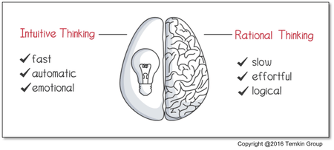
How customers are making choices regarding the 28 priorities tested
Immediate decisions on each individual attribute
Each tends to be reviewed in isolation to any other
Knee–jerk based on if easy to understand (and short description)
More likely to be seen as having an immediate direct impact on them
If have experience or recognise (little effort required)
More likely to be tangible and visible – so if experience of it or can see it has a stronger resonance
If have to work hard to comprehend it – it has a lower resonance
Emotive & visceral (e.g. helping customers who are struggling or health related or sewerage)
Reflective – hence in qual some attributes change position once thought more about them
Some attributes become more of a priorities when understand consequences more
Attributes judged on their knock-on impacts … start to see connections (if do x will improve y)
Longer term considerations – easy to initially see environmental issues as attributes that can wait and focus on cost of living but on reflection questions arise if this is storing problems for the future
For some attributes need first to easily understand benefits or impacts – will not be chosen if need to work hard to comprehend
95%
5%
Therefore attributes which require more thought or consideration (and are not so immediate to comprehend) may not be chosen as a priority especially when have a long list to quickly respond to

Slide 20
Many attributes were HIGH priority (without bill impact knowledge), but broad themes emerged
Quality of drinking water
All put providing water that is safe to drink & taste, look & smell as being a very high priority.
A basic expectation from YW but also an essential to deliver on.
Critical as related to health, safety & well-being.
Keeping bills low
Although not listed as a specific attribute, conversations around current cost of living crisis & why some attributes were only nice to haves (see overleaf) show this to be a key priority.
Providing value for money & avoiding large bill hikes a recurring theme to deliver on.
Supporting customers who are in vulnerable circumstances
When explained the types of customers these are – those through no fault of their own e.g. disabilities, medical conditions are expected to receive additional help.
Causes an emotional response – so respondents found it difficult to place anywhere else.
Investment in infrastructure
Lots of specific attributes grouped together as engineering issues – e.g. reducing leaks & sewer issues, ensuring can meet future demand.
Important but difficult for customers to prioritise specific ones over others.
For many this is a crucial foundation & starting point which will have knock-on impact on many problems shown in specific attributes (e.g. helping nature & environment).
Prioritise this & many feel other attributes will be solved as a consequence (e.g. good river & beach water quality, no hosepipe bans).
Also seen as a long term way to reduce bills by being efficient & reducing costs.
Sewer flooding
Very emotive – can image how awful if effected therefore hard not to have as a high priority.
Worse the closer it is to or in home.
CSOs – when understood seen as nasty & raises questions why this happens – although largely unaware those who know the scale are shocked & awareness changes views of the priority to sort out.
Fix problems (v similar to ‘investment in infrastructure)
Many surprised to be asked about what priority they would place on resolving leaks, reducing disruptions, tacking sewer problems, investing to meet future demand, avoiding negatively impacting on nature & wildlife etc.
Generally expect YW to do all of these as core functions. Desire for YW to be proactive rather than reactive.
Successfully manage
the ‘day job’
High priorities seen as the bare minimum expected from a water company.
Looking after the network to ensure no problems with providing a safe water supply and then taking away and treating waste water so it does not create a problem. Whilst keeping bills as low as possible.
Most feel this is the current situation.

Slide 21
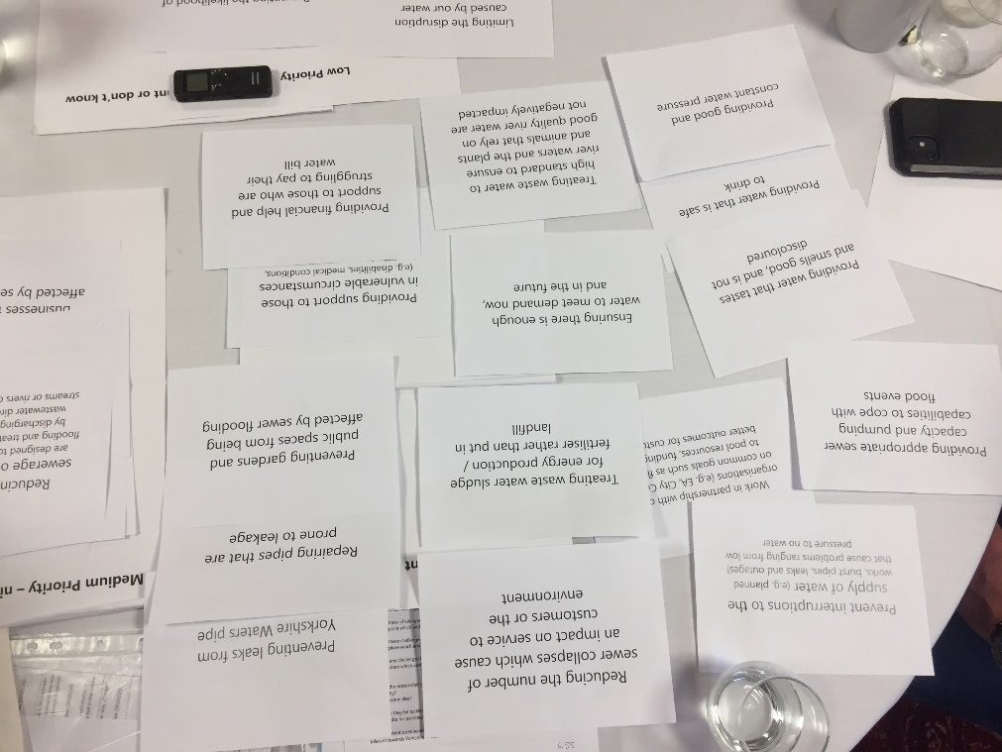
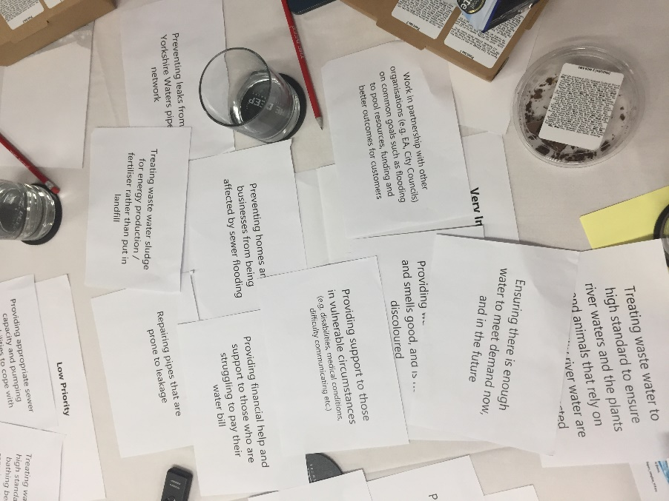
Difficult not to see each of the attributes as being very important

Slide 22
Priorities similar; also supply interruptions & environment
Strong similarities to views of households:
Quality & safety of drinking water is essential
Keeping bills low, but for households & business customers. Current priorities linked to this inferred a domestic customer focus
Sewer flooding, regarded as potentially devastating to businesses (& homes)
Where businesses had experienced or knew of (either professionally or personally) an incident, then this increased it’s priority due to this first hand experience
High importance on preventing interruptions to water supply:
Assumed to be an existing area of heavy investment due to not experiencing problems; but should continue if infrastructure requires it
Note also made that investment in some areas will help others i.e. reduce leaks = meeting future demand
Environmental focus again ranked highly
Being responsible & ethical regarded as important even though this had a lower impact on businesses themselves
“High up the agenda - you want to know that the water you are drinking is safe to drink.” (Healthcare, Medium)
“This depends on how old the infrastructure is and what repairs have been carried out to protect equipment or supply systems. If it is old it is a high priority but it’s a difficult one to answer. Interruptions do cause big problems for businesses.”
(Charity, Small)
“Everybody needs to do their bit in terms of protecting the environment and reducing emissions. Every business has a corporate responsibility.” (Healthcare, Medium)

Slide 23
MEDIUM priorities (important but can wait) some mixed views & can change with more understanding
If current provision deemed ok
No desire for reduction in provision as seen as working ok as is. Majority perceive customer service to be ok – although very limited contact. No demand for YW to be best in class but need to be good. Limited awareness of any issues with nature or quality of river & bathing water. Generally if unaware of current problems easy to view situation as ok as is.
When factor is perceived to result in higher bills
Although important aspects such as being net zero by 2030 less of a priority in light of cost of living crisis & worries over increasing future water bills. No desire to store up future problems but impact of YW alone in this area is seen as minimal. As has to be achieved by 2050 due to legislation most happy to wait & delay activities if these result in bill increases now.
Financial support for customers who are struggling
Really split opinions once understand it is other customers who are paying for any cross-subsidy. Some see as very important & needed, others see ‘benefit payments’ as a role for government not YW. A controversial topic & either a charitable or ‘political’ response depending on wider views – but shows importance of clearly understanding any descriptor.
If the activity can or is likely to reduce bills increasing
Initially working in partnership is a nice to have – implications for general customers not really comprehended. When appreciate this may mean YW spending less or speeding up what is achieved – Priority is not partnership working per se but the benefit of keeping bills low, once this is recognised views change to make it a sensible higher priority.
Spending money on changing behaviours
Very mixed views depending if believe more communications and education will work, resolve problems being caused & ultimately save all customers money. Less of a priority if feel everyone should know about saving water but some refuse to act ‘properly’ & when see current levels of leakage from unrepaired pipes (why bother).
Whether likely to directly enjoy impacts
Very mixed views regarding recreational access to land, improving river & bathing water quality & improving biodiversity. Not against but if unlikely to use then less of a priority & vice versa if of interest or likely to use.

Slide 24
Consistency in medium and low priorities
“Water companies have been trying to do that [educate customers] for years and years and nothing changes. If I was them I would give up, it doesn’t work.”
(Hospitality, Small)
High degree of similarity between households & businesses
Views sometimes changed when had more information
Often due to current provision being effective already; areas others should take responsibility for e.g. support for those struggling to pay bills; or basic business functions such as customer service
‘Resilience’ not regarded as a word expected to feature as a ‘given’
A familiar & understood term by most
Businesses do view YW as resilient though led to questions e.g. do they work with other water authorities should a particular area be short?
Responsibility regarded to be a more positive word to use by some
“If I had to sacrifice that over making sure we were preventing sewage leaks then sorry but the dog won’t get walked around the reservoir.”
(Construction, Medium)
“Everything covered enables you to be resilient and provide a particular service responsibly. I’m not sure it is a great word, I prefer responsibility. Having that environmental and social responsibility is important in the long-term.”
(Hospitality, Small)

Slide 25
LOW priorities (in comparison to other attributes) but some views changed with better understanding
If perceive there is a problem (or not)
Many attributes are hidden from view so not always appreciate there may be a challenge or a problem to address.
Others can become less of a priority when see performance targets (already ahead on net zero targets, low numbers of households affected by what YW classifies as low water pressure)
Low comprehension
Some attributes quite technical and new information for customers to digest so not easy to understand such as CSOs, partnership working and treating sludge so when reviewing a long list easy to place down the priority order.
When understand attribute may result in YW saving money or generating income and the belief this will mean bills stay low then seen as sensible to make action more of a priority – to achieve key goal of keeping bills low.
If have limited experience of it being a major issue
Only older lifestages had experience of a long lasting hosepipe bans – easy to place it down list of priorities if don’t expect the event to happen or if only perceived to happen rarely (accidental pollution – by nature of the descriptor expected to be infrequent). Few mentioned spontaneously mentioned sewerage outflows into rivers and on Yorkshire’s seaside.

Slide 26
Reluctant to classify any priorities as ‘irrelevant’
Indeed, very few priorities were seen as a low priority – let alone not important or irrelevant
This may change if costs & impacts were attached to each action
Customers unlikely to tolerate performance getting worse but also unlikely to pay significantly more in current cost of living climate
Overwhelmed by list of 28 to suggest any other aspects to include.

Slide 27
Mixed views on willingness to pay more
Only briefly touched upon & in principle rather than testing potential amounts
Clear than the cost of living crisis is at the forefront of many minds – especially C2DE where the impacts are already biting
Water bill is seen as low compared to other utilities & Council Tax but cost of living is seen in the round
Generally seen as very low for what customers get when the cost of individual water bill discussed & worked out per day or per week
Split in those willing & unwilling to pay even a small amount more in order to pay for more actions & positive impacts. Often based around personal interests (e.g. if more eco-focussed see value in doing more on this) or attitudes towards charity (e.g. paying a £1-2 more to help those struggling) rather than lifestage or social grade
Some more open to pay a bit more now if knowing any small rise will effectively tackle issues resulting in future savings due to better infrastructure, less wastage & therefore less costs
For some, willingness to pay more will depend on knowing shareholders & levels of senior renumeration are also taking a hit. Not something they are currently seeing from their gas or electricity providers!

Slide 28
Major concerns over price rise; though accepting if benefits clear
Current bills seen as good value compared to other utilities
Also relatively stable unit cost
Increasing energy & input / supply costs are a worry for all
Business customers worried about their increasing costs
Even though water not the biggest contributor, it is a concern
They feel they can’t all pass all these costs on to their customers
‘Willing’ is the wrong word, but ‘accepting’ of having to pay more if priorities right
Transparency needed over what else is being done to negate putting prices up. YW need to show they realise the difficult situation most of their business customers (esp. smaller) are experiencing at the moment
Clear communications are important
Need to be mindful that even a small % increase for high water users could be particularly unfeasible
“If I knew that the money was going to go to the areas that I was concerned about then of course I would. If dividends went up I’d be upset.“
(Hospitality, Small)
“It I thought things were getting done and I could see it I wouldn’t mind. It’s when you think nothing is happening you begrudge it. I’ve got to think about my situation though, I need to keep all my bills down for now as retail has its own challenges.“
(Retail, Micro)

Slide 29
Comprehension
of attributes tested

Slide 30
For clarity & comprehension, wording of some priorities will need revising for quant research
Specific comprehension issues shown overleaf but in general:
Too many attributes to digest for anyone in much detail, so likely to get very immediate rather than considered answers
Some considerably easier to understand than others = more immediately comprehensible, so in max-diff may be selected for this reason rather than necessarily being the main priority out of a list of more complex options
Some are lengthy – so in max-diff may result in the attribute being skimmed or ignored as easier to digest a considerably shorter descriptor
One key word tends to be the immediate focus
Several descriptors are quite similar - nuances not always clearly pick up on
Priority often changed significantly when some attributes explained further or clarified or the consequences or benefits appreciated – but as is they may be given less of a priority due to low comprehension or low awareness of the impacts.

Slide 31
Specific issues – understanding each priority
Descriptor / Attribute | Issues to resolve
Prevent interruptions to the supply of water (e.g. planned works, burst pipes, leaks and outages) that cause problems ranging from low pressure to no water | Some had different reactions if the interruption is planned (which many had experienced & could accept is required to replace old pipes when given plenty of advanced notice) & unplanned due to infrastructure failure. Should these be two separate attributes – one proactively replacing & the other reactively responding?
Providing good & constant water pressure | On surface easy to understand … although information in current performance targets suggest only affects 39 properties so likely some participants who said they have low pressure are getting this confused with what YW understands by this
Providing water that tastes & smells good, and is not discoloured | Easy to understand – short and clear. Often an emotive reaction to the phrase discoloured which may mean it is more likely to be selected. IN some ways seen as very similar to the attribute below
Providing water that is safe to drink | Easy to understand – seen as the core basic requirement
Preventing leaks from Yorkshire Waters pipe network | Easy to understand but need to know how much of an issue before being able to judge if it is a priority – few have any direct experience
Preventing the likelihood of restrictions on water use incl. hosepipe bans in a drought, restricting non-essential use for businesses | Difficult for many to quickly comprehend as it is a double negative … requires linguistic gymnastics. Seen as a consequence but some want to know what the action(s) would be to prevent this before they can fully support or not
Treating waste water sludge for energy production / fertiliser rather than put in landfill | Words ok but without explanation not understand what sludge is, how it can create energy & the impact on customers. Once told YW can generate £ from selling it – seen as a sensible thing to do & a way to reduce bills
Preventing homes & businesses from being affected by sewer flooding | Easy to understand. Again one of many attributes which were seen as being very similar (with a focus on sewer flooding)

Slide 32
Specific issues – understanding each priority
Descriptor / Attribute | Issues to resolve
Preventing gardens & public spaces from being affected by sewer flooding | Easy to understand but there are numerous attributes relating to sewer flooding – may not distinguish between them when reading quickly
Treating waste water to a high standard to ensure bathing beach waters remain safe to swim in | Bathing beach waters not how general customers refer to this. Replacing with Yorkshire’s beaches. Few drew the connection with treating waste water & the impact this has on the quality of the sea water
Treating waste water to high standard to ensure river waters and the plants & animals that rely on good quality river water are not negatively impacted | Rather lengthy & time consuming to read and digest. No one wanted things to get worse but should the descriptor be more focussed on specifics i.e. reducing pollution levels in rivers caused by untreated waste water
Preventing accidental pollution of rivers or streams (e.g. sewage leaks) from Yorkshire Waters sewage pipes) | Sounded very similar to the CSO & also other leakage / pipe attributes. Hard to judge until know the scale of the problem. Accept accidents can happen so is this word correct
Providing a level of customer service which customers expect e.g. queries resolved quickly | Seen as rather vague … easy to make a judgement how important if the choice is more to have similar levels or go for better / higher levels than now
Limiting the disruption caused by our water network & treatment facilities (e.g. minimising odour, flies, noise, traffic) | Disruption from water network not understood – so focus on sewerage treatment plants which they know can smell – therefore e.g. only pick up on minimising odour. Are customers appreciating the breadth of this attribute?
Ensure that land owned by Yorkshire Water is conserved, restored or enhanced to improve plant & animal life biodiversity | Quite wordy & not all that clear what is being offered or proposed. Biodiversity rather technical. Not expect YW to be harming wildlife so should the descriptor be focussed on doing more …
Providing public access to our land, reservoirs & rivers for recreational use (e.g. walks, cycling, watersports) | Understand YW have reservoirs which can be used for outdoor recreation. Less clear about how much land & rivers YW controls access to

Slide 33
Specific issues – understanding each priority
Descriptor / Attribute | Issues to resolve
Ensuring there is enough water to meet demand now, & in the future | Easy to understand
Providing appropriate sewer capacity & pumping capabilities to cope with flood events | Rather technical – so focus was more on building infrastructure & engineering projects. Do the impacts need explaining before a judgement can be made
Providing financial help & support to those who are struggling to pay their water bill | On surface clear to understand but when know more detail especially about cross- subsidy initial views sometimes change. Is more information required so respondents understand who is paying to achieve this?
Providing support to those in vulnerable circumstances (e.g. disabilities, medical conditions, difficulty communicating etc.) | On surface easy to see as being the same or very similar to attribute about financial vulnerability. Moved up the priority list when examples used. YW expected to provide support so not mean much … some suggest prioritise a better word if aim is to understand how important this is seen to be
Supporting customers to reduce their water use | Preference for the word educating rather than supporting … suggests more definite actions but clear to understand
Helping to prevent blockages & pollution through a communication programme which educates customers on the impact of incorrect disposal of wipes & fats | Quite lengthy .. many not pick up on the reference to education campaigns to change behaviours which they desired. Can it be made shorter & more succinct?
Reducing the use of sewerage outflows. Outflows are designed to help prevent local flooding & treatment works flooding by discharging excess untreated wastewater directly in to nearby streams or rivers during heavy rainfall | Extremely technical which needed moderators to explain – unlikely to be picked as a priority not because it is not one but because others are easy to grasp what they mean. Scale and the impact of CSOs not conveyed by the description
Reduce & offset carbon emissions to achieve a 'net zero' position by 2030 | The word position not needed. The attribute fails to convey the choice is YW doing this sooner than 2050 which is the government target – information needed to make an informed judgement

Slide 34
Specific issues – understanding each priority
Descriptor / Attribute | Issues to resolve
Work in partnership with other organisations (e.g. EA, City Councils) on common goals such as flooding to pool resources, funding & better outcomes for customers | Not immediate understood what partnership working might involve or the benefits phrased as better outcomes for YW customers. When explained this could mean sharing the costs of investments to achieve a common goal the attribute was seen as sensible, potentially meaning lower bills & therefore became more of a priority. Is an example or the benefit needed to explain this?
Repairing pipes that are prone to leakage | Easy to understand – although many surprised at the scale of the problem based on current performance levels. The description itself does not reflect this
Reducing the number of sewer collapses which cause an impact on service to customers or the environment | The word collapses is emotive. Hard to decide if it is a priority without context – how big an issue is it? Impacts are vague
Improving the level of service customers experience whether they contact us or not. This is an Ofwat survey for all 17 companies in the water industry, YW always aim to be in the top half of companies for customer experience & satisfaction | Confusing – already another attribute about customer service so what else does this add – very long & technical description which hides what it is trying to say

Slide 35
Conclusions

Slide 36
Conclusions
Cost of living crisis at the forefront of many minds. This appears to be having a big influence of priorities.
Environmental attributes are still important but for many of less immediate short term concern that keeping bills low.
The key focus is on delivering the basics & investing in areas & activities which will help to keep future costs & therefore bills down.
Customers are less concerned about very specific attributes, grouping them together into broad themes.
Should the quantitative research look to test priorities between broader themes or very specific priorities? If the later it is crucial respondents comprehend the attribute & in some case the impact or benefit this could deliver – in order to make an informed choice.

Slide 37
Qa Research Merchant House 11a Piccadilly York YO1 9WB 01904 632039 info@qaresearch.co.uk Qa Research is a trading name of QA Research Ltd, UK registered, company registration number 3186539, address in York as above.
Project code: SKILL02-9052
File name: YW valuing water customer priorities research
Date: May 2022
Approved by: Richard Bryan
Authors: Nick How & Nick Lynch
Comments to: nick.how@qaresearch.co.uk
This research was carried out in compliance with ISO 20252, (the International Standard for Market and Social research), The Market Research Society’s Code of Conduct & UK Data Protection law.

