Slide 1
DWMP Showcards
Session 2

Slide 2
Showcard 1
PRIVATISATION
Water and waste water services were privatised in England and Wales in 1989.
OFWAT
Regulation & Charging
OFWAT are the water industry regulator
They regulate the amount of money water companies are allowed to charge its customers
Charges are set out by water and sewerage companies
This happens via a price control process whereby water and sewerage companies submit their business plans (investment plans and customer charges)
This process happens in five-year cycles
The plan for 2025-2030 is submitted to Ofwat for review in 2024
OFWAT scrutinise companies’ business plans and challenge them to deliver value for money, while ensuring they can continue to invest to maintain and improve vital water and sewerage services

Slide 3
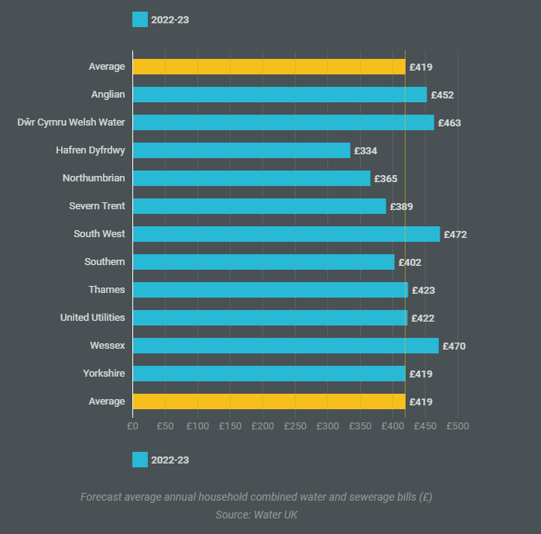
Showcard 2

Slide 4
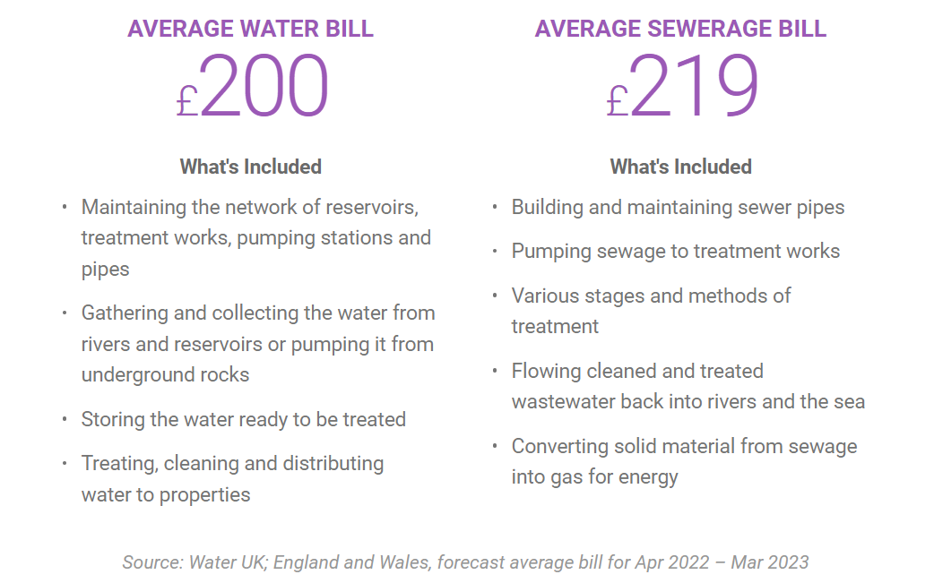
Showcard 3.1

Slide 5
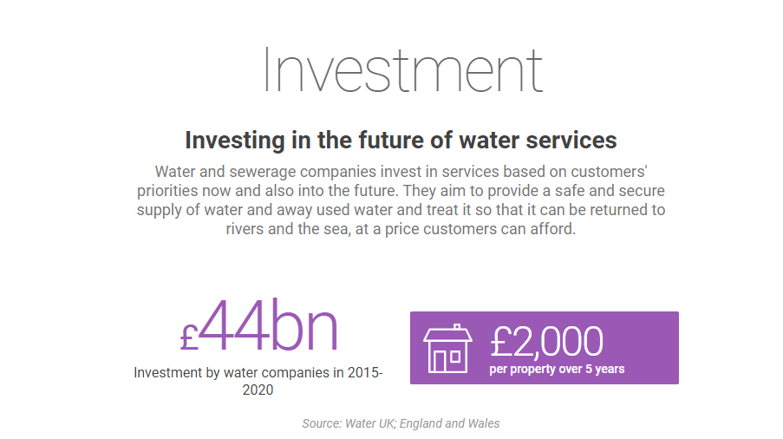
Showcard 3.2

Slide 6
Current Performance on Waste Water & Environmental measures……………….
Showcard 4
Measures
Explanation
Current Performance
A: Internal Sewer Flooding
YW are measured on the total number of internal sewer flooding incidents through the year per 10,000 sewer connections.
Currently not on track to meet current year targets
B: External Sewer Flooding
This performance commitment measures the total number of external sewer flooding events through the year.
Currently on track to meet current year targets
C: Risk Of Sewer Flooding In A Storm
As part of a national drive to improve the country's resilience to extreme weather events, this performance commitment measures how many of YW customers would be at risk of internal sewer flooding from a 1 in 50-year storm, based on modelled predictions.
Currently on track to meet current year targets
D: Sewer Collapses
If a part of a sewer collapses, it can block the sewer and lead to sewer flooding or pollution. This performance commitment measures the number of sewer collapses that affect our customers’ supply or the environment, per 1,000 km of our sewer network.
Currently on track to meet current year targets
E: Pollution Incidents
YW want to make sure their operations don’t harm the environment. This performance commitment measures the number of pollution incidents caused by our wastewater assets, for every 10,000km of our wastewater network.
Slightly off track to meet current year targets
F: Treatment Works Compliance
YW have permits that control their discharges into watercourses. This performance commitment measures the percentage of their treatment works that comply with their discharge permits.
Slightly off track to meet current year targets
G: Length of River Improved
Improving our environment benefits everyone in Yorkshire. We’re working hard to improve river water quality and this performance commitment measures the length of river we’ve improved in the 2020-25 period. We currently have four projects running, to improve 45.6km of river.
Currently on track to meet current year targets

Slide 7
Showcard 5
Nature Based/Sustainable Drainage Systems (SuDS)

Slide 8
Showcard 6
Metrics: avoiding………………​
Internal flooding of customer properties due to overloading ​
Internal flooding of infrastructure property (schools/hospitals) due to overloading​
Internal flooding of a business/commercial property due to overloading​
Internal flooding of any property due to blockages or sewer defect​
External Flooding of a customers garden due to overloading​
External Flooding of infrastructure property (main roads) due to overloading​
External flooding of a business/commercial property due to overloading​
External Flooding of any properties due to blockages or sewer defect​
Pollution of a river with sewage due to a blockage or sewer defect​
A deterioration in river water quality due to untreated sewage spills from storm overflows​
A deterioration in river water quality due to reduced quality of treated wastewater treatment works discharges to the river or sea​
Solutions Options
Development of sustainable drainage systems
Development of traditional drainage systems
Combination of sustainable and traditional systems
Partnerships

Slide 9
Showcard 7
Best Value Plan: Your Target: Price of your bills to achieve your plan:

