Slide 1
Welcome to the
‘Your Yorkshire Water, Your Say’ event
A thriving Yorkshire. Right for customers.
Right for the environment.

Slide 2
Housekeeping
The meeting is being recorded for note-taking purposes, and the recording will be deleted once the written summary has been approved and published.
Auto captions are available, just click the icon in the toolbar to activate them if yours aren’t working.
We encourage you
to keep your cameras on throughout the session, as it helps make the event
more interactive and engaging.
Your microphones are muted by default, but if you’d like to ask a question verbally, we’ll unmute you when it’s your turn.

Slide 3
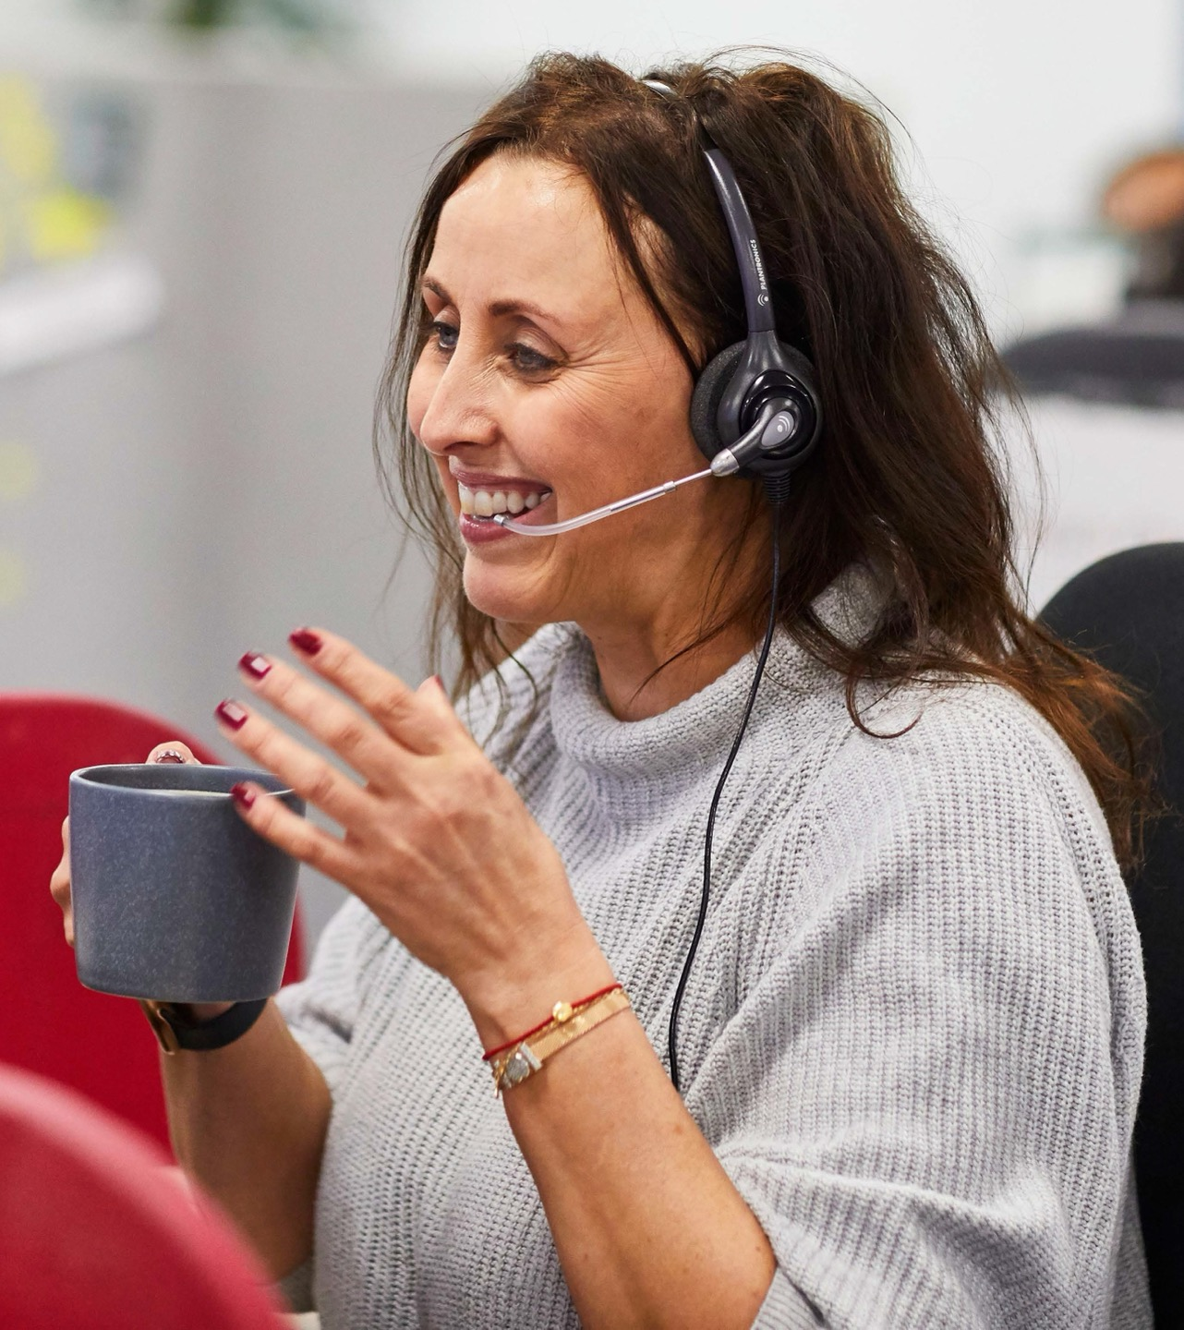
Using Zoom
Some questions submitted ahead of the event will be asked by the host.
If you’re asking a question directly, we’ll unmute your microphone and the Chair will invite you to speak.
Feel free to use the chat function to submit any additional questions during the event –
just click the chat button in the toolbar. Looking ahead, there are changes in how we assess and report pollution.

Slide 4
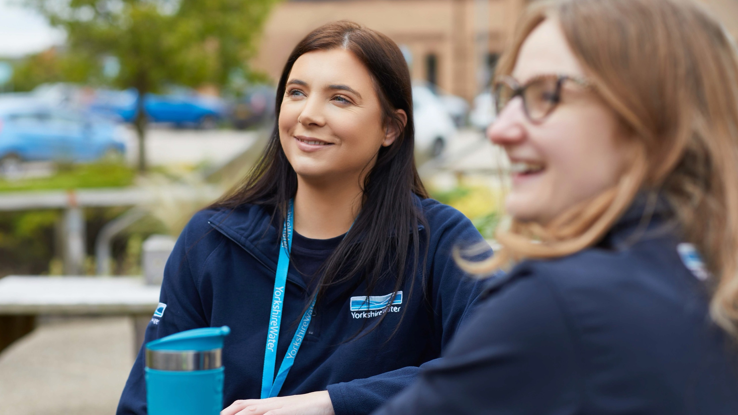
Welcome

Slide 5
What today’s session will cover
6pm
Welcome and introductions to the Yorkshire Water directors
6.10pm
A summary of Yorkshire
Water’s half year performance and regional plans by Nicola Shaw
6.25pm
Your opportunity to ask questions!
7.25pm
Close and next steps
*Please note timings are indicative and subject to change by Chair.

Slide 6
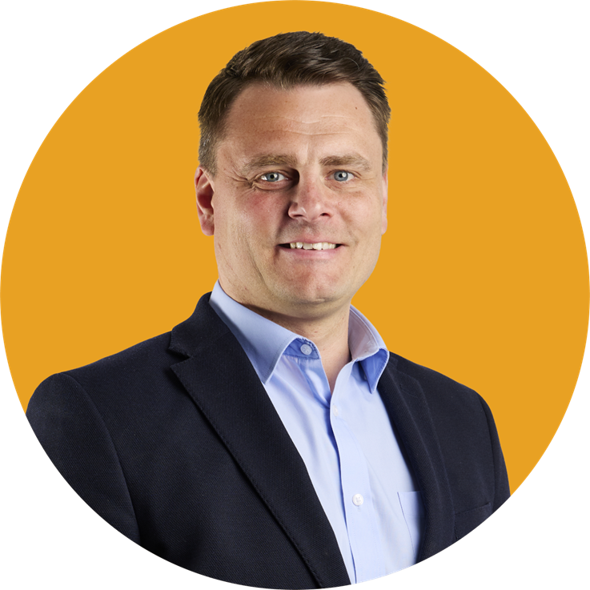
Our directors here today
Nicola Shaw CBE Chief Executive Officer
Andy Shaw
Director of Control, Production and Process
Matthew Pinder Director of Customer, Distribution and Collection
Richard Stuart Director of Capital Delivery

Slide 7
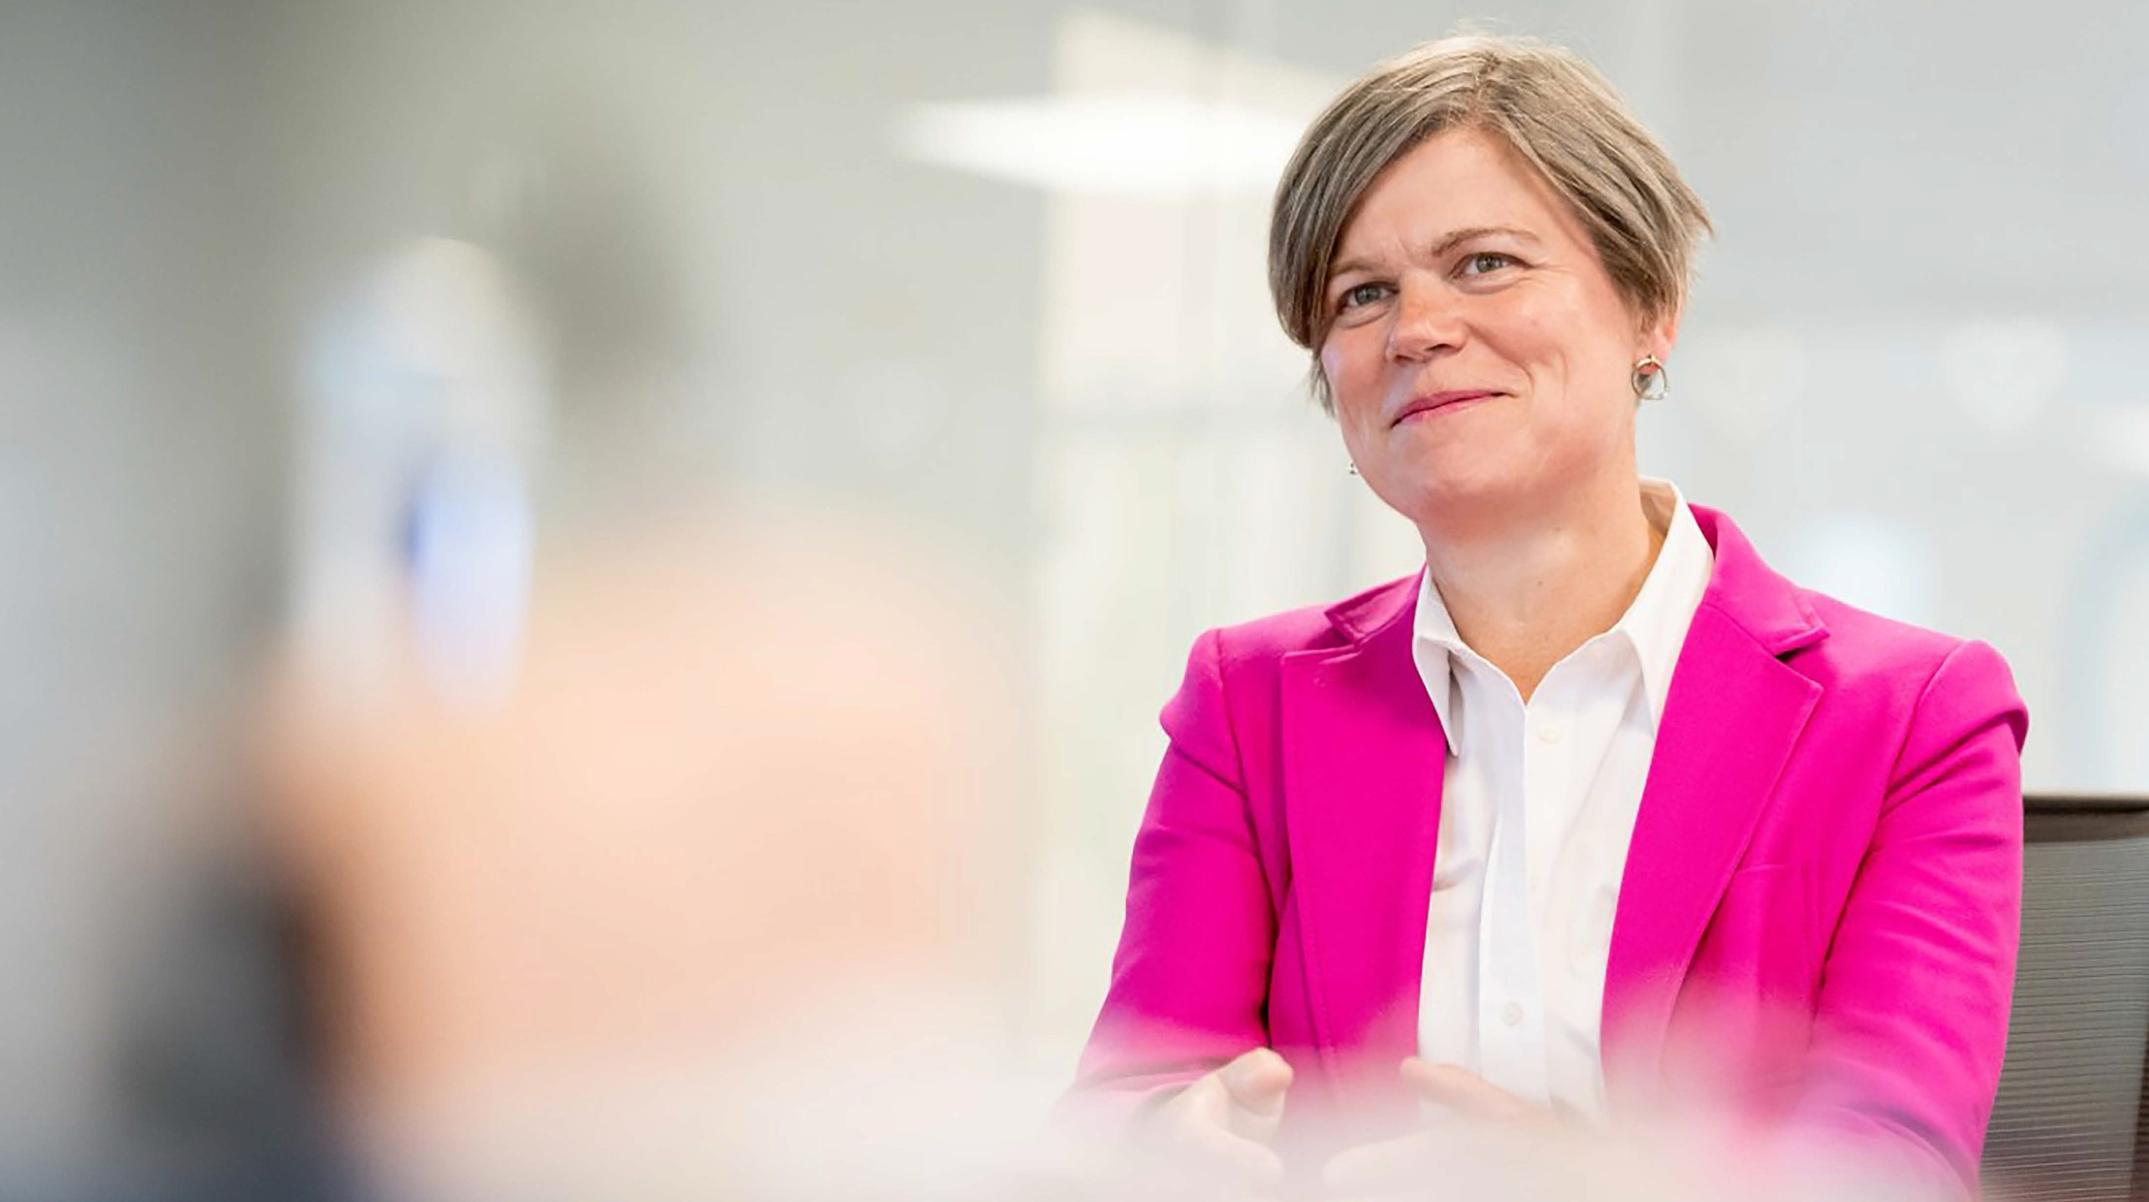
Introducing Nicola Shaw CBE,
Chief Executive Officer of Yorkshire Water

Slide 8
What I’ll take you through today…
Improvements we’ve delivered this year
What we’re doing to help Yorkshire thrive
How we’ve performed
…then it’s over to you for questions

Slide 9
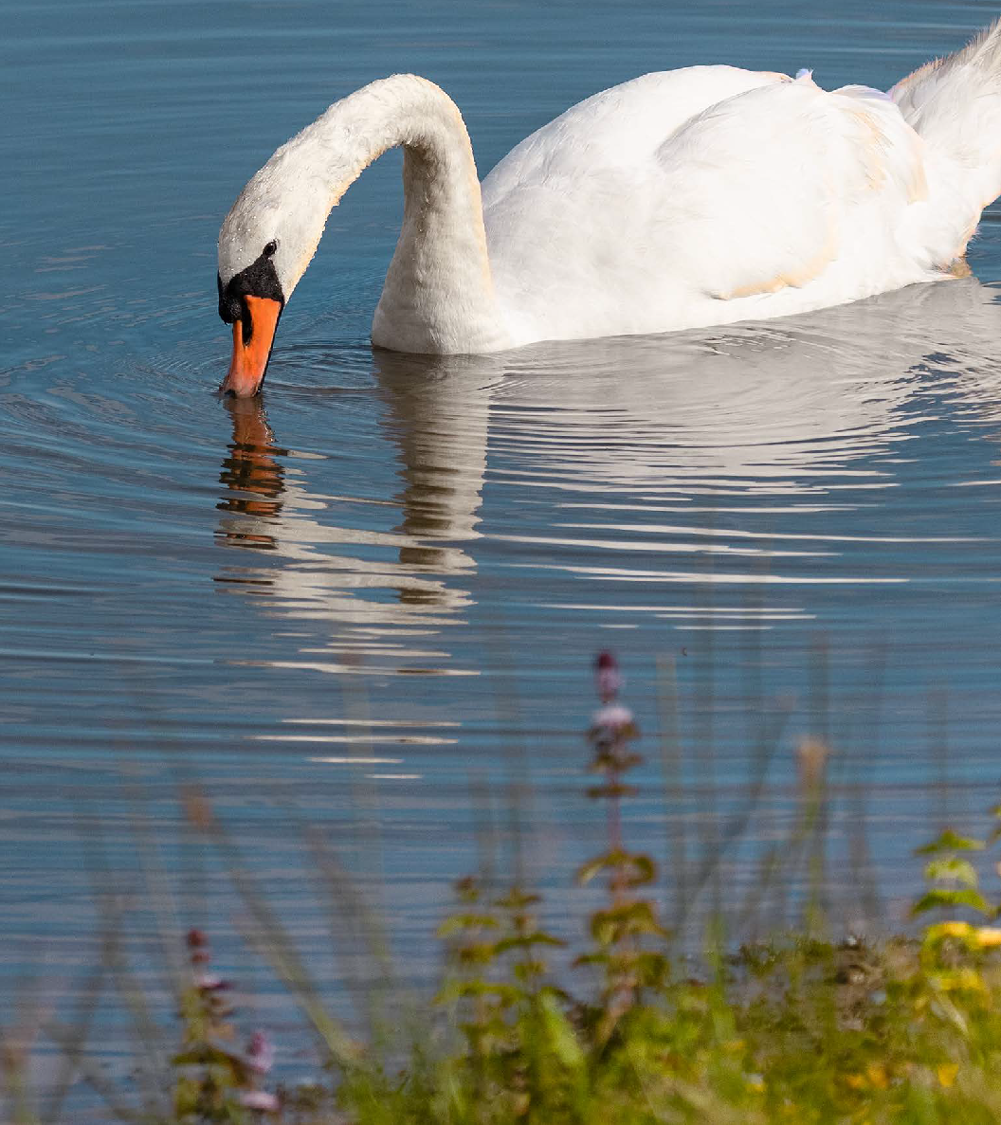

The first year of our largest environmental investment -
£8.3 billion
between April 2025 and March 2026
£990m 88
invested
completed projects, half of which were mains replacement

Slide 10
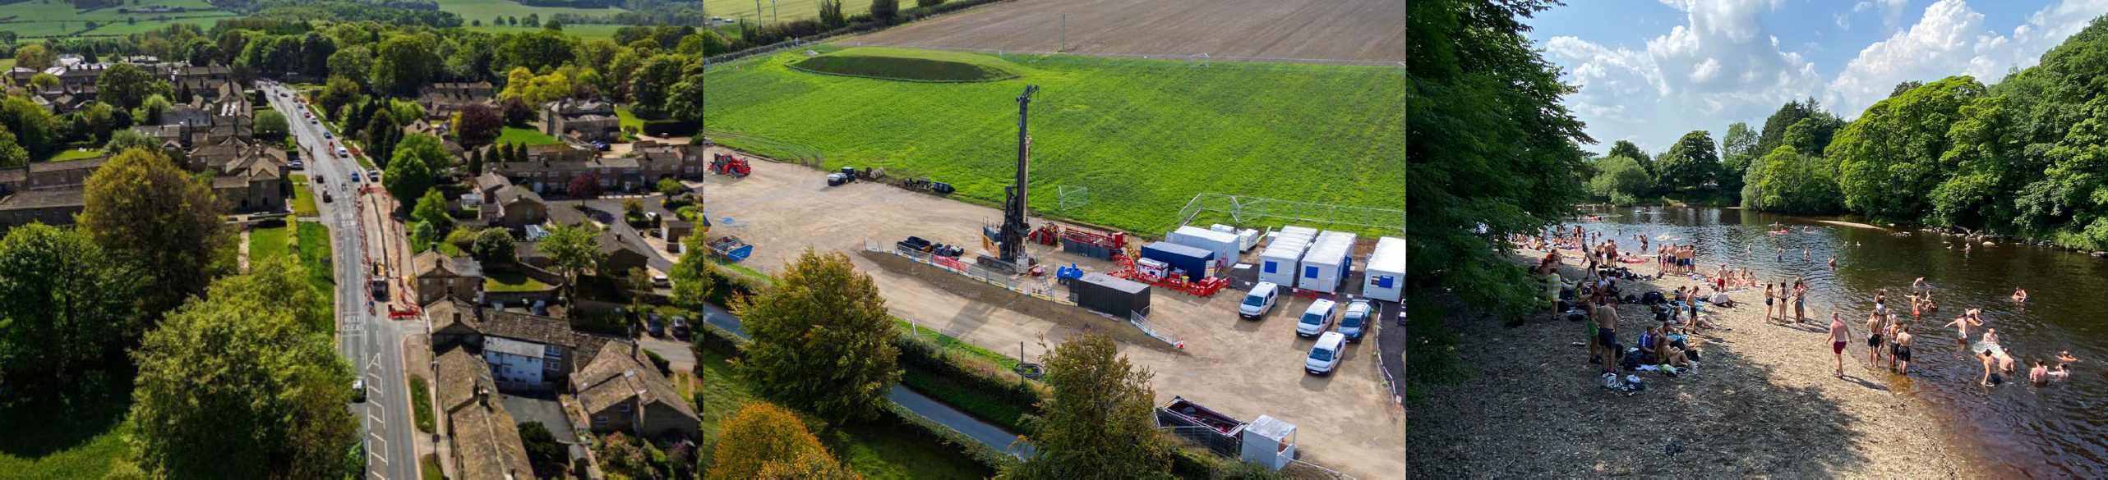


Replacing water mains helps to:
Additional groundwater projects to increase resilience through additional supply availability:
upgrade of borehole at Heck Water Treatment works, North Yorkshire
new boreholes at East Ness, Brayton Barff, Malton and Norton
Improving bathing water quality on the River Wharfe:
new storage created and completed
integrated wetlands underway
storm overflow discharges reducing
reduce leakage
reduce supply interruptions
improve water quality and the service you receive

Slide 11
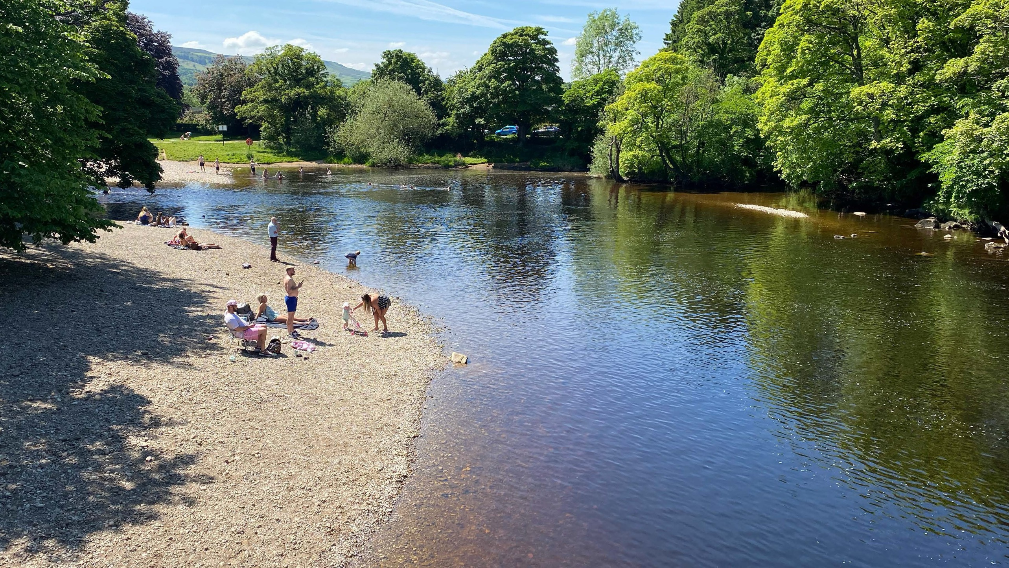
Investing in our bathing water sites
Ilkley, Richmond, Knaresborough, Wetherby, Scarborough, Bridlington

Slide 12
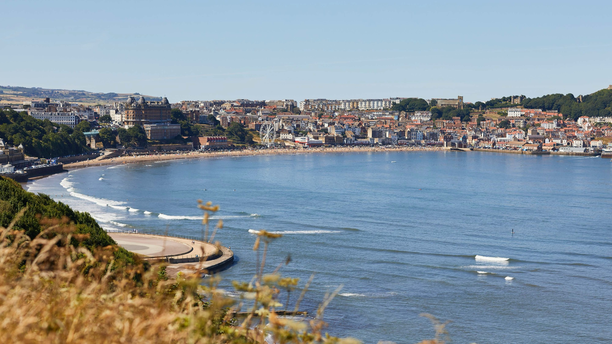



Investing in Yorkshire’s bathing water sites
£250m
£150m
Our Storm Alliance is preparing plans for Knaresborough, Richmond and Wetherby
investment on our coast before 2030
First phase consultation finished in Scarborough –
£150m programme coming soon
Bridlington work will begin in this year

Slide 13
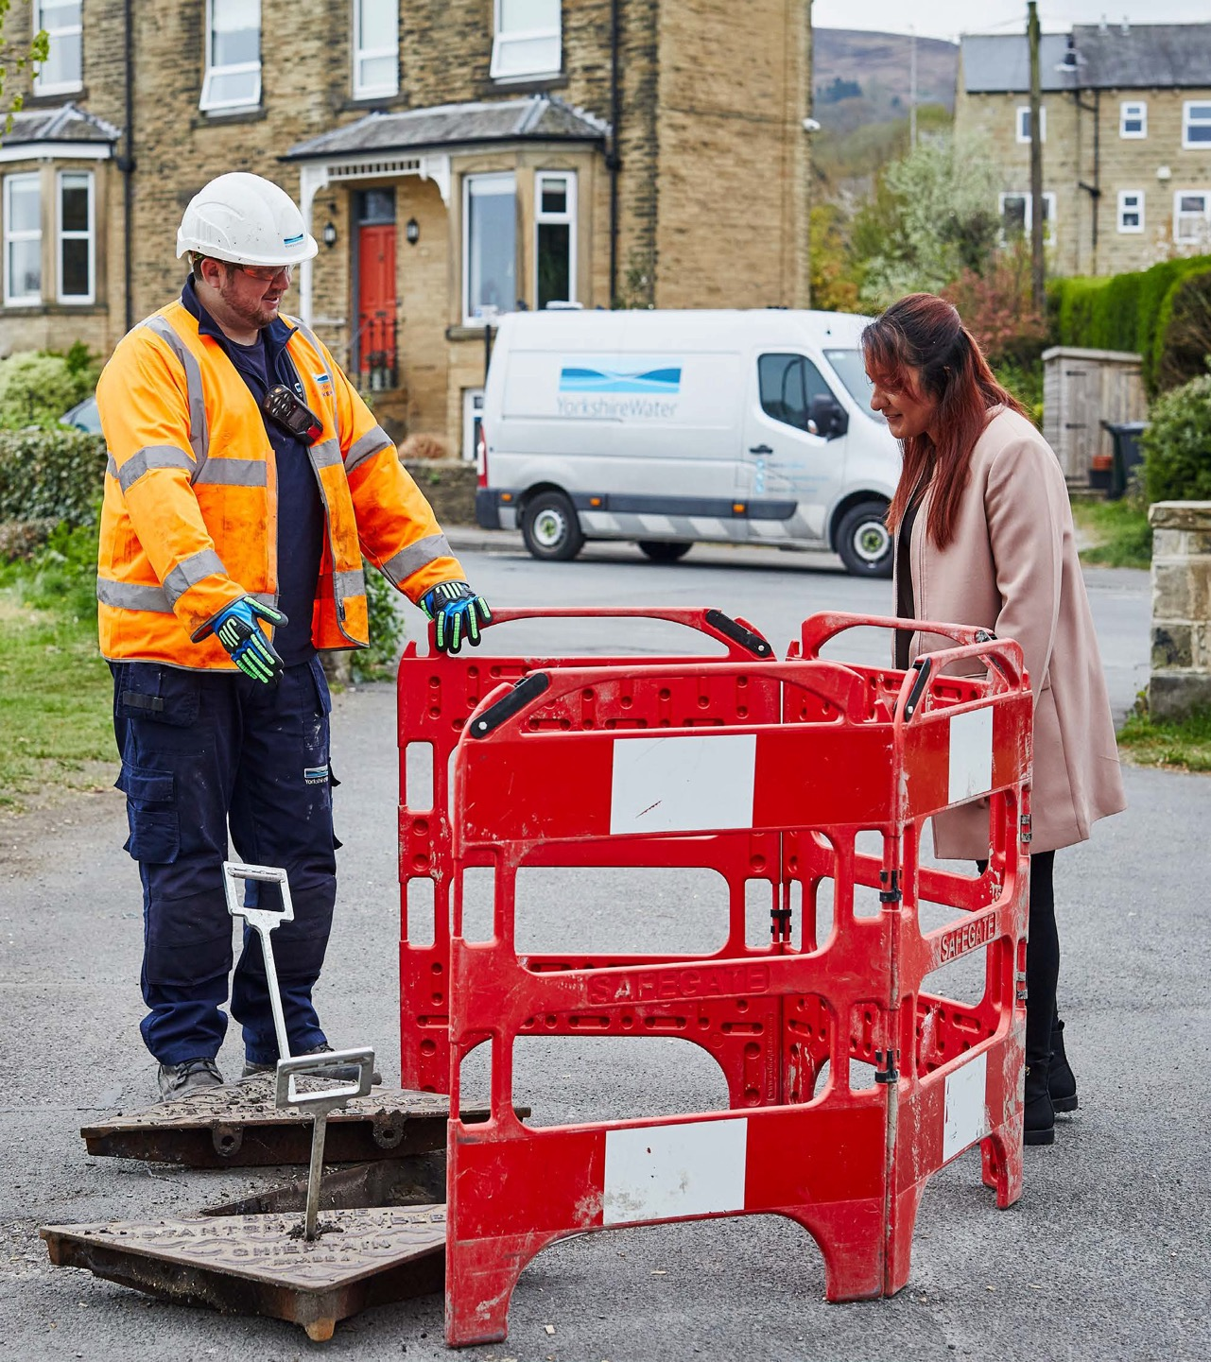
We’ve recruited 1,200 colleagues into the business
Increased our headcount by 16% to help us deliver our largest ever investment
Over half of these are colleagues you might interact with every day – helping us improve our service and performance
Hired 40 new apprentices, 19 new graduates – even more joining in September

Slide 14

Doing right for customers

Slide 15
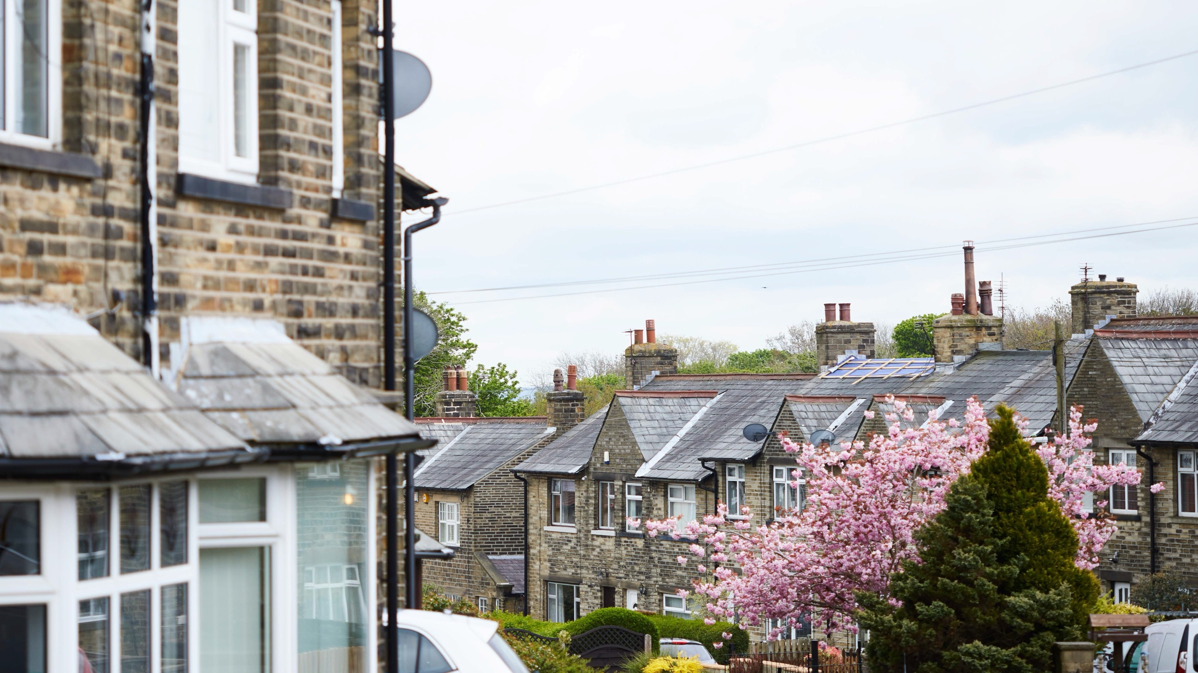


10%
175km
177k
reduction in external sewer incidents
Achieved our target for mains replacement
Achieved our target for smart meter upgrades

Slide 16
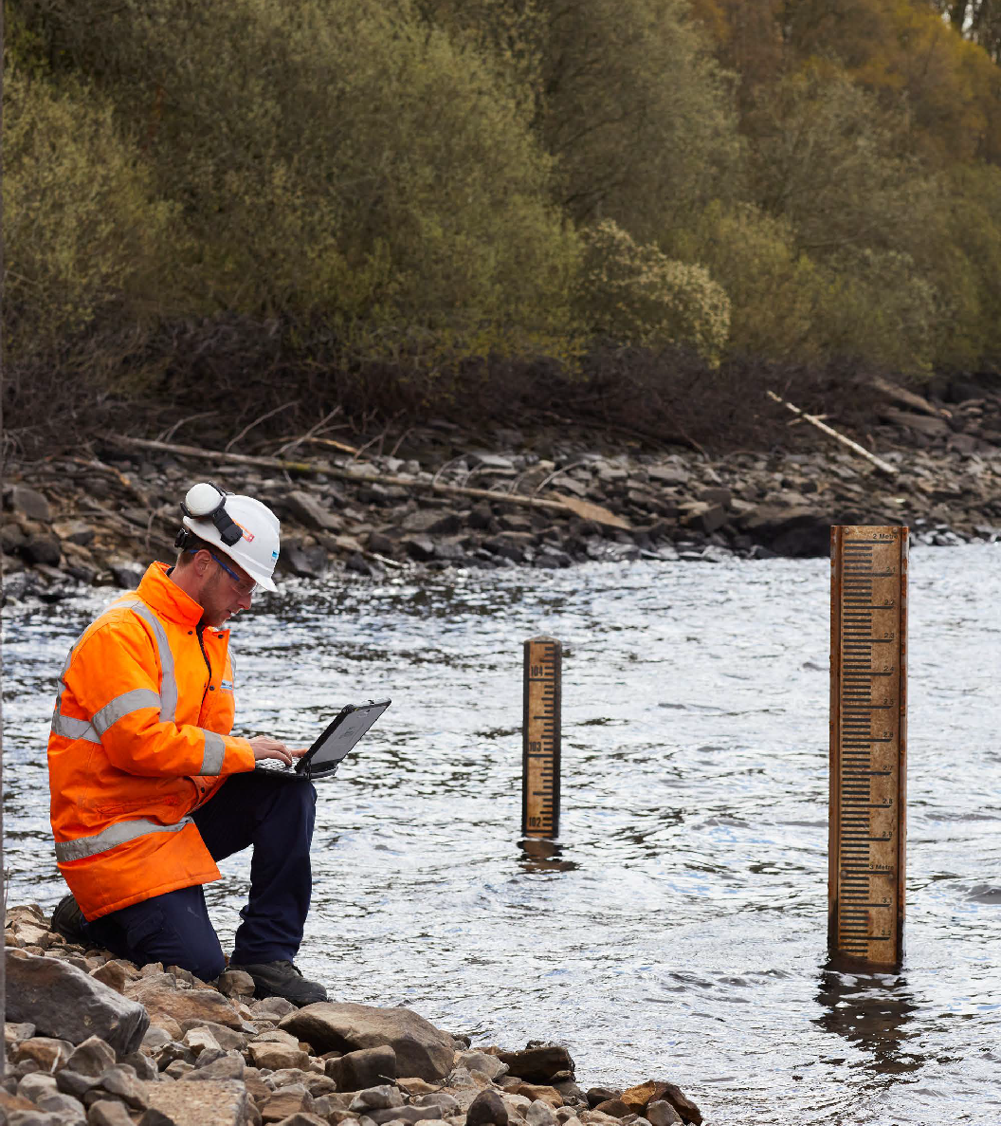
Improvement in water quality - seeing a reduction in contacts from customers
The drought brought challenges to burst water main repairs
However, performance was better than in the 2022 drought

Slide 17

Improving our service for customers
C-MeX score
12/17 companies
Higher bills
Hosepipe restrictions
Working to improve service
£8m invested last year
Additional new frontline colleagues
Improved end-to-end customer journeys
Interventions to recover
Digital service improvements
Self service journey development
WhatsApp service trial
Process and system improvements

Slide 18



We’ve helped an additional 55,000 customers with their bills over the past year.
We’ve supported 246,000 customers with £70m worth of bill support.
We’ve added an additional
80,000 customers to our Priority Services Register.

Slide 19
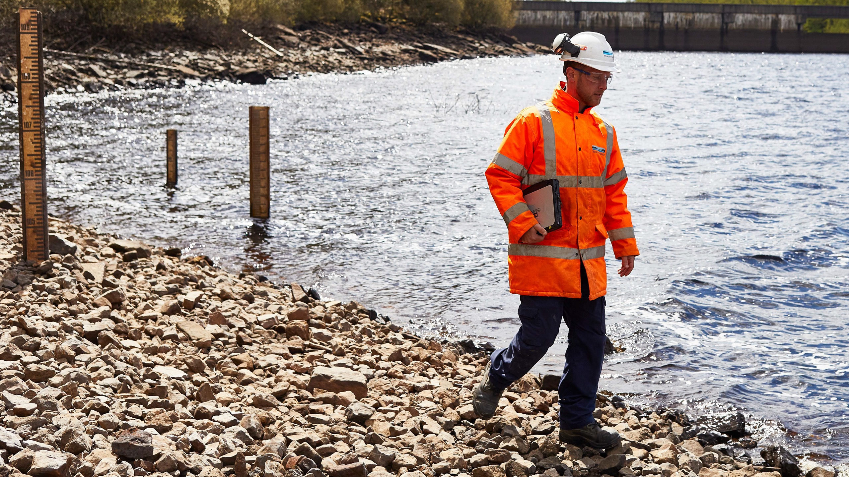
Doing right for the environment

Slide 20
18.5%
1.8
Continuing our excellent performance
reducing leakage
Improved storm overflow performance with 1.8 fewer discharges per storm overflow

Slide 21
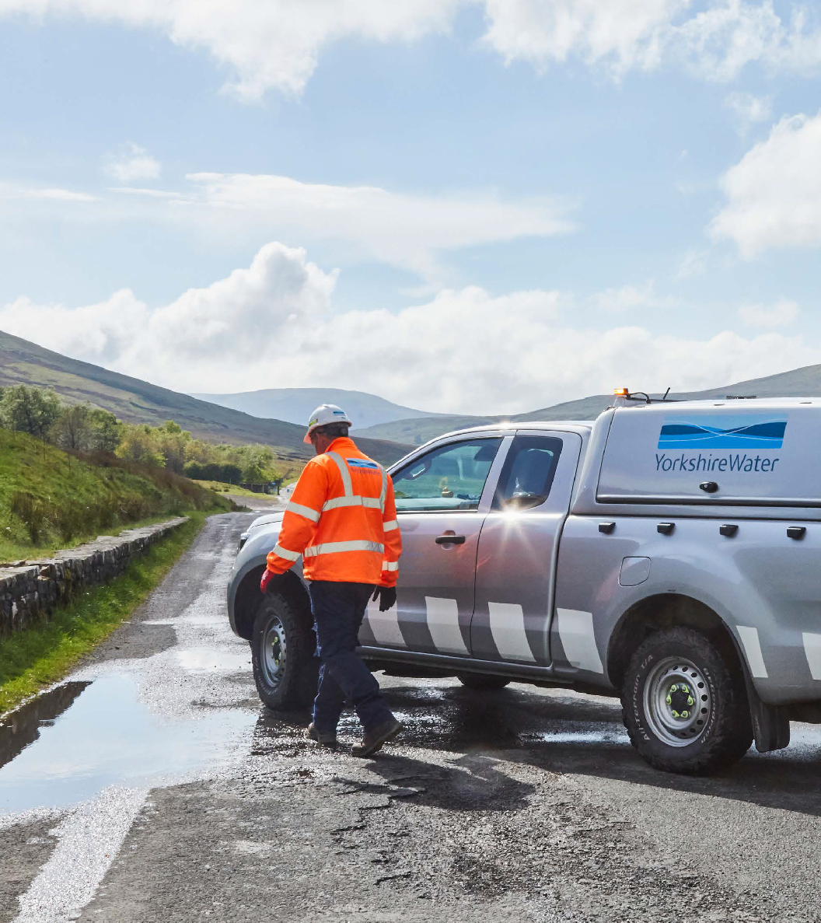
Investing in 450 storm overflows before 2030
Started 18 in Leeds, Barnsley and Sheffield
2026–27 £158m will be spent at 100 different projects
2025 saw an increase in pollution events
Plan in place to drive improvements
Complex investment projects – results will come

Slide 22
What your bill pays for
Every £1 of your bill covers:
7p
23p
Energy
Investing to
This pays for all the energy it takes to clean, supply and take away water from people’s homes and businesses across Yorkshire.
improve our services
This funds our borrowing and returns to investors, so we can deliver the level of service you expect.
Here’s what an average bill is in Yorkshire –
£636 – that’s 5.6% up on last year.
Just remember, bills vary due to lots of different circumstances, e.g. if you have a meter or not.
6p
17p
Taxes
and licences
This is the amount we pay on things like VAT and licences that we need to deliver our services.
Investing
in Yorkshire
Investing in our infrastructure and processes to deliver
a better service for you and to protect Yorkshire’s environment for the future.
36p
11p
Running
our business
Keeping
everything flowing
Yorkshire’s a big place, so there’s a huge network to look after, including all the pipes, reservoirs and pumping stations.
There are over 4,000 people at Yorkshire Water, working hard to keep water flowing every day for our 5.5 million customers.

Slide 23
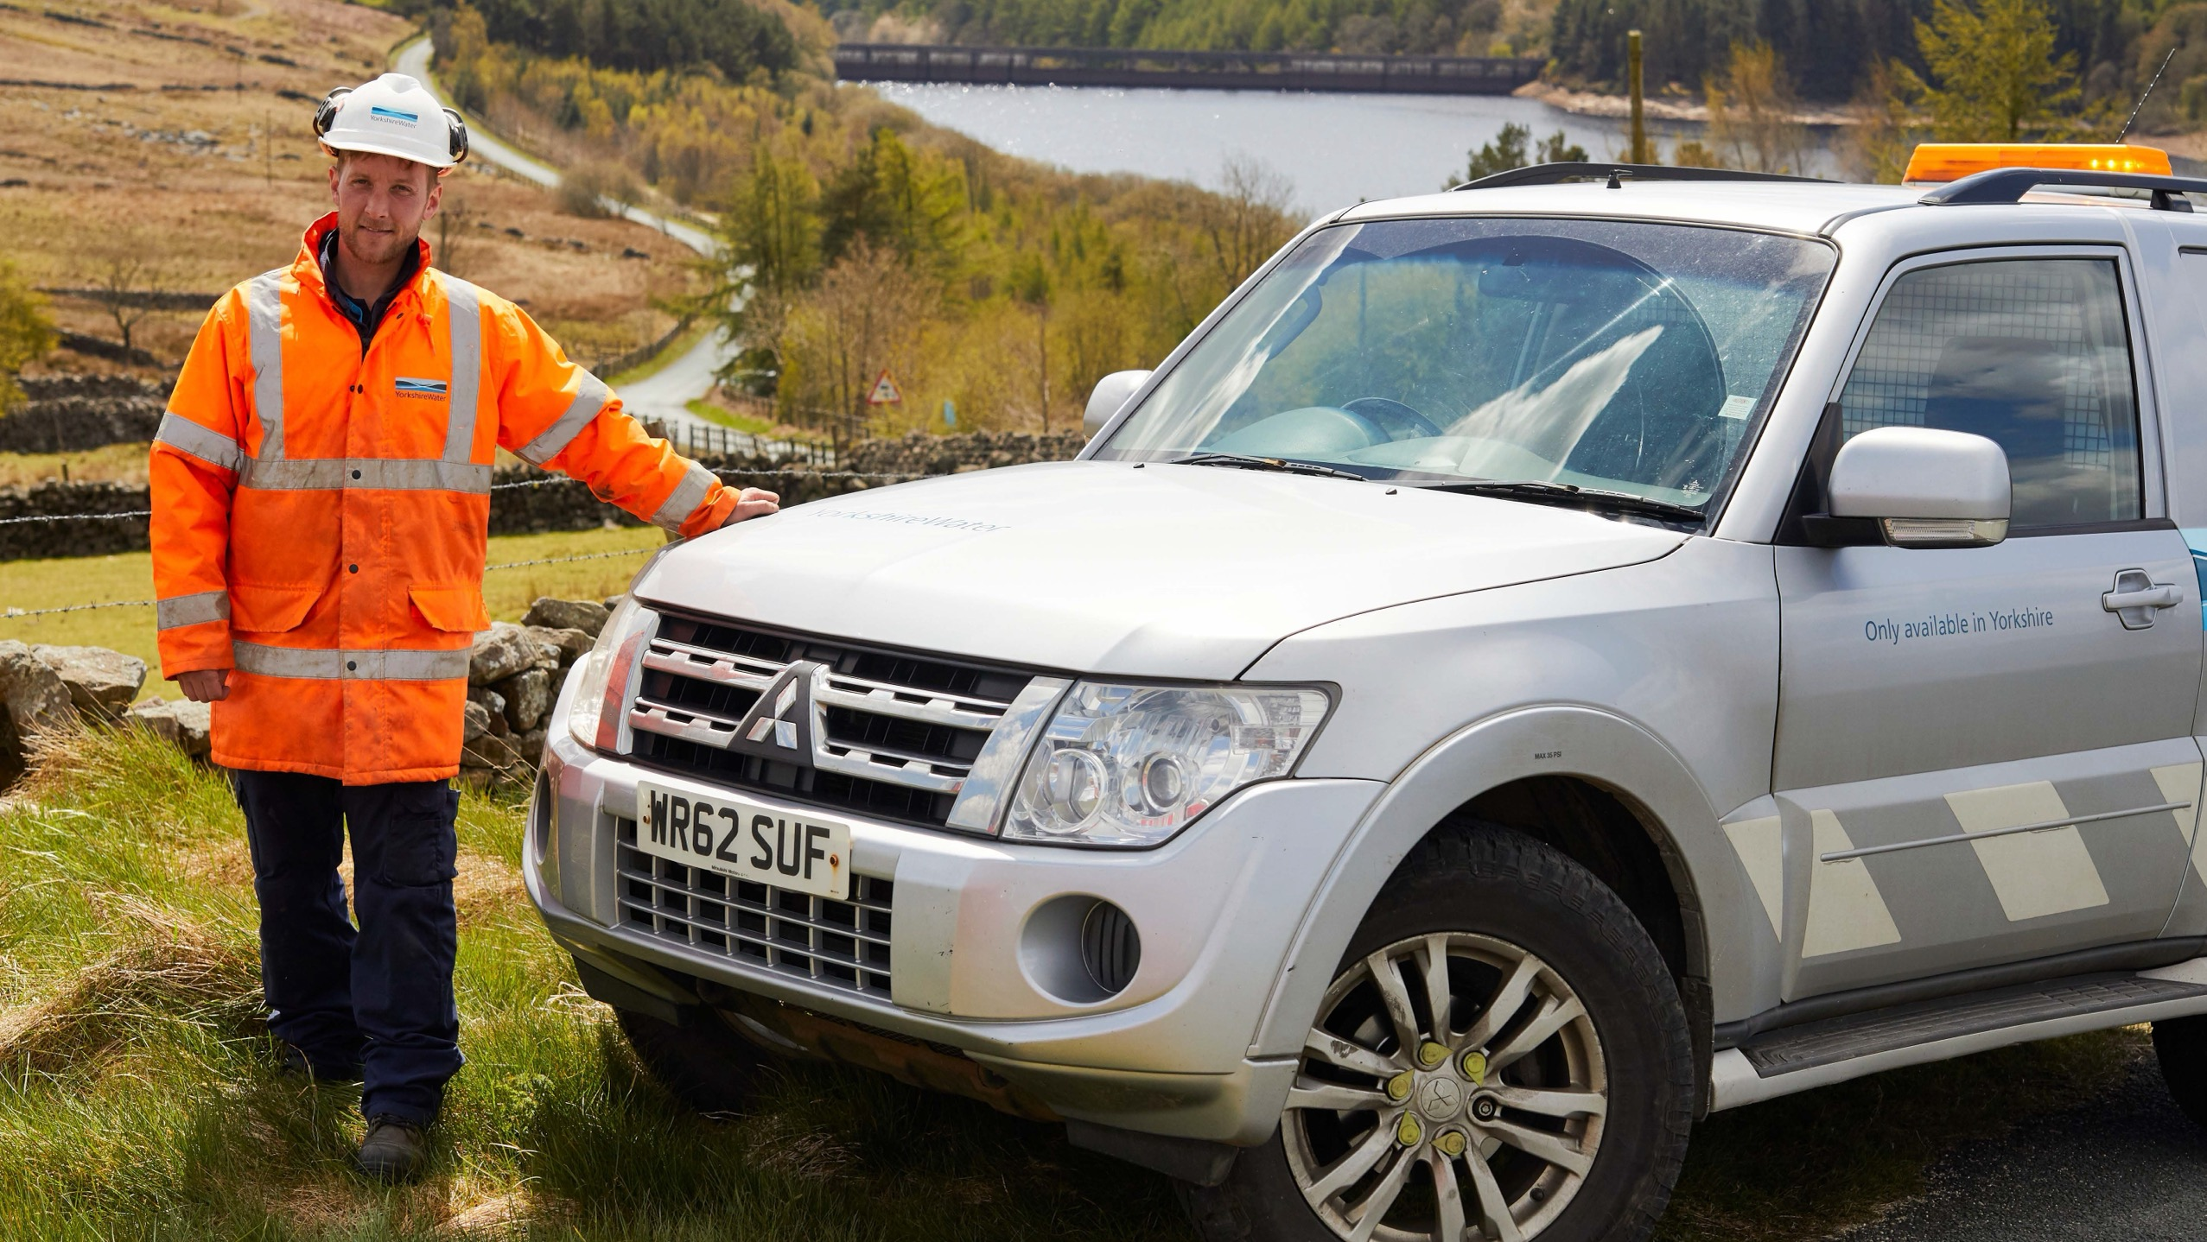
Now for your questions

Slide 24
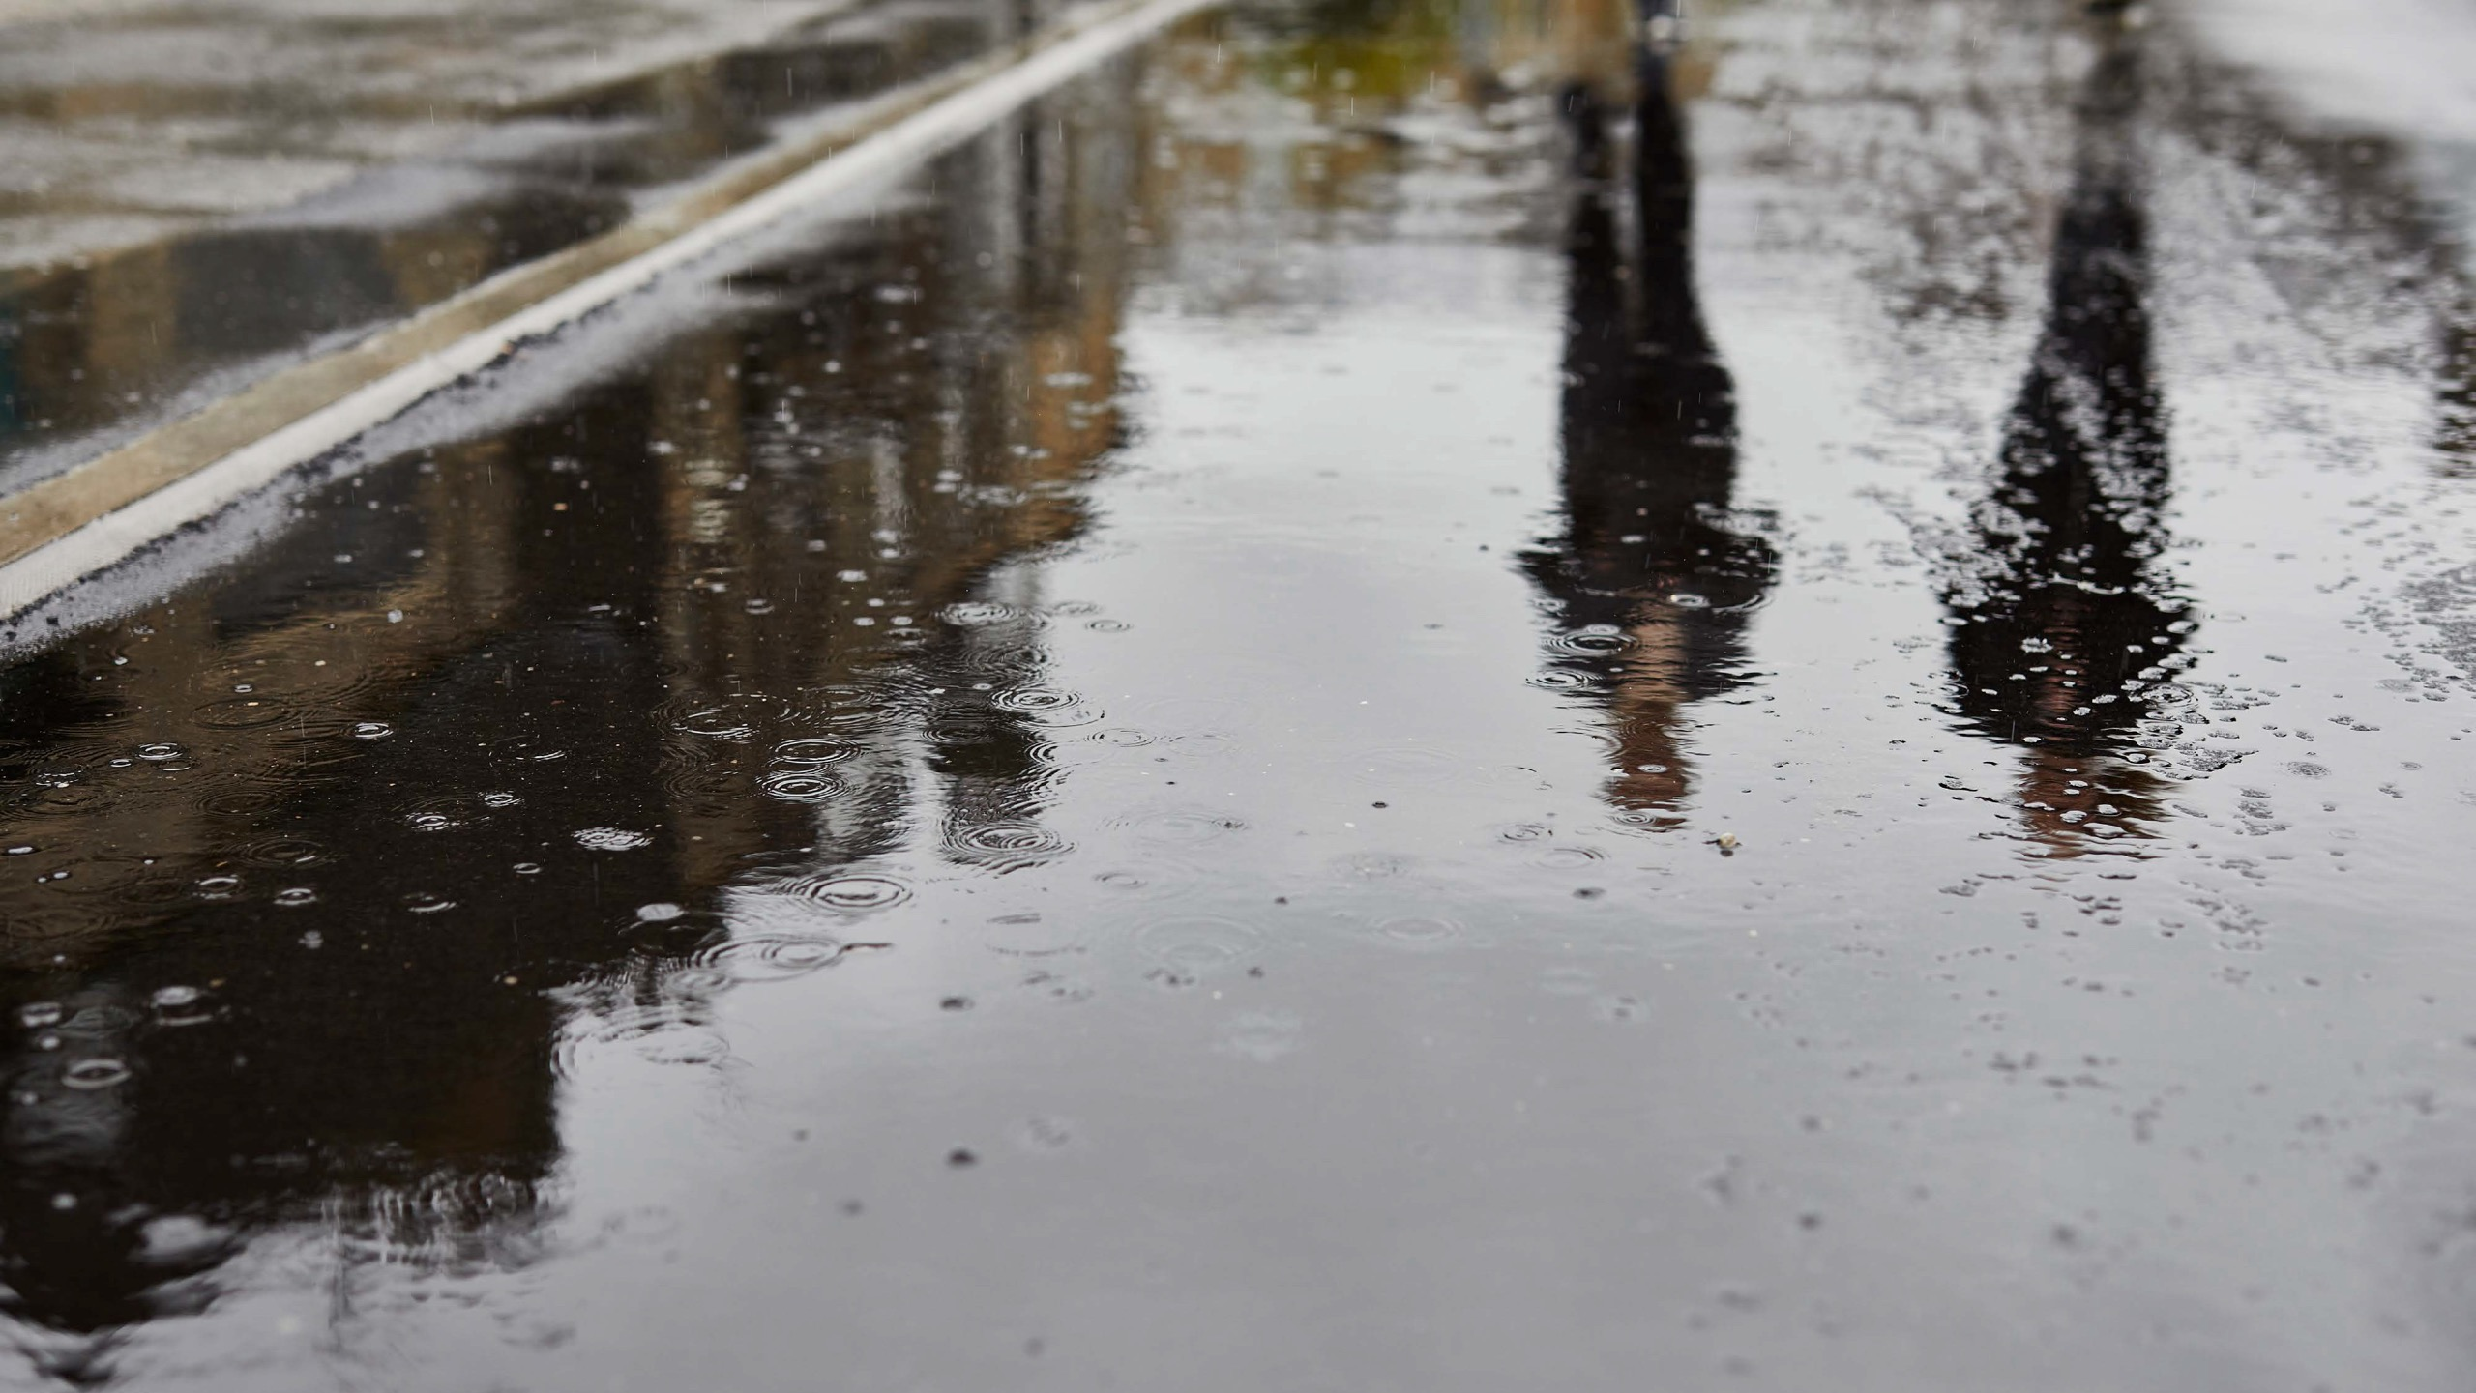
Thank you for your time.
If you have any further questions, please email us:
yourwateryoursay@yorkshirewater.co.uk

Slide 25


Slide 26
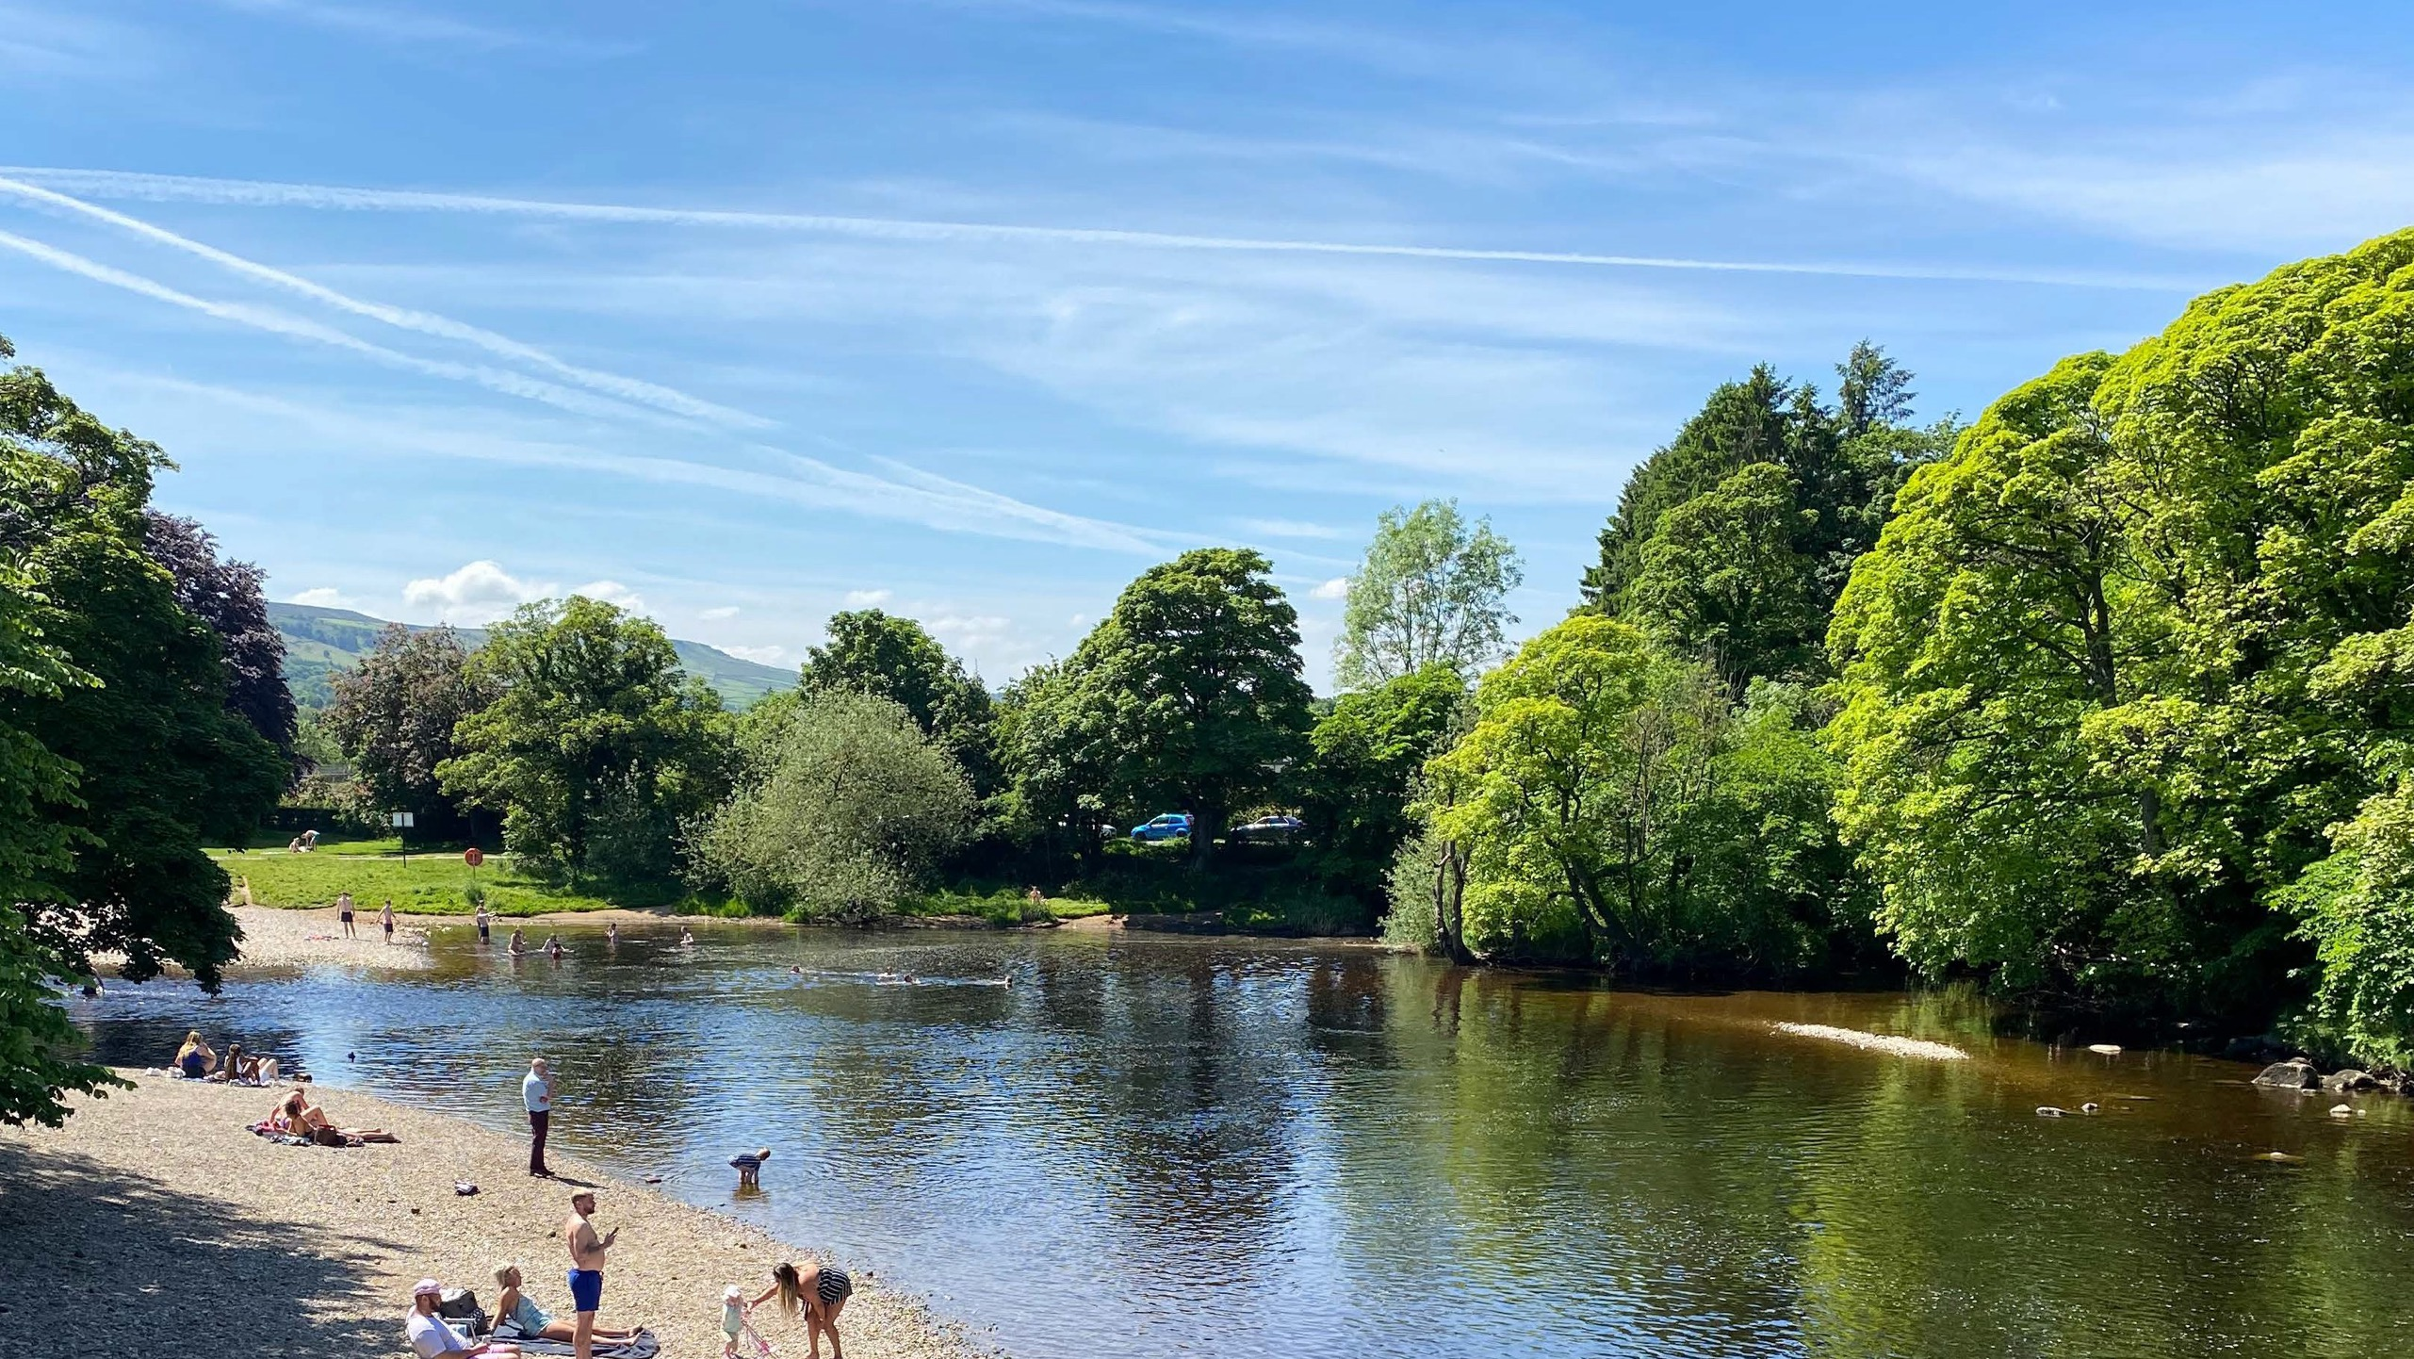
Investing in inland bathing water sites
£60m
On to the last phase of our
£60m investment in Ilkley
Creation of integrated wetland

Slide 27
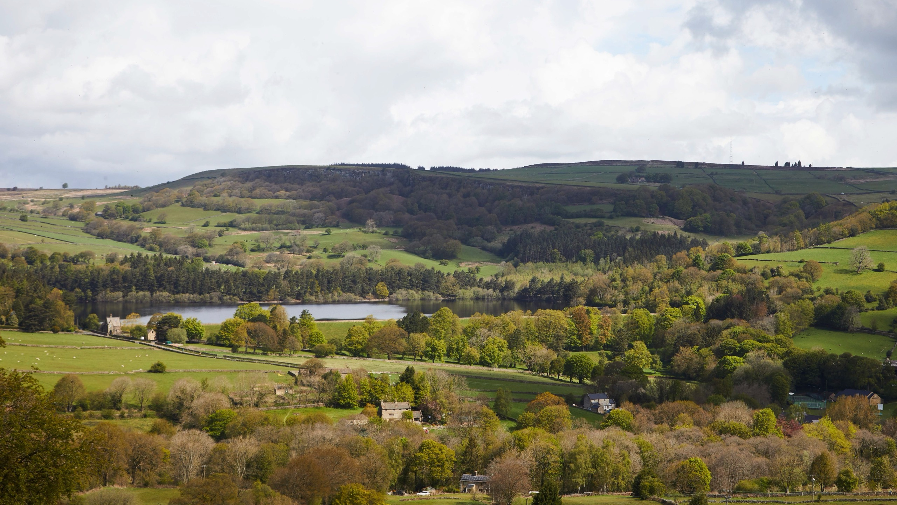
Investing in Yorkshire

Slide 28

How we’re delivering our programme
89%
23%
of our five-year programme is already in the design stage, with over 1,500 projects either being designed, built or completed
of our projects are already onsite being delivered

Slide 29
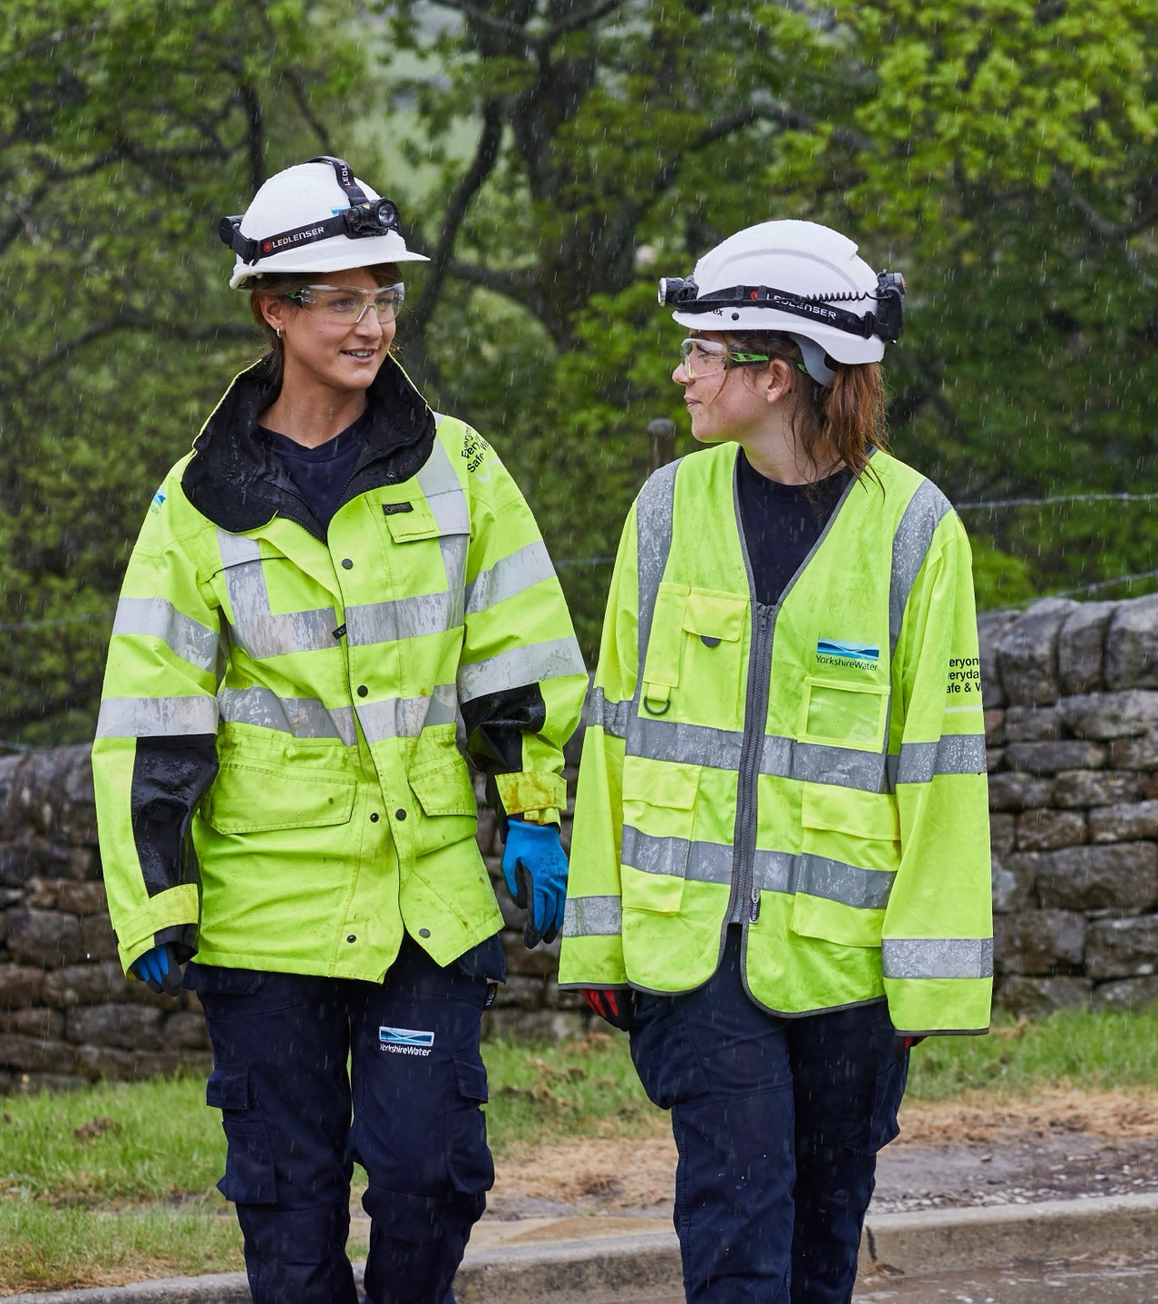
We hired 40 new
apprentices
and 19 new graduates

Slide 30

We’ve recruited 1,234 new colleagues into the business
to help deliver our largest ever investment programme, increasing our headcount
by 16%.
Over half of these roles are frontline, so we can focus on providing a better experience for customers and improve our performance.

Slide 31
We hired 40 new
apprentices
and 19 new graduates

Slide 32
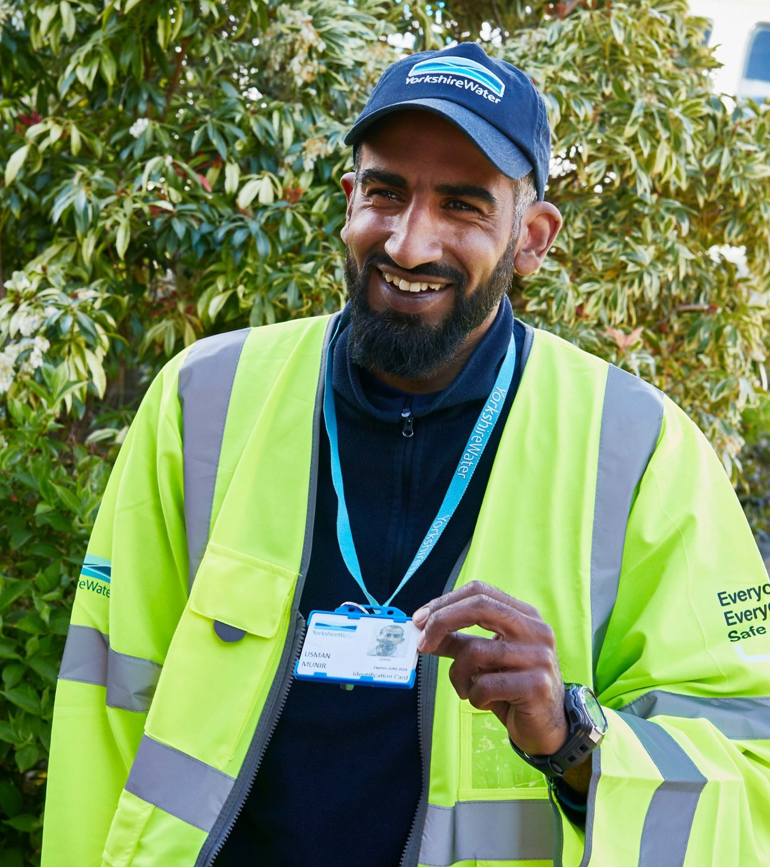
We’re out and about talking to customers about their bills and the investment we’re making in their area.

