Slide 1
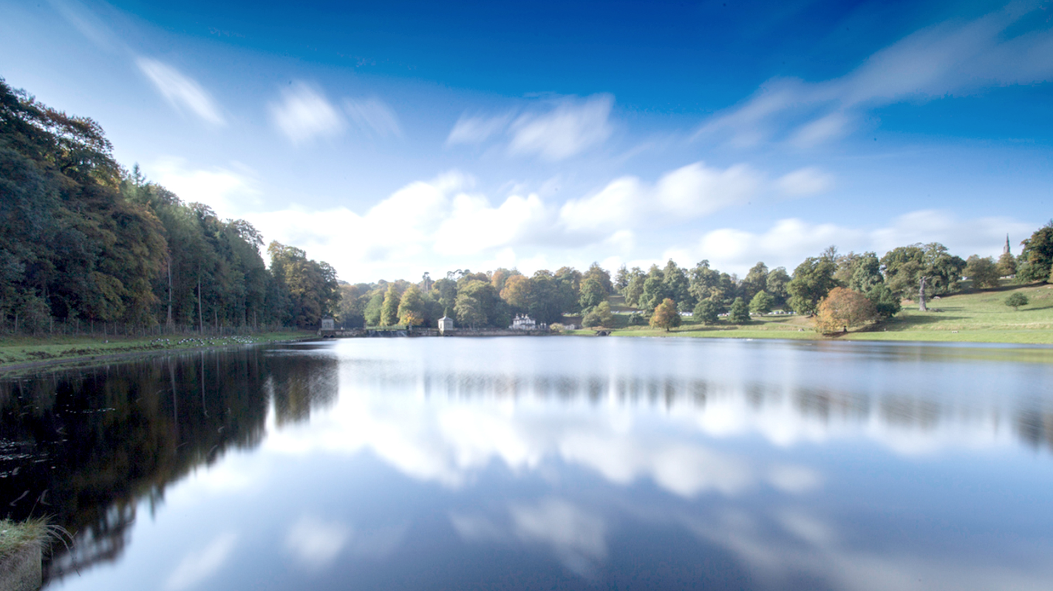
Yorkshire Water Pre-task for discussion group
August 2023

Slide 2
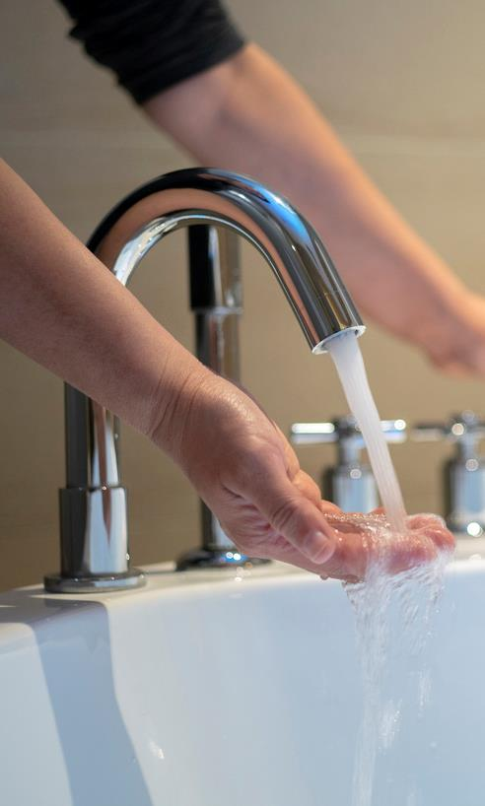
Pre-task Information
Your task
Thank you for agreeing to take part in this study for Yorkshire Water. Your thoughts and feedback are highly valued and we appreciate your input.
The research is about Yorkshire Water's business plan for the coming five years. We will share the plan with you as part of the group discussion, but before then we just have some information about the plan that we would like you to consider.
Please read the information on the following pages and consider the below questions. The information has been split across three pages. Please read the first page and think about the questions, before moving onto the next couple of slides to do the same again.
As there is quite a bit of information to digest, we suggest you make a few notes about what you think as you go through. You don't need to share this with us before the group, but we will be asking some questions relating to this so it might be useful to have any notes you make to hand.
For each page, consider the following:
What is your initial reaction to the information provided?
Is there anything here that surprises you? Is any of it new to you - if so, what?
Based on what you have read, how do you feel about Yorkshire Water and the process they've been through for developing their plan?

Slide 3
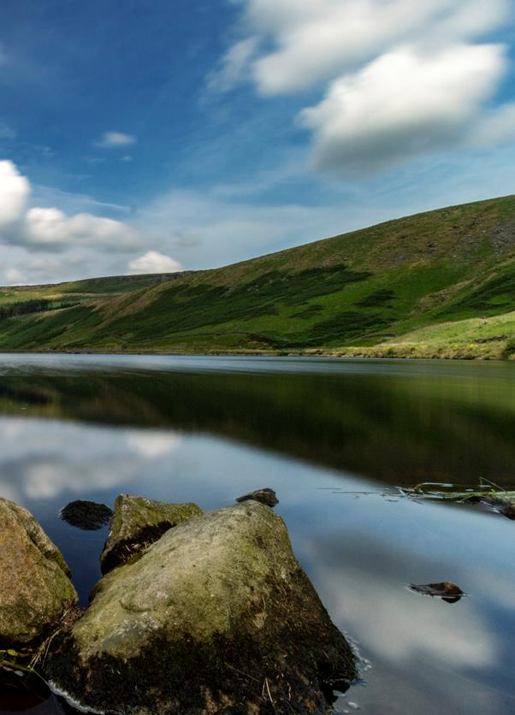
Headers – 24pt – 2 lines max
The price review
The Price Review:
Every five years, water companies develop a ‘business plan’ that sets out their ambition for the services they provide, including the proposed cost to customers. Yorkshire Water is currently working on their 2025-2030 plan. Final plans and prices are finalised by Ofwat. Yorkshire Water must show Ofwat that our plan reflects what customers want.
How we engaged:
Yorkshire Water have had 45,000 quality conversations/ consultations with customers over the past three years. This involved focus groups, surveys, door-to-door surveys and even sitting down with some of our most vulnerable customers in their homes.
Please consider this information and then answer the questions on page 2

Slide 4
Headers – 24pt – 2 lines max
Our performance
Our performance:
While our performance has continued to improve, we understand that in some areas it isn’t where it needs to be. In 2021/22 we met 25 of our 44 performance commitments, failing in important commitments such as internal sewer flooding, pollution and the length of time customers are without water due to an unplanned disruption.
The last few years have proven to be much tougher than we expected. Initially we were slowed down by the pandemic and the challenges of increasingly volatile weather patterns, including Storm Arwen, the highest temperatures and worst drought in 15 years in 2022. However, we did excel in other priority areas including achieving our leakage targets, external sewer flooding and mains repairs.
Storm overflows:
We know water companies have featured in the media a lot recently, often in relation to the use of storm overflow spills into rivers. Storm overflows are designed to stop our customers’ properties and outdoor spaces from being flooded with sewage when heavy rain fills the system. However, population growth and changing weather patterns mean these are being used more often, and we know this is no longer acceptable.
To address this, Yorkshire Water shareholders have committed £100m to reduce spills to the environment from storm overflows. This is on top of investment Yorkshire Water has already committed to storm overflows by 2025.
Just so you know, when we fail to deliver the service we promised, a penalty is triggered in the form of a refund to customers. For internal sewer flooding alone, a penalty of £9.5 million was triggered - customers received a refund of £3.31 in their annual bill for 2022/23.
Please consider this information and then answer the questions on page 2

Slide 5
Headers – 24pt – 2 lines max
Drivers of the plan/prioritisation
Statutory Drivers of our plan:
This business plan cycle is very different to past cycles. This is because Yorkshire Water and every water and wastewater company, must deliver the biggest ever environmental programme of work - this has been mandated by the government.
This focuses on the need to protect our environment for the long-term by not taking too much water from the environment and it means we will need to change how we manage our water and improve the quality of the water we put back into the environment. The extent of this is vast, but we know this aligns with our customers’ priorities. Meeting this programme of work is going to cost £1.7 billion.
As well as this, from 2025-2030 Yorkshire Water and every other wastewater company must significantly reduce the use of storm overflows by law. This is especially expensive in the Yorkshire region due to our Victorian heritage; we have more overflows than many other wastewater companies. Meeting these obligations is going to cost £700 million from 2025-2030.
In addition to this, customers supported us bringing forward our programme of work to tackle the reduction of storm overflows used on the coast from 2030-2035 to this five-year planning period (2025-2030). Addressing these additional coastal storm overflows will cost £300 million.
Why we can’t do it all:
Whilst we’d love to ensure we never fail, with the creation and delivery of 1.2bn litres of safe clean drinking water to over 5 million customers and businesses and the capturing of and treating of 1 billion litres of litres of wastewater every day, there is an endless to-do list and one that we work hard on every single day. Achieving zero failures is impossible with the technology available today and would be prohibitively expensive for our customers. This is why we continue to innovate and will always strive to make improvements year on year despite the challenges posed by climate change and population growth.
Please consider this information and then answer the questions on page 2

