Slide 1
SHOWCARD 1

Slide 2
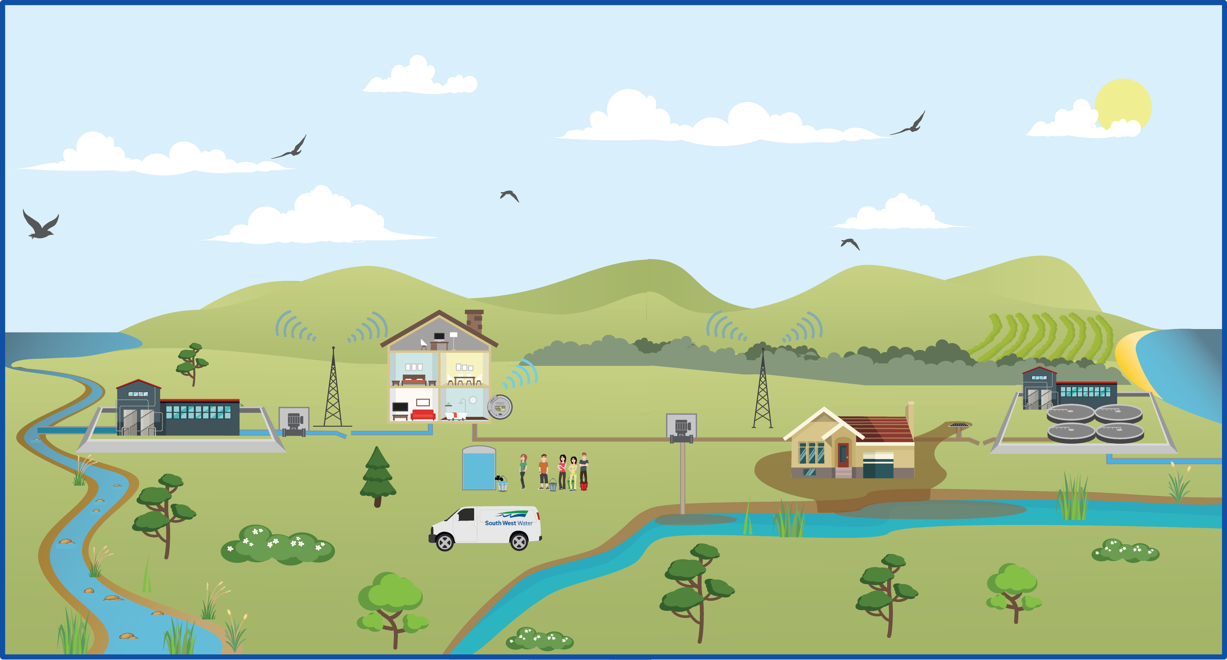
1
Notes:
Water is taken from the water environment – this is called abstraction. Most water is abstracted from rivers – rivers are used to fill reservoirs (mostly when its wet in winter), and water is then taken from the reservoir through the year. Some water is also taken from underground “the water table”. This is around 10% of water only. In times of hot dry weather rivers and reservoirs can become low – which can harm wildlife.
How drinking water looks and tastes can be affected by the quality of water in the environment. Some deposits found in rivers can make water discoloured or have an earthy or musty taste. Hard water is water that comes from ground sources (as it passes through rocks it absorbs minerals from the rocks).
Water companies work with farmers to maintain untreated water quality – if fertilisers and slurry gets into water it can make it unpleasant to drink – and in extreme cases not able to be used anymore for drinking.

Slide 3
2
Notes:
Water is treated in water treatment works. The standards in the UK are very high – amongst the highest in the world.
The quality of water is tested as it leaves works, and through the system and at customers taps. Hundreds of thousands of samples are taken each year. These are tested in laboratories.
If there is any doubt about whether water is okay to drink – customers will be asked to boil water before drinking it (they are told about this on the doorstep, through social media, adverts and phone calls). This is precautionary only.

Slide 4
3
Notes:
The network of water pipes is huge.
Pipes can start to leak or burst. The water is heavily pressurised in the pipe – this is in order to ensure water is kept clean (the pressure stops dirt and germs from getting into pipes that have cracks).
Bursts result in supply interruptions and leakage. Water companies will provide alternative water when there are interruptions – with vulnerable customers given first priority.
Once a burst is fixed there are often issues with deposits in the mains being stirred up – this can cause brown water, which needs to be run off.
Most of the time customers phone water companies to say their water is off or to report leaks – telemetry to auto-detect this is in its infancy.

Slide 5
4
Notes:
Increasingly houses are metered. This means you pay for the water you use. The price you pay (whether metered or not) is regulated by Ofwat.
At the moment meters are read by a meter reader – who comes to the house to read the meter. Smart meters are in their infancy – but allow meters to be read automatically, and for people to review their bills and consumption online to help manage water use. Water companies offer devices in the home to reduce water use – such as shower heads, water butts.
Homes may ring water companies to report issues – such as report a leak or a blockage. Call centres are based in the UK.

Slide 6
5
Notes:
Waste water is taken through sewers. Rain is also taken through sewers. Sometimes this means there is too much for the sewers to cope with. Overflow pipes take the excess and put into a local river or the sea. It’s heavily diluted, but can contain toilet paper, sanitary products, etc – which is unpleasant.
These overflow pipes are legal – but should only be used due to increased flows associated with rainfall events. The only way to get rid of these is to build storage or make sewers larger. Or to stop rainwater going into sewers in the first place; for example by diverting water away from the sewers.

Slide 7
6
Notes:
When there is heavy rain or when people put stuff down sewers that does not belong (e.g. nappies, wet wipes, fats and oils), sewers can spill and go into houses and gardens or rivers. If it enters a river it is called pollution; if not it is called sewer flooding.
Sewer flooding can cause a lot of damage – those with sewage inside the house may have to leave whilst the house dries and is repaired.

Slide 8
7
Notes:
Waste water is taken to treatment works to be treated.
This involves taking the water out of the waste – to put back into the river or sea. The water returned to the sea has to meet very strict standards. Meeting even higher standards can improve the quality of rivers and coastal waters.
The waste that is left – called sludge – has to be disposed off. This as much as possible should have a beneficial use, such as being used to produce renewable energy or for fertiliser. Any that is left is send to landfill – water companies look to avoid that.

