Slide 1
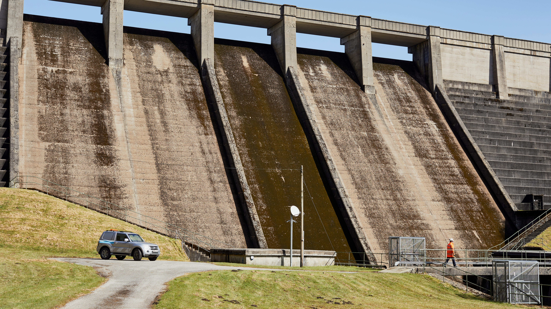
A bit about Yorkshire Water & the Water Industry
Notes:
Tip: This slide is to be used an intro slide. Keeping the header short and sweet will make sure it doesn’t become difficult to read.

Slide 2
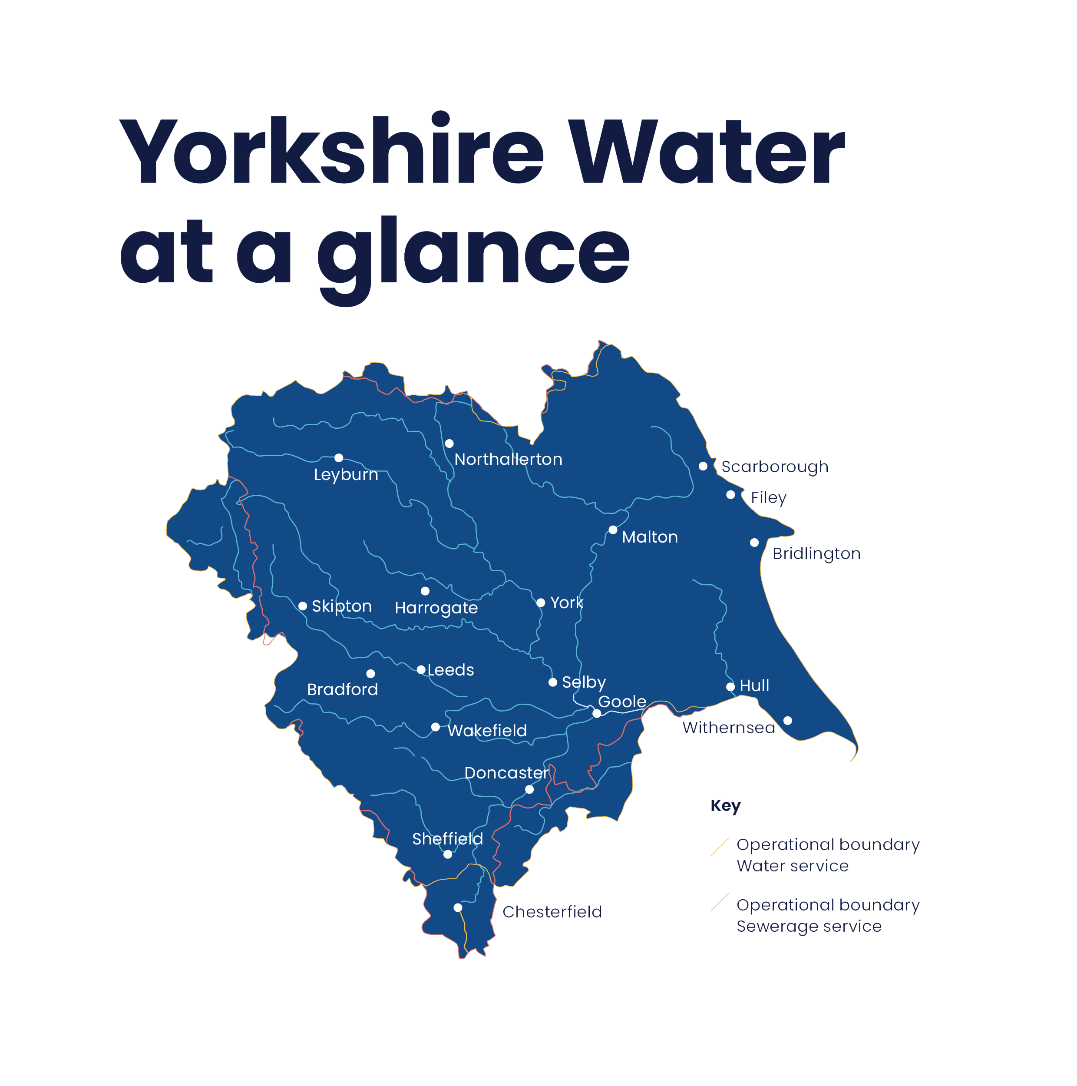
Established in 1989
Supply fresh water & treats sewerage
Cover the entire Yorkshire Region and parts of Derbyshire
Serve 5.4 Million customers and all those who visit Yorkshire
Serve around 140,000 businesses
Water demand is just over 1.29 billion litres a day!
Notes:
Established in 1989
Supply fresh water & treats sewerage
Cover the entire Yorkshire Region and parts of Derbyshire
Serve 5.4 Million customers and all those who visit Yorkshire
Serve around 140,000 businesses
Water demand is just over 1.29 billion litres a day

Slide 3
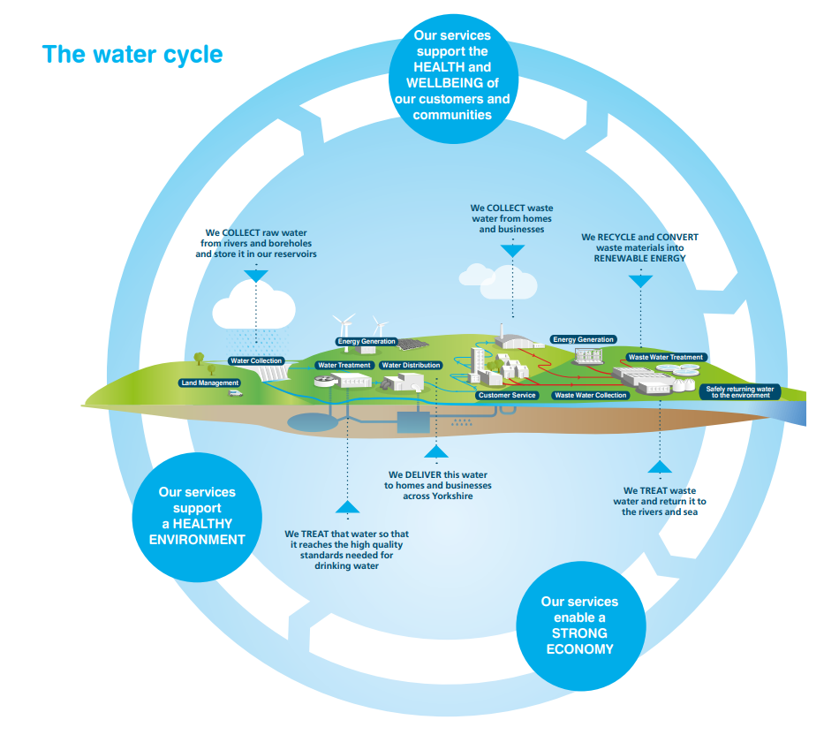
What Yorkshire Water does
Collect raw water from rivers, boreholes to store in our reservoirs,
Treat the water to meet high quality drinking standards,
Deliver water to homes and businesses
Collect wastewater from homes and business,
Recycle and convert waste materials into renewable energy, and,
Treat waste and return it to the rivers and seas.

Slide 4
Yorkshire Water is regulated
Ensure YW provides required service levels at a fair price
…and these are just a few examples of many…
Notes:
The Water industry is regulated by a number of organisations – a few examples include
ofwat – they aim to ensure that water companies are providing the right service levels at a fair price.
Ccw – Consumer Council for water - who are the voice of water consumers. They help out people like yourselves, and businesses, if you have a problem and your water company cannot resolve it sufficiently they will support and advise
DWI – Drinking water inspectorate – provide independent reassurance that the water is safe
And Environment Agency – a govn. Dept. who’s main aim is to protect the environment

Slide 5
Business Planning
&
Price Setting
5
years
Water ​companies go through ​a process of business ​planning
(known as a Price Review)
Performance over the last 5 years is reviewed
Priorities and investments are planned for the next 5 years and beyond
PerformanceMeasures
What Customers think
Water Industry developments and future needs
Water Industry targets
Notes:
Every 5 years water companies complete business planning. This involves reviewing past performance, and planning priorities and areas for investment for the next 5 years and beyond
Ofwat reviews this and based on the plans proposed by water companies either approves or challenges any changes to customer’s water bills and the service levels they receive in return for their bills
As you can probably imagine, this is a critical and complex task – ensuring that Yorkshire Water invest in the right areas, the areas that make a difference to all the people served and to Yorkshire as a whole
To do this YW look into a lot of areas – reviewing performance metrics, performance vs current industry targets and likely future targets, developments within the water industry AND critically speaking with customers, like yourselves, YW makes it a priority to listen and understand what you think. Which is why we are here this evening. What we have been discussing so far, and this section of the session that we are about to launch into feeds into this planning and will help guide YW on their performance priorities for the future.

Slide 6
Yorkshire Water Challenges
Increasing customer expectation
Increasing energy
costs
Climate Change
Squeezed household budgets
Population Growth
Digitisation
Technology advancements
Protecting the Environment
Changing Political Landscape
Achieving Net Zero by 2030
Increased reliance on customers to do their bit
Changing legislation
Shifting usage patterns (move to WFH to Hybrid, business closures)
Increased home usage due to time spent at home and behavioural changes, more time in paddling pools etc.
Squeezed household budgets
Maintaining service levels whilst protecting staff and customers (PPE, sanitizer, WFH)
Employment Skills gap
Covid-19:

