Slide 1
Acceptability & affordability research

Slide 2
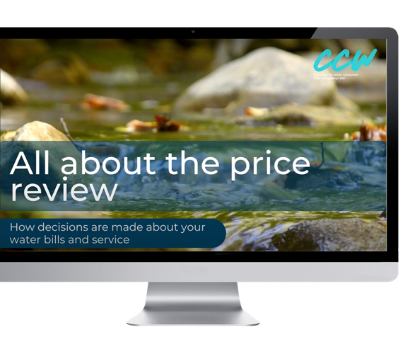
“
Every five years, water companies develop a ‘business plan’ that sets out how they want to develop their services, and the proposed cost to customers. As customers are not able to choose their water company, water companies must give them a say about what they want from their services and the price they pay. Talking to customers also helps water companies prioritise what to do first or what to do most of – because they are not able to fund everything they would like to do or do all of the things that customers might want them to do.
The business plan and prices are then finalised by Ofwat in a process known as the Price Review.
There is more information about this here: ‘All about the price review’.
Available at: www.youtube.com/ watch?v=OWmivC93AF8
One of the ways that people have their say is through this research, which will explain what the plans are for where you live, and ask what you think – whether the plans are ‘acceptable’ to you and whether you can afford the proposed bills from 2025–2030.
Companies also have to show to Ofwat that their plans reflect what their customers want – that means refining the plans based on what customers tell them.
“

Slide 3
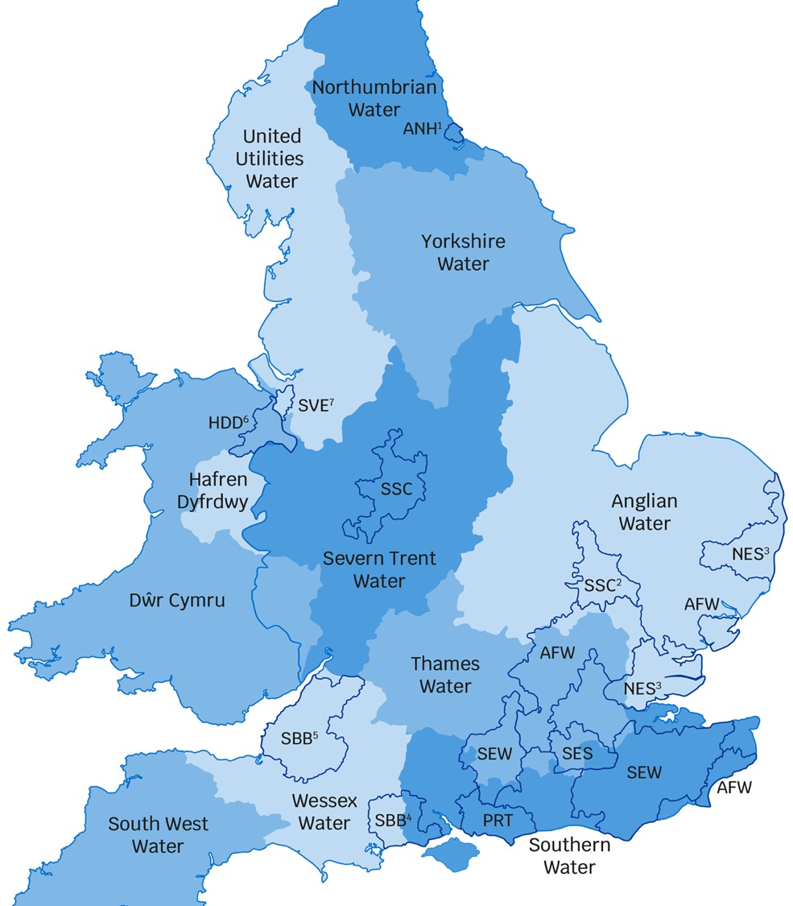
16
water companies in total
Water & wastewater companies
ANH: Anglian Water
WSH: Dwr Cymru
HDD: Hafren Dyfrdwy
NES: Northumbrian Water
SVE: Severn Trent Water
SBB: South West Water
SRN: Southern Water
TMS: Thames Water
UUW: United Utilities Water
WSX: Wessex Water
YKY: Yorkshire Water
Water only companies
AFW: Affinity Water
PRT: Portsmouth Water
SEW: South East Water
SSC: South Staffs Water
SES: SES Water
Key
1. Water services provided under the Hartlepool Water name.
2. Water services provided under the Cambridge Water name.
3. Water services provided under the Essex & Suffolk Water name.
4. Water services provided under the Bournemouth Water name.
5. Water services provided under the Bristol Water name.
6. Hafren Dyfrdwy provides water services only in this area.
7. Severn Trent Water provides water services only in this area.
Source: www.ofwat.gov.uk/households/ your-water-company/contact-companies

Slide 4
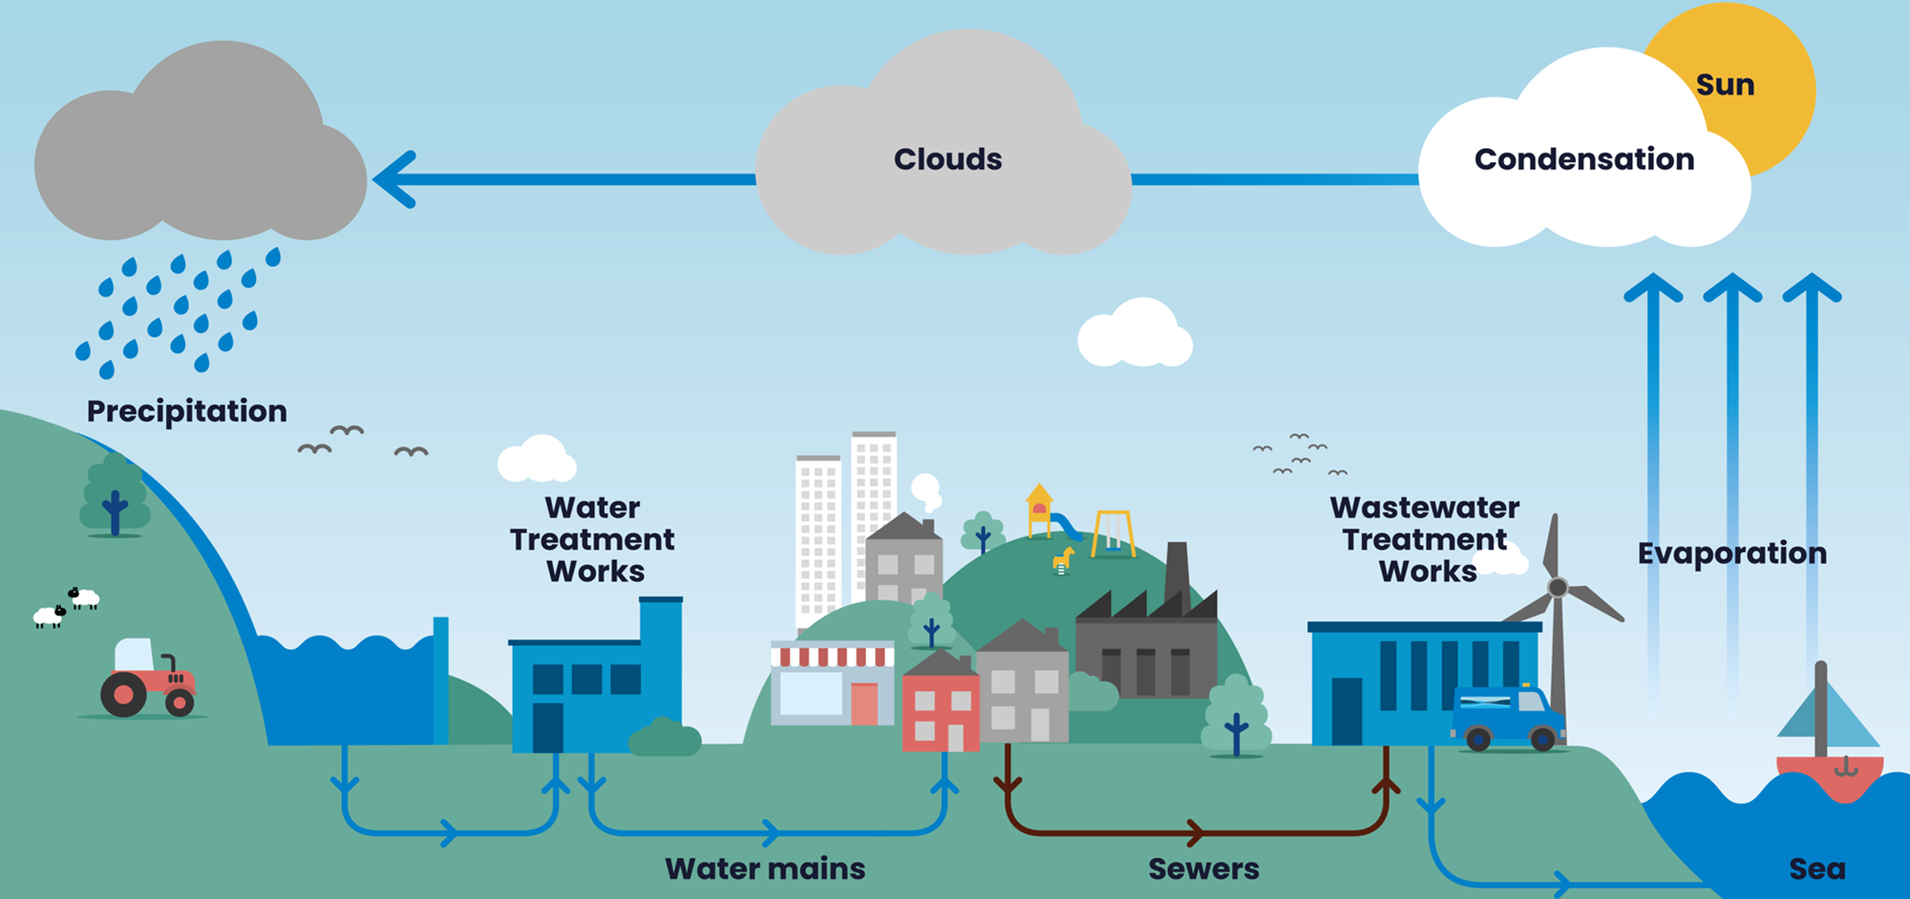
What we do: the water cycle & the role of Yorkshire Water

Slide 5
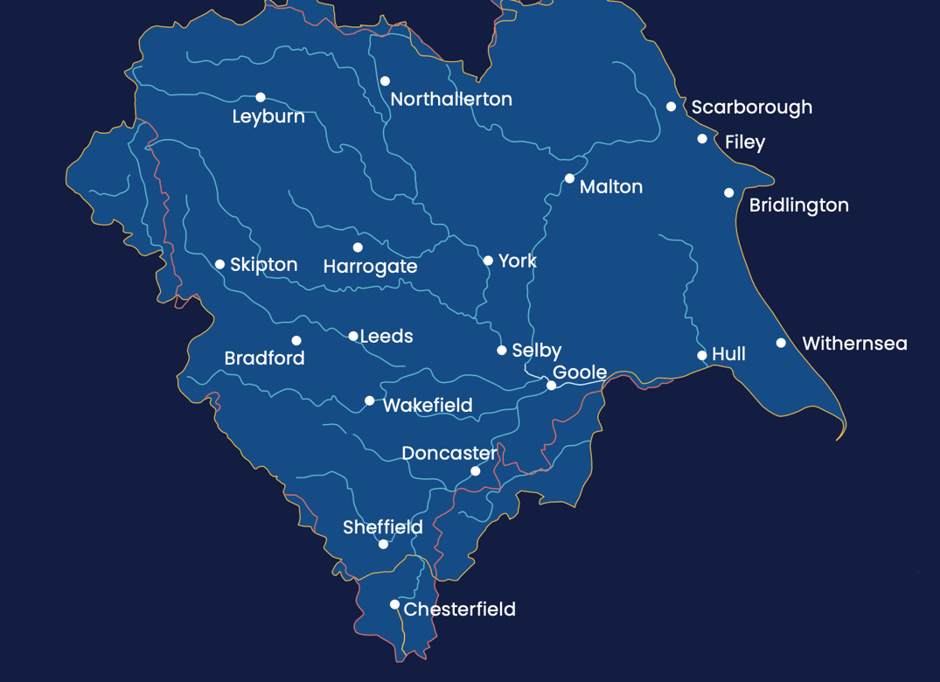
What Yorkshire Water do...
Provide water and waste water services to over 5 million people within 2.3 million homes
Sewerage collection & treatment: collection of wastewater from Yorkshire’s homes, liquid waste from industry, and rainwater that falls on roofs and roads. We treat wastewater and return it safely back to our rivers and coasts.
Investing over £1m every day to maintain and improve Yorkshire’s network of pipes, pumps and treatment works.
Drinking water: we provide 1.24 billion litres of drinking water every single day across Yorkshire.
Education & community: our colleagues volunteer in their local communities, they give talks and educate, they really make a difference locally. We also provide educational programmes for schools focusing on key issues facing the water industry such as water treatment, water conservation and pollution.
Taking care of the environment : As one of Yorkshires biggest landowners, keeping the land well looked after is one of our priorities - a thriving land environment ensures we can continue to provide clean and safe drinking water. We do this in many ways - we restore bogs and habitats, we ensure our operations are sustainable and where possible we generate energy from our processes. We aim to lessen the impact of water supply on climate change and innovate continuously to improve how we operate.

Slide 6
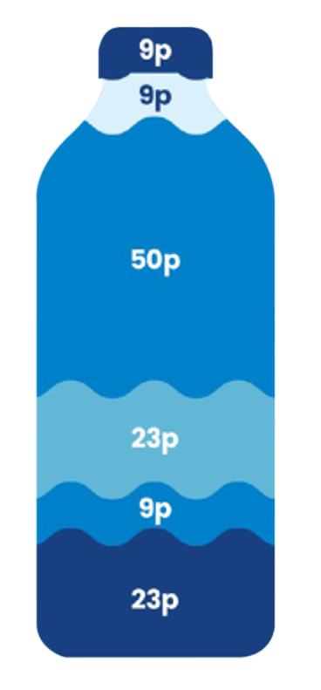
The average household spends £1.23 per day on water and wastewater services, this is how its broken down...
On energy
On taxes and licences
On running our business: people costs, material costs – the things we need to deliver services everyday.
On maintaining our equipment: looking after our pipes, pumping stations and reservoirs
On making improvements: investment in new projects and technology
On investing to improve our services: funding our borrowing debt that allows us money for investment
Notes:
The ‘profit’ sits within the 0.23p that goes on investing to improve our services: funding our borrowing debt that allows us money for investment. It is 5 pence of it, however, its reinvested at the moment.

Slide 7
Long-term direction
2025 – 2030
2045 – 2050
Across each five-year planning period from 2025 to 2050 our goals remain clear, we plan to deliver the following:
More resilient water supply:
Making water resources more resilient to climate change and population. We will do this by increasing our treatment capacity and reducing leaks. We will strive to ensure no environmental harm is caused to the water environment due to the water we abstract.
Enhancing our natural environment:
We will enhance our rivers and coastal waters through improved performance of wastewater management. We will improve the quality of the treated wastewater we return to the environment, we will work hard to reduce pollution and spills in any form, even in periods of bad weather. We will improve designated bathing sites through a programme of wastewater system improvements and monitoring. We will support the water industry climate change ambition of achieving net-zero carbon emissions by 2030. We will work with other land owners who contribute to river and sea water quality to ensure they are limiting their impact on the water environment.
Protecting against flooding:
We will work in partnership with the EA and local authorities to tackle localised flooding in areas where flooding is high risk in very wet weather.
Providing a reliable & affordable service:
We will strive to have a service that customers can rely on 24/7 and to put things right quickly if they go wrong. We will support customers in circumstances which may make them vulnerable through our Priority Services Register by campaigning for vulnerable customers and those who support them to sign-up. Whilst we aim to keep bills low, increases are likely, we will support customers who struggle to afford their bill.

Slide 8
Water companies are currently part way through their five-year business plan for 2020 to 2025. They have service level targets, called ‘performance commitments’, in every five year business plan. These targets are based on what customers have previously told companies they would like them to do, and on Ofwat’s assessment of what companies should deliver. These targets cover a wide range of the different services that water companies provide.
Ofwat monitors water company performance against each performance commitment every year to see if they have met the service level in their business plan. We are now going to show you how well your water and/or sewerage company is doing on some of their performance commitments, compared to other water companies in England & Wales.
These performance commitments are a snapshot out of the wide range of services companies provide. We are showing these examples as customers have told us they are particularly important to them.
Water companies have to provide reliable services, and plan for their services to be resilient to changing weather patterns and demand from consumers. Companies can miss or exceed performance commitment targets for a number of reasons. For example, leaks from pipes happen more often after very cold weather, which can contribute to a company not meeting the target, and flooding from sewers is less likely in dry weather, which can lead to better performance for sewer flooding service targets.

Slide 9
Water company performance
Penalties:
Financial penalties for the water company, applied when the company fails to meet the target set, or if the company delivers much worse levels of service than promised.
Rewards:
Financial reward where the water company has over-delivered against a set target (delivering a significantly improved service) or reduced its costs through innovation for example (without impacting on service).
As the regulator, Ofwat monitors the performance of water companies against their targets.
To encourage them to reach their targets, Ofwat have developed performance incentives.
These can be penalties or rewards:
Consequences of poor performance:
If water companies are failing to deliver, they will need to address how they are putting things right through a clear improvement plan which Ofwat will monitor.
Customers bills may go up to account for company rewards because essentially, customers are getting a better service than the paid for, or they will go down for penalties, because customers are not receiving the service they paid for.

Slide 10
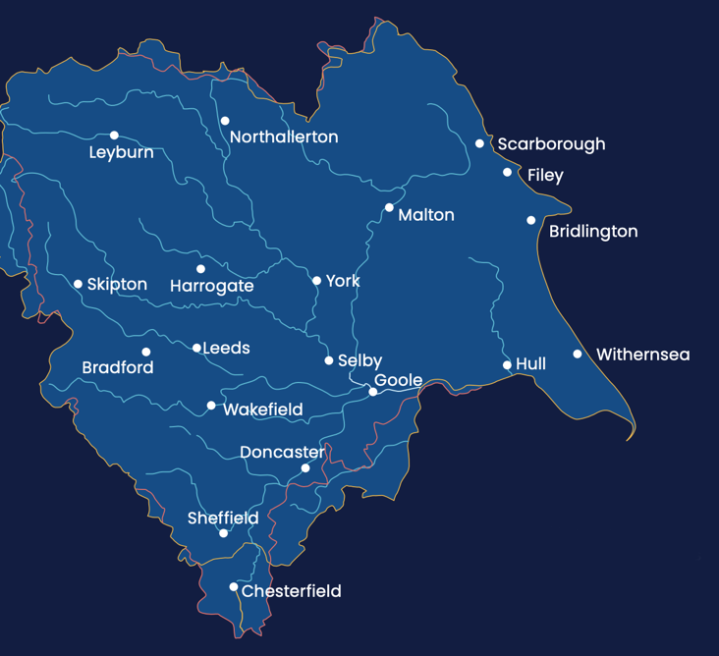
How did Yorkshire Water perform in most recent assessment?
Overall, Yorkshire Water’s performance in 2021/22 was scored as ‘Lagging behind’ for the sector by Ofwat.
Customer satisfaction
Priority services
Leakage
Per capita consumption
Supply interruption
Water quality
Mains repairs
Unplanned outage
Internal sewer flooding
Pollution incidents
Sewer collapses
Treatment works compliance
At or better than performance commitment
Lagging behind
Poorer than performance commitments

Slide 11
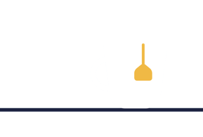
Ofwat have selected 6 areas of service as priority areas of service for customers, these are outlined here….
Water supply interruptions without warning, for longer than 3 hours
The appearance, taste and smell of tap water
Sewage flooding inside properties
Sewage flooding outside properties
Reducing leaks
Pollution of rivers & bathing waters
…..these 6 areas will be the focus of much of this research. The next few slides will cover how Yorkshire Water performance compares to other water companies for each of these 6 areas as well as their goals to improve performance in these areas from 2025-2030.
Please keep in mind what you pay covers many other things that Yorkshire Water deliver to customers such as protecting customers against droughts, carbon reduction schemes, improving biodiversity and providing support to customers in circumstances which might make them vulnerable. For 2020-2025 Yorkshire Water have 44 areas of service for which they have targets, you can read more about their performance across all areas of service on the website: https://www.yorkshirewater.com/about-us/our-performance

Slide 14
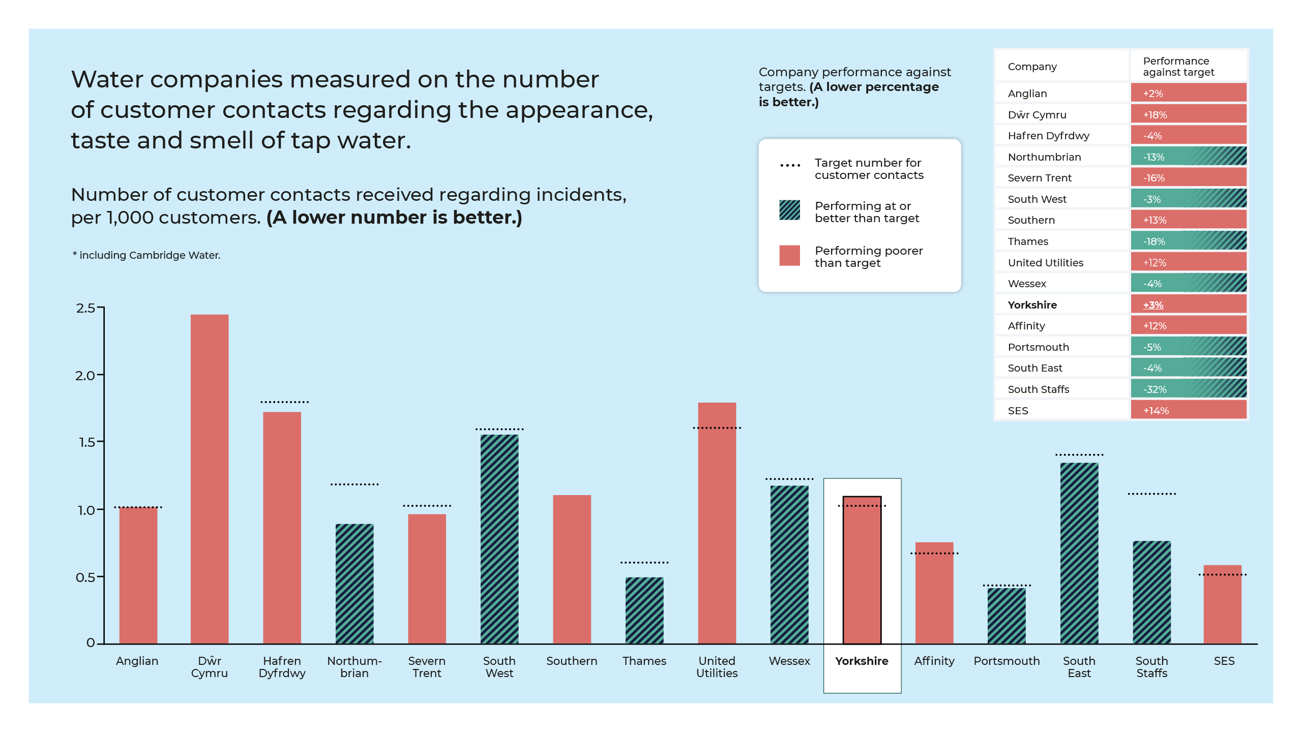
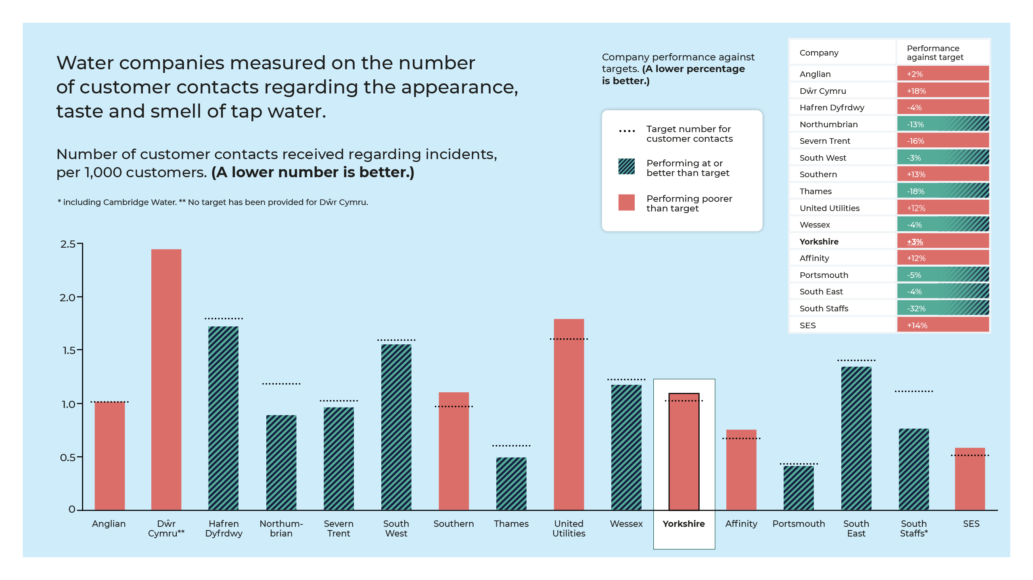

Slide 15
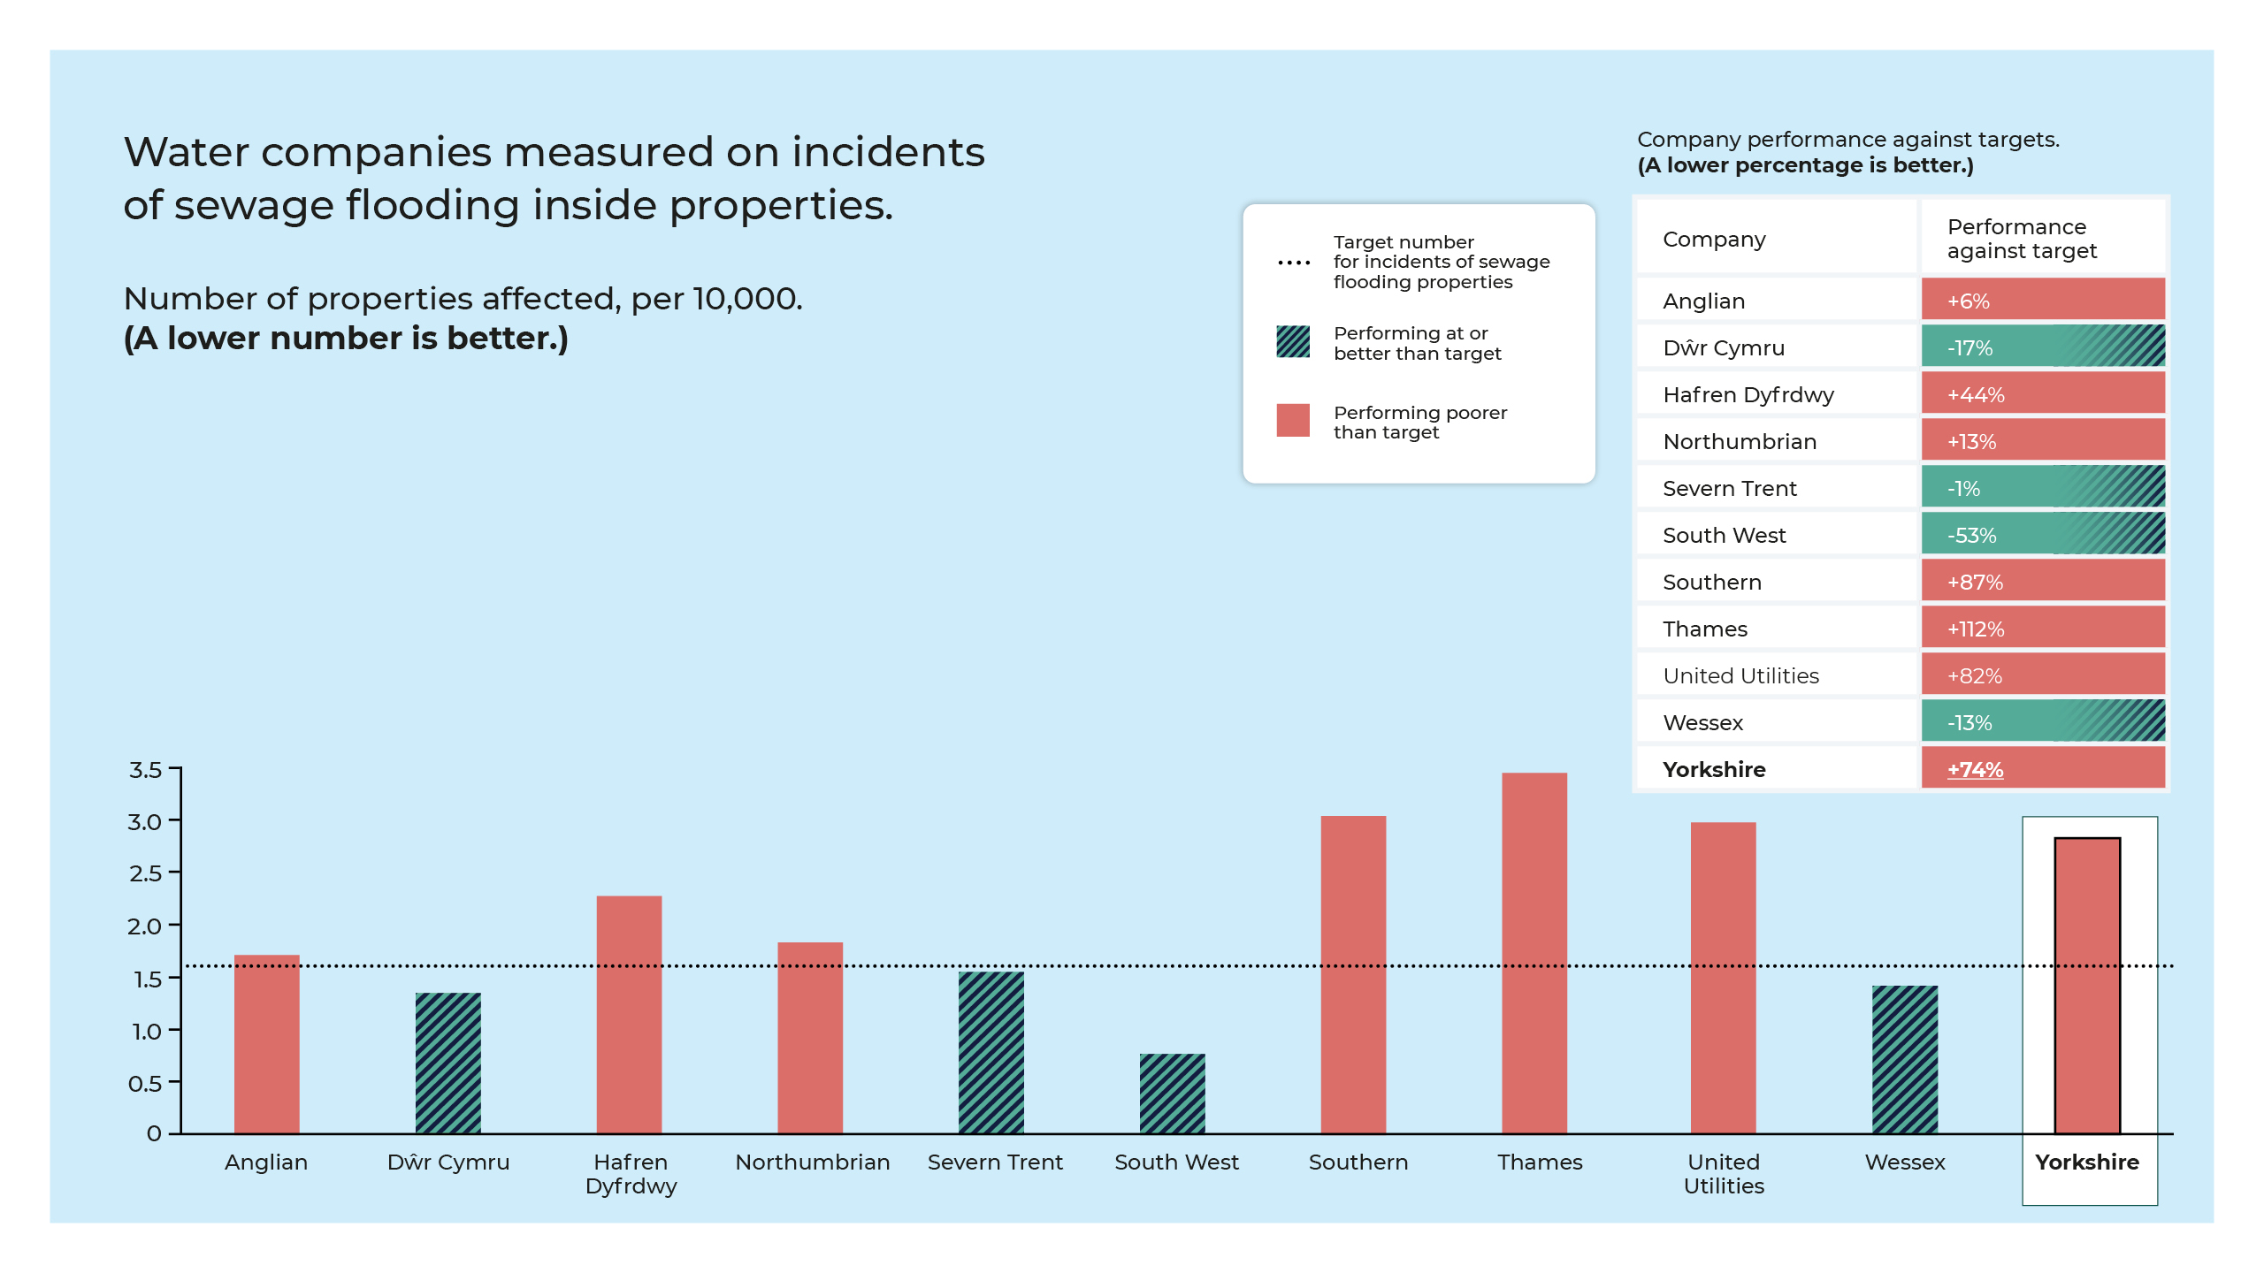

Slide 18
Priority service areas for PR24
Water supply interruptions without warning, for longer than 3 hours
The appearance, taste and smell of tap water
Sewage flooding inside properties
Sewage flooding outside properties
Reducing leaks
Pollution of rivers & bathing waters
Measure: average no. of mins that water supply is lost across all properties
Measure:
no. of contacts per 1,000 customers
Measure:
no. of incidents per 10,000 properties
Measure:
no. of incidents per 10,000 properties
Measure: no. of litres of water lost per property per day
Measure:
no. of incidents per 10,000 km of sewer
Current performance: 10 minutes 38 seconds
Current performance: 1.09
Current performance: 2.83
Current performance: 19.52
Current performance: 122.91
Current performance: 27.36

Slide 19
Water supply interruptions without warning, for longer than 3 hours
Current performance: 10 minutes 38 seconds
Missing current target of 6 minutes 8 seconds in 2021/22, largely due to: a failure at Graincliffe Water Treatment works (Graincliffe Water treatment works services 12,000 customers); a large number network failures (e.g. mains bursts) in the summer of 2021; the impact of Storm Arwen in November 2021.
Target agreed for 2025: 5 minutes
If a water supply is interrupted without warning for between 3 and 6 hours, it
would not be possible to run water from the taps or flush the toilet; it may be necessary to buy bottled water.
To achieve this target: we plan to increase asset health investment through actions such as mains replacement and monitoring, allowing us to strengthen areas of weakness in our networks and proactively condition the network to ensure proactive identification of risks before they happen.
2030 position: 1 minute 34 seconds
Measure: average no. of minutes that water supply is lost across all properties in Yorkshire
Industry ranking: 10th out of 17 companies

Slide 20
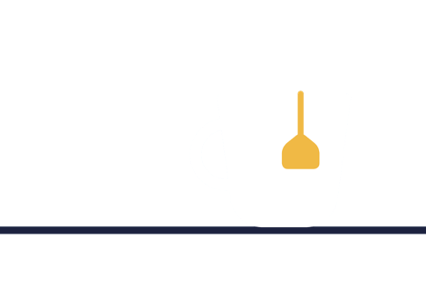
The appearance, taste and smell of tap water
Current performance: 1.09
Missing target (1.06) in 2021/22: the hot weather last summer caused a huge spike in demand. This lead to more contacts as our system was running to capacity. Despite this, we had a strong finish to the year. Whilst we haven’t hit our target, we improved on the previous years performance.
Target agreed for 2025: 0.81
Tap water may look discoloured or taste/smell different to usual. Although still safe to drink, people may prefer bottled water as a precaution until it returns to normal.
To achieve this target: we will work hard on our upland catchment management to ensure the raw water we collect and treat is high quality. This involves peatland restoration schemes as well as working very closely with farmers and other partners to reduce chemicals in the water we collect.
2030 position: 0.5
Measure: no. of customers contacting us per 1,000 customers we serve
Industry ranking: 9th out of 17 companies

Slide 21
Sewage flooding inside properties
Current performance: 2.83
Missing target (1.63) in 2021/22: OFWAT set very high targets in this area (only 4/11 companies are achieving their targets). Despite our best efforts, we are not on track to achieve our 2025 target of 1.34, our current forecasts predict we will only achieve 2.38, hence why the 2030 position is worse than the 2025 target. The 2030 position is more achievable but will still be challenging.
An escape of sewage inside properties is highly inconvenient, disruptive and a potential health risk. In bad cases, people need to move out of their properties while things are put right.
Target agreed for 2025: 1.34
To achieve this target: we will improve the hydraulic capacity in our wastewater system and sewers to reduce the risk of sewer flooding inside properties. We will proactively maintain the network through checking and clearing for blockages, do extra checks on areas prone to flooding and installing telemetry devices to provide an early warning of potential sewer flood risks before they happens. We will work to educate customers on what can and can’t be put down the drain/loo.
2030 position: 1.37
Measure: no. of incidents per 10,000 properties
Industry ranking: 8th out of 11 companies

Slide 22
Sewage flooding outside properties
An escape of sewage into gardens or outbuildings is inconvenient and unpleasant and can restrict access to properties.
Current performance: 19.52
Significantly outperforming current target.
Target agreed for 2025: 24.20
Measure: no. of incidents per 10,000 properties
2030 position: 10.32
Industry ranking: 7th out of 11 companies

Slide 23
Reducing leaks
Current performance: 122.91
Meeting target current target (123.55)
Leaks can affect customers directly if their water supply is affected. They are sometimes unnoticed if underground. But leakage is often seen in the media and has a cost to people on their bills and a cost to the environment.
Target agreed for 2025: 113.39
To achieve this target: we will fit more acoustic loggers to help us identify the leaks we struggle to find underground. We will undertake a mains renewal programme for older mains in need of investment, we will undertake trunk mains monitoring to identify problems early. Will invest in proactive network conditioning to help us manage water smarter and to help us understand where losses occur, allowing us to identify losses at a local level.
Measure: no. of litres of water lost per property per day
2030 position: 102.52
Industry ranking: 7th out of 17 companies

Slide 24
Pollution of rivers & bathing waters
Current performance: 27.36
Missing current target of 23.74: In 21/22 we reported 126 category 3 (minimal) incidents and six category 2 incidents (significant). Whilst we did not hit our target there were some significant regulatory changes that took place by the Environment Agency (EA) which had an impact on our reported performance.
Accidental sewage escapes from treatment works or networks can affect rivers and bathing waters.
This can have a minimal or major effect on the river or sea water ecology depending on the scale.
Target agreed for 2025: 19.5
To achieve this target: we will keep our wastewater inside our pipes through enhanced maintenance programmes of CCTV monitoring (cameras inside our pipes and on our network!), jet washing sewers, replacing old mains and investing in improving/upgrading old assets. We will work smarter by using our data to identify problem areas and reduce the risk before problems occur. Help our customers understand their role in reducing pollution.
2030 position: 13.6
Measure: no. of incidents per 10,000 km of sewer
Industry ranking: 7th out of 11 companies

Slide 25
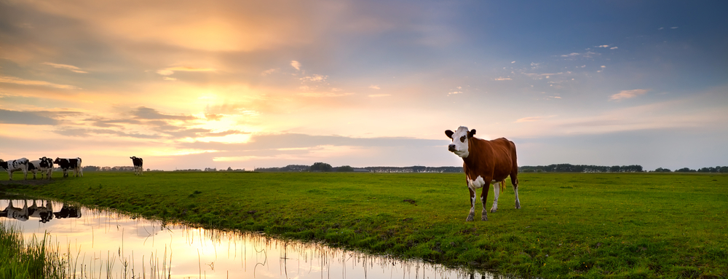
Enhanced investment area: The Water Industry National Environmental Programme (WINEP)
WINEP is a programme of actions that water companies will undertake to improve the environment.
The obligation includes multiple obligations including enhancing habitats and biodiversity, catchment restoration, working in partnership with landowners and farmers across the Yorkshire region to improve the raw water we collect and therefore improve the extent of treatment of the water we provide to customers.
What will we do?
These improvements will benefit 35 of 52 Water Treatment Works across the Yorkshire region, helping them to become more resilient, allowing Yorkshire Water to secure future water supplies.
Yorkshire Water has a target in its least cost ('must do') business plan to deliver WINEP requirements for 2025-2030, and this will cost £22 to the average household water bill.
*We have 2,221 overflows and on average they spill 26 times in a year.

Slide 26
Enhanced investment area: Water Resource Management Plan (WRMP)
Every 5 years, water companies produce a Water Resource Management Plan (WRMP). This plan ensures that future public water supplies are secure and resilient in the face of challenges such population growth, climate change, and the need to protect our water environment.
What will we do?
We have a target to cut current leakage by 11% and reducing the water used by homes and businesses by 5%*
Yorkshire Water has a target in its least cost ('must do') business plan to deliver the above WRMP goals for 2025-2030, and this will cost £6 to the average household water bill.
We aim to increase the water we have available to supply to our customers through investment in acquiring and onboarding three new ground water sources and either extending or building 2 water treatment works.
*This will be achieved through education, promoting meter take-up, smart metering and water use audits for business customers .

Slide 27
Enhanced investment area: storm overflows
At times of heavy or continued rainfall, the sewer system can't always cope with the extra volume. Storm overflows are used to prevent sewers from flooding our homes, gardens and streets with sewage. They act as a safety valve, diverting some of the rainwater and wastewater directly into rivers and the sea.
What will we do?
Defra’s Environment Act improvement planning requirements means 211 storm overflows will be improved between 2025-2030 to spill no more than ten times on average per year to rivers and the sea.
Yorkshire Water has a target in its least cost ('must do') business plan to deliver 211 improved storm overflows* for 2025-2030, and this will cost £29 to the average household water bill.
*We have 2,221 overflows and on average they spill 26 times in a year.
Notes:
We have £180m already invested in this 5 years 2020-2025 to progress this improvement. 45% of this is funded by customers and 55% is funded by the company (again, profits, pay for these improvements).

Slide 28
Proposed least cost plan: annual bill impact for households
Inflation*
Proposed plan
Annual bill
Average household bill, £/property.
Bills already agreed to 2025
2025-2030 Bills to cover improvements in service… namely WINEP, WRMP and Storm Overflows
Totals:
£416
£447
£475
£565
£568
£579
£591
£603
*Inflation presented is based on current projections and is likely to change

Slide 29
About inflation:.
Water bills change each in year in line with inflation. Inflation is the increase in prices paid for goods and services over time. Household incomes also change over time.
If your household income keeps up with inflation (increases at the same rate), then you are likely to notice little difference in what you are paying for things.
If inflation increases by a faster rate than your household income, then you are likely to have less money to go around.
If your household income increases by a faster rate than inflation, then you are likely to have more money to go around.
The Bank of England aims to keep inflation at 2%, but it has recently been much higher than this.
As well as changing by inflation each year, bills change by an amount set by Ofwat as part of their price review process every five years.
Like the rising cost of living challenges our customers face, inflation has had a major impact on operating costs at Yorkshire Water, soaring energy and chemical costs have impacted Yorkshire Water too. Yorkshire Water have no control over the cost or rate of inflation, this can go up and down.

Slide 30
Helping customers who are struggling to pay their bills
Yorkshire Water are proposing to support around 150,000 households per year with financial support tariffs and schemes.
The schemes include:
Social tariff, WaterSupport, is funded by Yorkshire Water and customer cross-subsidy. Yorkshire Water are one of the few companies that contributes and are proposing to continue the £2m per year investment. Latest research conducted by Yorkshire Water with customers confirms customers are willing to contribute
up to £6 from their annual bill for this.
WaterSure (which is a national tariff) The WaterSure tariff helps if you're on a lower income and if use more water than the average household. It works by capping your yearly bill regardless of the amount of water you use.
Metering: this is one of the best options for customers but requires more engagement and cost to buy and fit meters which requires investment from Yorkshire Water.
Debt schemes: funded by Yorkshire Water (essentially write-offs of debt).

Slide 31
Optional investment choices
Yorkshire Water would like to go over and above just meeting the statutory requirements as outlined in its ‘least cost’ plan. To do this, they need customer support. There are 3 areas where Yorkshire Water would like to go over and above requirements:
Further improving our water supply resilience
YW have a number of zones where customers are at increased risk of experiencing a water supply interruption due to only having a single water treatment works delivering their water.
This investment would enable YW to secure alternative supplies of water for 135,000 customers, reducing their risk of interruptions.
Further increasing resilience to flooding
This investment will allow continued innovative work to improve surface water flooding protection in the most impacted part of our region - Hull and East Riding.
This work will create a new approach to surface water management for the whole of Yorkshire which relies upon more natural/environmentally friendly infrastructure to improve flood resilience as opposed to carbon intensive traditional approaches.
Further reducing the use of storm overflows to our seas
Defra’s Storm Overflow Reduction Plan has a target for designated coastal bathing waters (these are beaches monitored and assessed for water quality) - it sets out that by 2035 no coastal storm overflow should spill sewage more than 2 times in a bathing season.
This investment will allow us to reduce storm sewage spills to no more than 2 sewage spills from 29 of our coastal storm overflows by 2030, ahead of the 2035 target.
Investment needed to deliver this additional improvement: £126m
Customer bill impact: £1.30 per year
Customer bill impact with inflation: £1.47 per year
Investment needed to deliver this additional improvement: £59m
Customer bill impact: £0.61p per year
Customer bill impact with inflation: £0.69p per year
Investment needed to deliver this additional improvement: £300m
Customer bill impact: £3.32 per year
Customer bill impact with inflation: £3.74 per year
Total Investment required for all 3 optional areas: £5.23 per year
Total Investment required for all 3 optional areas including inflation: £5.90 per year

Slide 32
Phasing options over time:
Option 1
Option 2
Option 3
Potential
options
Investment is spread overtime from 2030 to 2050, gradually improving levels of service during this period.
Investment is sooner and therefore improvements are made sooner and rapidly.
Investment is delayed so that service improvements happen later.
Impact
on bills
Bills will increase gradually from 2030 until 2050.
Bills increase sooner, increasingly steeply at first and then levelling out over time.
Bills increases happen much later with a steeper increase later on.

Slide 33
Glossary of terms:
Unplanned outage: An incident where water to supply to properties is unexpectedly not available and where customers had not received prior notification.
Internal sewer flooding: Where a sewer overflows and spills inside a property. This can happen due to a blockage, a sewer collapse or not enough capacity in the sewer during heavy rainfall.
External sewer flooding: Where a sewer spills its contents outside of properties in to gardens or outbuilding due to a blockage, a sewer collapse or not enough capacity in the sewer during heavy rainfall.
Treatment works compliance: Whether a wastewater treatment works is complying with its requirements e.g. the treated wastewater (effluent) is meeting its standards before being put back into the environment (rivers or the sea).
Per capita consumption: This is number of litres of water used per person per day. Lower per capita consumption (PCC) means less water is taken from the environment and fewer resources are required to extract, treat and distribute it.
Priority services: A range of services and accessibility options offered to customers who may need extra support, perhaps because of circumstances that might make them more vulnerable in a supply disruption incident or because of accessibility or communication needs.
Supply interruption: An incident when properties are without a continuous supply of water.

