Slide 1
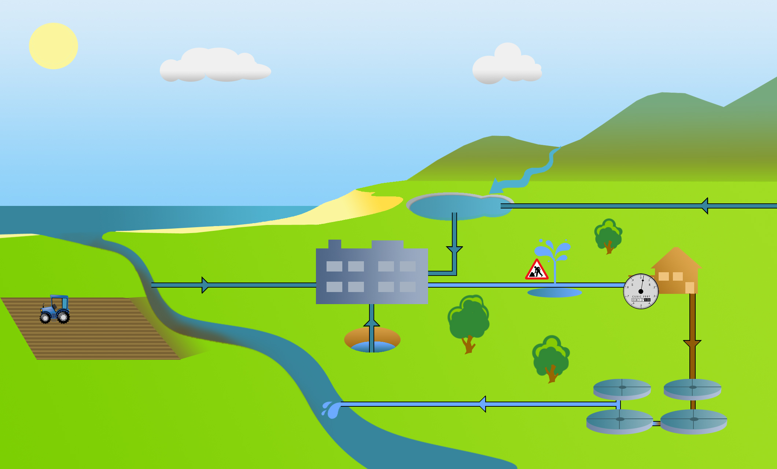
Showcard 2
Water Resource Management
Increase leakage detection
Transfer water from other regions
Increase metering
Managing land and water catchments
Take water from under ground sources
Take water from rivers, lakes and reservoirs
Increase water efficiency measures
Re-Use

Slide 2
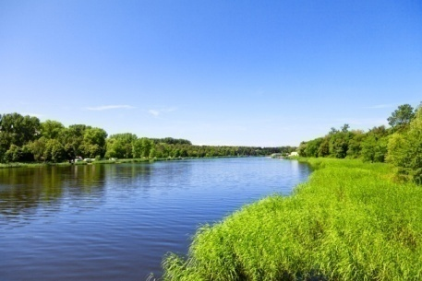
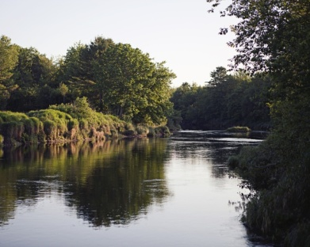
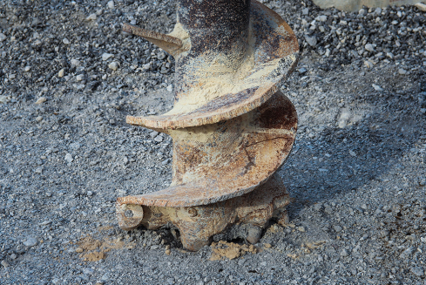
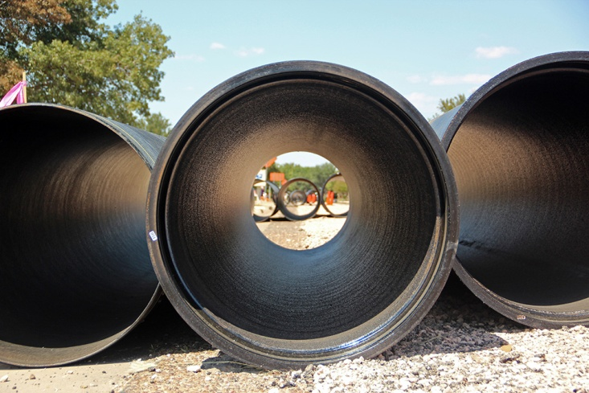
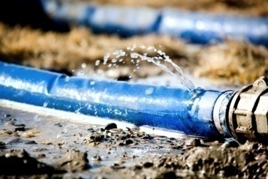
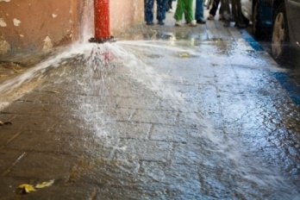
Showcard 2
Take water from rivers, lakes and reservoirs
Take water from the ground
(i.e., the water table)
This is a major source of water supplies.
Taking more water from the rivers, lakes and reservoirs results in lower water levels in these, which in turn can impact on wildlife and plant habitats
This supplements surface water supplies in our region.
This involves drilling holes to take water from the ground where water is stored. Taking more water from the ground over time can deplete stocks.
Increasing leakage detection and fixing leaks
Transfer water to or from another region (or water company)
Replacing old pipes can prevent leakage into the environment. This means less water needs to be taken from the environment.
This involves spending time finding leaks and potentially digging up roads to fix them.
Underground water pipes are built to take water from an area with lots of water to areas where water is needed.

Slide 3
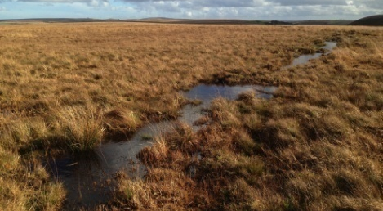
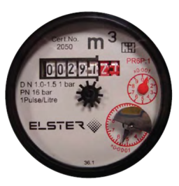
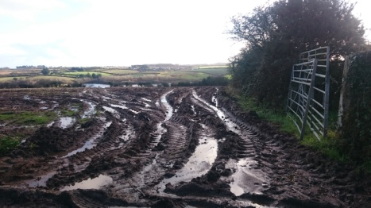
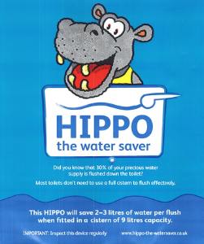
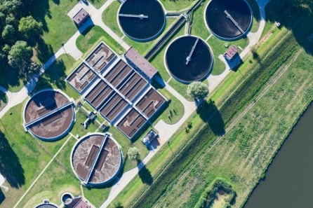
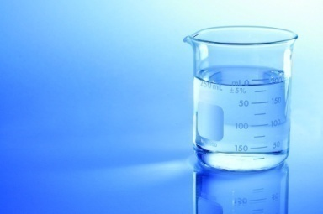
Showcard 2
Catchment management
Increased metering
This involves working with other organisations to prevent pollutants entering rivers, lakes and other watercourses. The water can then be used for drinking water supplies.
For example working with farmers to prevent pesticides and slurry entering watercourses, or preventing peat run off from moorlands into rivers. This helps to protect water sources.
Metering involves charging people for the water they use. This can be seen as more fair and encourages water saving, but it can have a significant financial impact on large families with low incomes.
Smart meters automatically provide customers with information on their water use
Re-Use
Increase water efficiency measures
Re-use involves using pumping treated wastewater from sewage treatment works to the river close to a water treatment works, to be used as part of the water taken from the river.
Drinking water produced using this way will meet all of the legal requirements for water quality and be safe to drink.
This involves helping homes and businesses to use less water.
Measures includes water butts, Hippo bags, low flow shower heads, dual flush toilets, education leaflets on saving water tips, water saving audits, and online water efficiency calculators.

